Slide 2
Happiness

Slide 3
The Virtues

Slide 4
The Virtues
Whatever is true, whatever is honorable, whatever is just, whatever is pure, whatever is lovely, whatever is gracious, if there is any excellence, if there is anything worthy of praise, think about these things (Phil 4:8).

Slide 5
Virtue in General
“Virtue is a good habit of mind, by which we live righteously, of which no one can make bad use, which God works in us, without us.” – St. Augustine of Hippo

Slide 6
Virtue is a good habit of mind, by which we live righteously, of which no one can make bad use, which God works in us, without us.
By habit we mean a disposition in the soul whereby someone is disposed, well or ill - “for when the mode of the subject is suitable to the thing’s nature, it has the aspect of good; and when it is unsuitable, it has the aspect of evil” Ia-IIae 55.4
Virtue is not just any habit, but a good habit

Slide 7
Virtue is a good habit of mind, by which we live righteously, of which no one can make bad use, which God works in us, without us.
of the mind from the Latin: mens which has a fuller meaning of the whole person, or the soul; so virtue resides in the soul

Slide 8
Virtue is a good habit of mind, by which we live righteously, of which no one can make bad use, which God works in us, without us.
some habits are always referred to evil - this is vice - some are sometimes referred to evil and sometimes good - that’s why in the definition is specified by which we live righteously and of which no one makes bad use

Slide 9
Virtue is a good habit of mind, by which we live righteously, of which no one can make bad use, which God works in us, without us.
which God works in us without us is applied specifically to infused virtues since God is the cause of infused virtues, but if you leave this last phrase out, this definition applies to all virtues in general, whether acquired or infused

Slide 10
Virtue is a good habit of mind, by which we live righteously, of which no one can make bad use, which God works in us, without us.
“Infused virtue is caused in us by God without any action on our part, but not without our consent. This is the sense of the words, which God works in us without us. As to those things which are done by us, God causes them in us, yet not without action on our part, for He works in every will and in every nature.” Ia-IIae 55.4 ad 6

Slide 11
“Infused virtue is caused in us by God without any action on our part, but not without our consent. This is the sense of the words, which God works in us without us. As to those things which are done by us, God causes them in us, yet not without action on our part, for He works in every will and in every nature.”
This is the difference between cooperative grace and infused grace. Cooperative grace is when we act and God helps us along the way. Infused Grace is something God does in us without any action or even anticipation on our part.

Slide 12
Virtue is a good habit of mind, by which we live righteously, of which no one can make bad use, which God works in us, without us.
Virtue is for good living - human flourishing / happiness - using the faculties God has given us to their fullest capacity for their best use - this is living in virtue. Living in virtue is also called sanctity because Sanctity is to live well as a human being as God created us to live - living to the fullness of who we were made to be - this is the holy life to which God calls us: St. Irenaeus: “The Glory of God is man fully alive.”

Slide 13
We are imperfect creatures, which means that everything we do is imperfect. Therefore, if we are to have perfect virtue, we need something to perfect our actions and this is grace. Grace comes in and perfects the action of virtue so that virtue is perfect.

Slide 14
The end (goal) of virtue is operation

Slide 15
A virtue is a habitual and firm disposition to do the good. It allows the person not only to perform good acts, but to give the best of himself. The virtuous person tends toward the good with all his sensory and spiritual powers; he pursues the good and chooses it in concrete actions. The goal of a virtuous life is to become like God.
CCC, n. 1803

Slide 16
Virtues in Particular
All virtues have an object which specifies what they are. The object of the Theological Virtues is God - they come from Him and are directed toward God.
The object of the Cardinal Virtues can be directed toward God, others, or in respect of myself.

Slide 17
Theological Virtues
The Theological virtues give us direct access to God
Infused in us in our Baptism

Slide 18
The Theological Virtues
The human virtues are rooted in the theological virtues, which adapt man’s faculties for participation in the divine nature: for the theological virtues relate directly to God. They dispose Christians to live in a relationship with the Holy Trinity. They have the One and Triune God for their origin, motive, and object.
CCC, n. 1812

Slide 19
The Theological Virtues
The theological virtues are the foundation of Christian moral activity; they animate it and give it its special character. They inform and give life to all the moral virtues. They are infused by God into the souls of the faithful to make them capable of acting as his children and of meriting eternal life. They are the presence and action of the Holy Spirit in the faculties of the human being.
CCC, n. 1813

Slide 20
The Theological Virtues
Faith is the theological virtue by which we know God.
Faith is a Choice

Slide 21
The Theological Virtues
Faith is the theological virtue by which we believe in God and believe all that he has said and revealed to us, and that Holy Church proposes for our belief, because he is truth itself. By faith man freely commits his entire self to God. For this reason the believer seeks to know and do God’s will.
CCC, n. 1814

Slide 22
The Theological Virtues
The gift of faith remains in one who has not sinned against it. But “faith apart from works is dead”(Jas 2:26); when it is deprived of hope and love, faith does not fully unite the believer to Christ and does not make him a living member of his Body.
CCC, n. 1815

Slide 23
The Theological Virtues
The disciple of Christ must not only keep the faith and live on it, but also profess it, confidently bear witness to it, and spread it. Service of and witness to the faith are necessary for salvation.
CCC, n. 1816

Slide 25
The Theological Virtues
Hope is the theological virtue by which we desire the kingdom of heaven and eternal life as our happiness, placing our trust in Christ’s promises and relying not on our own strength, but on the help of the grace of the Holy Spirit.
CCC, n. 1817

Slide 26
The Theological Virtues
The virtue of hope responds to the aspiration to happiness which God has placed in the heart of every man; it takes up the hopes that inspire men’s activities and purifies them so as to order them to the Kingdom of heaven; it keeps man from discouragement; it sustains him during times of abandonment; it opens up his heart in expectation of eternal beatitude.
CCC, n. 1818

Slide 27
The Theological Virtues
Buoyed up by hope, man is preserved from selfishness and led to the happiness that flows from charity.
CCC, n. 1818

Slide 28
The Theological Virtues
We can therefore hope in the glory of heaven promised by God to those who love him and do his will. In every circumstance, each one of us should hope, with the grace of God, to persevere “to the end” and to obtain the joy of heaven, as God’s eternal reward for the good works accomplished with the grace of Christ.
CCC, n. 1821

Slide 29
The Theological Virtues
In hope, the Church prays for “all men to be saved.” She longs to be united with Christ, her Bridegroom, in the glory of heaven.
CCC, n. 1821

Slide 30
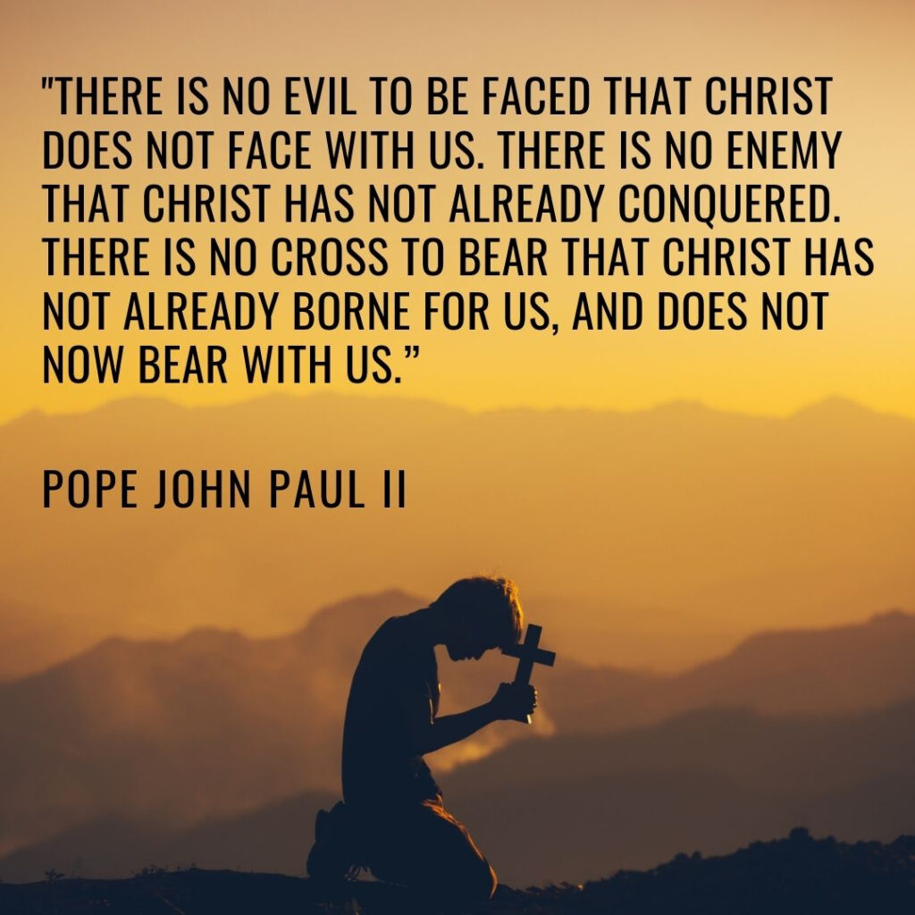
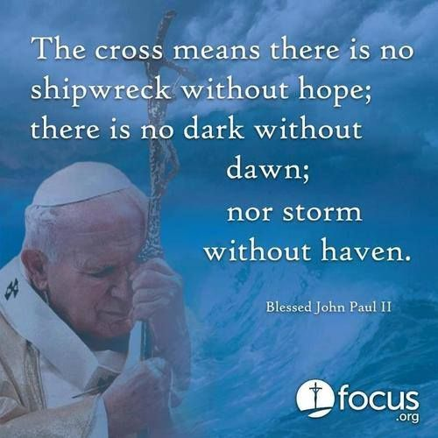

Slide 31
The Theological Virtues
To Love is to will what is good for the other
Charity is the friendship of man for God

Slide 32
The Theological Virtues
Charity is the theological virtue by which we love God above all things for his own sake, and our neighbor as ourselves for the love of God.
CCC, n. 1822

Slide 33
The Theological Virtues
Jesus makes charity the new commandment. By loving his own “to the end,” he makes manifest the Father’s love which he receives. By loving one another, the disciples imitate the love of Jesus which they themselves receive.
CCC, n. 1823

Slide 34
The Theological Virtues
Christ died out of love for us, while we were still “enemies.” The Lord asks us to love as he does, even our enemies, to make ourselves the neighbor of those farthest away, and to love children and the poor as Christ himself.
CCC, n. 1825

Slide 35
The Theological Virtues
The practice of all the virtues is animated and inspired by charity, which “binds everything together in perfect harmony”; it is the form of the virtues; it articulates and orders them among themselves; it is the source and the goal of their Christian practice.
CCC, n. 1827

Slide 36
The Theological Virtues
Charity upholds and purifies our human ability to love, and raises it to the supernatural perfection of divine love. CCC, n. 1827
Charity is God’s Love within us

Slide 37
The Theological Virtues
The practice of the moral life animated by charity gives to the Christian the spiritual freedom of the children of God. He no longer stands before God as a slave, in servile fear, or as a mercenary looking for wages, but as a son responding to the love of him who “first loved us.”
CCC, n. 1828

Slide 38
https://youtu.be/mm5joP0zlqc

Slide 39
Human Virtue
Human virtues are firm attitudes, stable dispositions, habitual perfections of intellect and will that govern our actions, order our passions, and guide our conduct according to reason and faith. They make possible ease, self-mastery, and joy in leading a morally good life. The virtuous man is he who freely practices the good.
CCC, n. 1804

Slide 40
Human Virtue
The moral virtues are acquired by human effort. They are the fruit and seed of morally good acts; they dispose all the powers of the human being for communion with divine love.
CCC, n. 1804

Slide 41
The Cardinal Virtues
Four virtues play a pivotal role and accordingly are called “cardinal”; all the others are grouped around them. They are: prudence, justice, fortitude, and temperance. “If anyone loves righteousness, Wisdom’s labors are virtues; for she teaches temperance and prudence, justice, and courage” (Wis 8:7).
CCC, n. 1805

Slide 42
The Cardinal Virtues
Prudence is the virtue that disposes practical reason to discern our true good in every circumstance and to choose the right means of achieving it. It is called auriga virtutum (the charioteer of the virtues); it guides the other virtues by setting rule and measure.
CCC, n. 1806

Slide 43
The Cardinal Virtues
It is prudence that immediately guides the judgment of conscience. The prudent man determines and directs his conduct in accordance with this judgment. With the help of this virtue we apply moral principles to particular cases without error and overcome doubts about the good to achieve and the evil to avoid.
CCC, n. 1806

Slide 44
The Cardinal Virtues
Justice is the moral virtue that consists in the constant and firm will to give their due to God and neighbor. Justice toward God is called the “virtue of religion.” Justice toward men disposes one to respect the rights of each and to establish the harmony that promotes the common good.
CCC, n. 1807

Slide 45
The Cardinal Virtues
The just man, often mentioned in the Sacred Scriptures, is distinguished by habitual right thinking and the uprightness of his conduct toward his neighbor.
CCC, n. 1807

Slide 46
The Cardinal Virtues
Fortitude is the moral virtue that ensures firmness in difficulties and constancy in the pursuit of the good. It strengthens the resolve to resist temptations and to overcome obstacles in the moral life. It enables one to conquer fear, even fear of death, and to face trials and persecutions. It disposes one even to renounce and sacrifice his life in defense of a just cause.
CCC, n. 1808

Slide 47
The Cardinal Virtues
Temperance is the moral virtue that moderates the attraction of pleasures and provides balance in the use of created goods. It ensures the will’s mastery over instincts and keeps desires within the limits of what is honorable. The temperate person directs the sensitive appetites toward what is good and maintains a healthy discretion.
CCC, n. 1809

Slide 48
The Cardinal Virtues
“To live well is nothing other than to love God with all one’s heart, with all one’s soul and with all one’s efforts; from this it comes about that love is kept whole and uncorrupted through temperance. No misfortune can disturb it—and this is fortitude. It obeys only God—and this is justice—and is careful in discerning things, so as not to be surprised by deceit or trickery—and this is prudence” (Augustine).
CCC, n. 1809

Slide 49
The Cardinal Virtues
Human virtues acquired by education, by deliberate acts and by a perseverance ever-renewed in repeated efforts are purified and elevated by divine grace. With God’s help, they forge character and give facility in the practice of the good. The virtuous man is happy to practice them.
CCC, n. 1810

Slide 50
The Cardinal Virtues
It is not easy for man, wounded by sin, to maintain moral balance. Christ’s gift of salvation offers us the grace necessary to persevere in the pursuit of the virtues. Everyone should always ask for this grace of light and strength, frequent the sacraments, cooperate with the Holy Spirit, and follow his calls to love what is good and shun evil.
CCC, n. 1811

