Slide 1
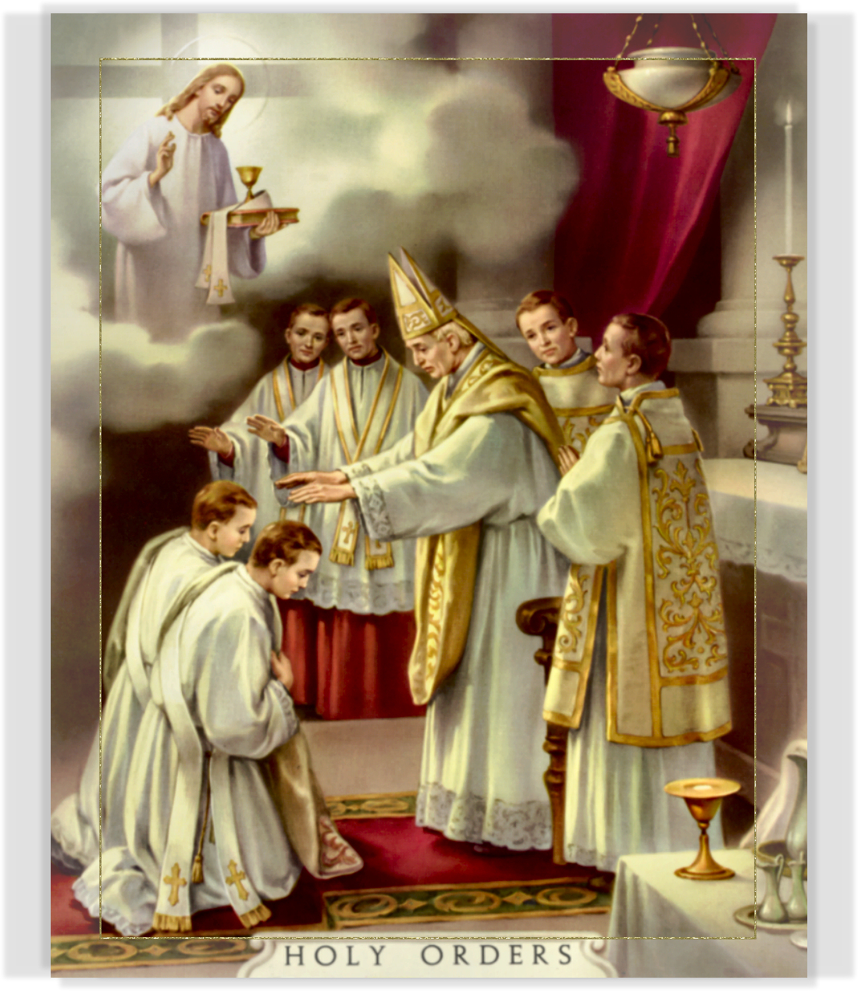
The Sacrament of Holy Orders
Sacrament at the Service of Communion

Slide 2
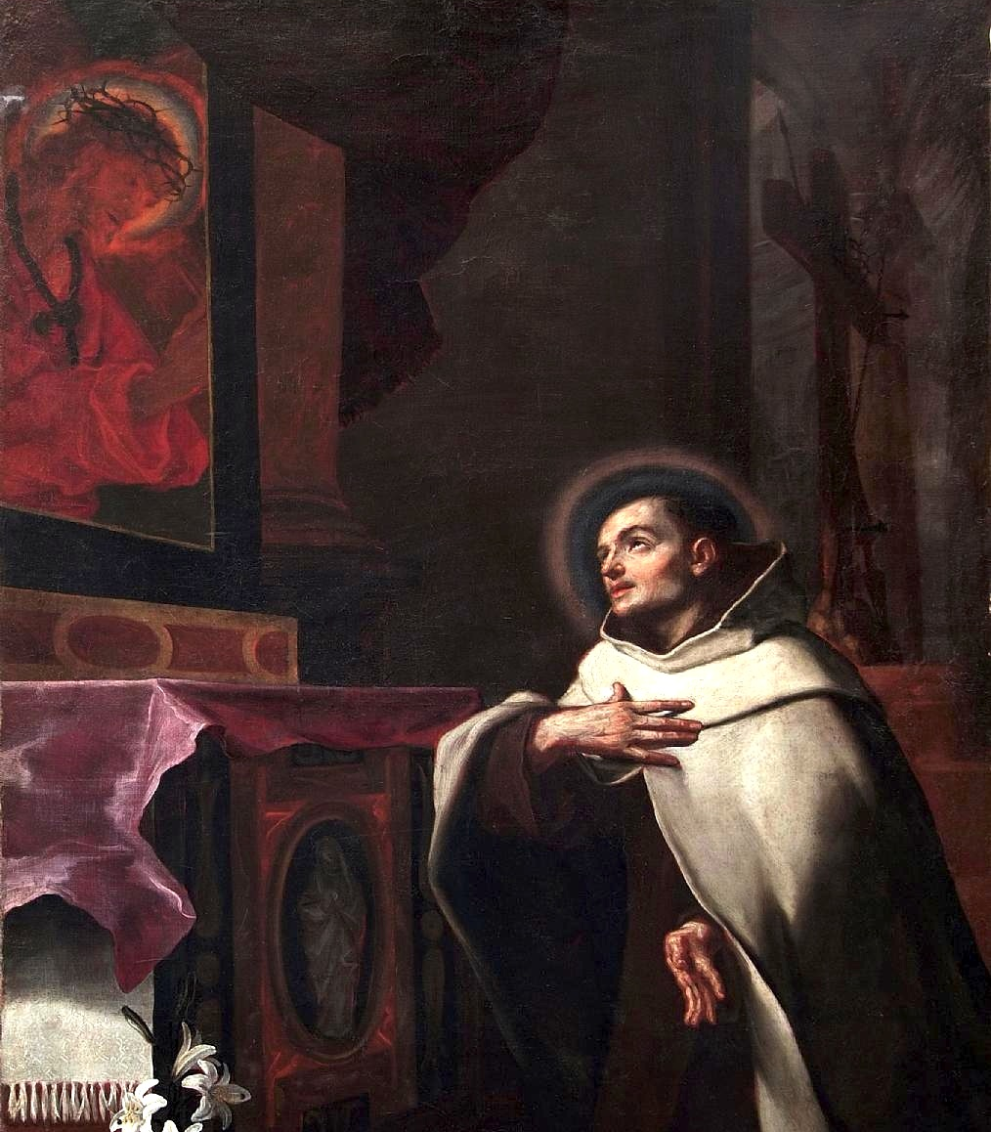
The Discernment Journey “To get to where you are not, you have to pass through where you are not. To reach the place of possessing all, desire to possess nothing. To reach the place of being all, desire to be nothing.” -- St. John of the Cross

Slide 3
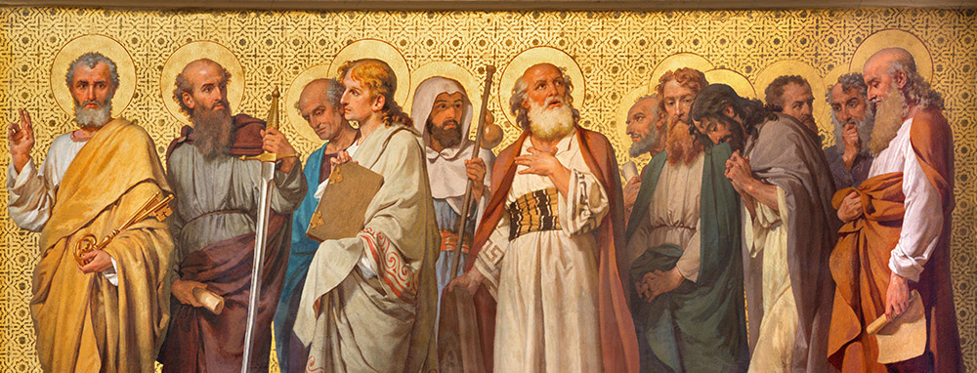
Apostolic Ministry
The Sacrament of Holy Orders (CCC 1533 -1600)
Article 6: Holy orders is the sacrament through which the mission entrusted by Christ to his apostles continues to be exercised in the Church until the end of time: thus it is the sacrament of apostolic ministry.
Three Degrees: Episcopate, Presbyterate, Diaconate

Slide 4
Holy Orders Three Degrees
Bishop: …receives the fullness of the sacrament of Holy Orders, which integrates him into the episcopal college and makes him the visible head of the particular Church entrusted to him. As successors of the apostles and members of the college, the bishops share in the apostolic responsibility and mission of the whole Church under the authority of the Pope, successor of St. Peter. (CCC 1594)
Priest: …united with the bishops in sacerdotal dignity and at he same time depend on them in the exercise of their pastoral functions; they are called to be the bishop’s prudent co-workers. They form around their bishop the presbyterium which bears responsibility with him for the particular Church. They receive from the bishop the charge of a parish community or a determined ecclesial office. (CCC 1595)
Deacon: …ministers ordained for tasks of service of the Church; they do not receive the ministerial priesthood, but ordination confers on them important functions in the ministry of the word, divine worship, pastoral governance, and the service of charity, tasks which they must carry out under the pastoral authority of their bishop. (CCC 1596)

Slide 5
Holy Orders Sacrament of Service?
Holy Orders, like the Sacrament of Matrimony, not directed at the called person’s salvation, but salvation of others
“If they do contribute to personal salvation, it is through service to others that they do so.” (CCC 1534)
Also: when exercised faithfully, contributes to persons growth in holiness and sanctification
Sacraments of discipleship (Holy Orders & Matrimony)

Slide 6
Holy Orders Integration into an Order
Integration into one of these bodies in the Church was accomplished by a rite called ordinatio, a religious and liturgical act which was a consecration, a blessing or a sacrament. Today the word “ordination” is reserved for the sacramental act which integrates a man into the order of bishops, presbyters, or deacons, and goes beyond a simple election, designation, delegation or institution by the community for it confers a gift of the Holy Spirit that permits the exercise of a “sacred power” which can only come from Christ Himself through His Church (CCC1538).
Ordination is also called consecration (from Latin consecratio), for it is a setting apart and an investiture by Christ Himself for His Church. (CCC 1538)
A call received from God, not something I just chose…experienced a call I believe God wants me to say yes to for the service of others

Slide 7
Holy Orders Who Can Receive The Sacrament
Only a baptized man validly receives sacred ordination. The Lord Jesus chose men to form the college of the twelve apostles, and the apostles did the same when they chose collaborators to succeed them in their ministry. The college of bishops with whom the priests are united in the priesthood, makes the college of the twelve an ever-present and ever-active reality until Christ’s return. The Church recognize herself to be bound by this choice made by the lord himself. For this reason, the ordination of women is not possible. (CCC 1577)
No one has a right to receive the sacrament of Holy Orders. Indeed no one claims this office for himself; he is called to it by God. Anyone who thinks he recognizes the signs of God’s call to the ordained ministry must humbly submit his desire to the authority of the Church, who has the responsibility and right to call someone to receive orders. Like every grace this sacrament can be received only as an unmerited gift. (CCC 1578)

Slide 8
Holy Orders Integration into an Order
With the laying on of hands by the bishop during the rite, there has been an extension of the very power of Jesus Christ that He extended over the apostles in giving them His gifts of reconciliation, authority, teaching, etc – which speaks to the apostolic nature of the Church
Passing on from the very time of Christ, this sacred power, where the individual bishop, priest, or deacon can do in Christ what they could never do without Him
Bishop Baron: Priest acting in Persona Christi saying the words of consecration … Citizen’s arrest vs duly appointed officer of the law “You’re under arrest”…
Must recognize Jesus Christ has given this gift and power (sacra potestas) through the Church to Bishops, Priests and Deacons via the laying on of hands and consecratory prayer by the Bishop

Slide 9
Holy Orders Ministerial and Baptismal Priesthood
The ministerial or hierarchical priesthood of bishops and priests, and the common (baptismal) priesthood of the faithful participate “each in its own proper way, in the one priesthood of Christ.” While being “ordered one to another,” they differ essentially.
In what sense? While the common priesthood of the faithful is exercised by the unfolding of baptismal grace—a life of faith, hope, and charity, a life according to the Spirit--, the ministerial priesthood is at the service of the common priesthood. It is directed at the unfolding of the baptismal grace of all Christians. The ministerial priesthood is a means by which Christ unceasingly builds up and leads his Church. For this reason it is transmitted by its own sacrament….Holy Orders. (CCC 1547)

Slide 10
Holy Orders Old Covenant Roots
The chosen people was constituted by God as “a kingdom of priests and a holy nation.” But within the people of Israel, God chose one of the twelve tribes, that of Levi, and set it apart for liturgical service…A special rite consecrated the beginnings of the priesthood of the Old Covenant. The priests are “appointed to act on behalf of men in relation to God, to offer gifts and sacrifices” (CCC 1539)
…priesthood nevertheless remains powerless to bring about salvation, needing to repeat its sacrifices ceaselessly and being unable to achieve a definitive sanctification…only the sacrifice of Christ would accomplish (CCC 1541)
The liturgy of the Church, however, sees in the priesthood of Aaron and the service of the Levites, as in the institution of the seventy elders, a prefiguring of the ordained ministry of the New Covenant. (CCC 1541)

Slide 11
Holy Orders Degrees and Nature
Degrees of the Sacrament: “…Catholic doctrine expressed in the liturgy, the Magisterium, and the constant practice of the Church recognizes that there are two degrees of ministerial participation in the priesthood of Christ: the episcopacy and the presbyterate. The diaconate is intended to help and serve them. (CCC1554)
This sacrament (Holy Orders) configures the recipient to Christ by a special grace of the Holy Spirit, so that he may serve as Christ’s instrument for his Church. By ordination one is enabled to act as a representative of Christ, Head of the Church, in his triple office of priest, prophet, and king (CCC 1581)
Indelible Character: As in the case of Baptism and Confirmation this share in Christ’s office is granted once for all. The sacrament of Holy Orders, like the other two, confers an indelible spiritual character and cannot be repeated or conferred temporarily (CCC 1582)

Slide 12
Holy Orders All Participate in the Priesthood of Christ
The whole Church is a priestly people. Through Baptism all the faithful share in the priesthood of Christ. This participation is called the “common priesthood of the faithful.” Based on this common priesthood and ordered to its service, there exists another participation in the mission of Christ: the ministry conferred by the sacrament of Holy Orders, where the task is to serve in the name and in the person of Christ the Head in the midst of the community.
Important: People tend to look exclusively to clergy and religious as candidates for sainthood and holy examples. Not so. All the faithful are called to holiness and become saints by reason of our Baptism and Confirmation.

Slide 13
DISCUSSION

