Slide 1
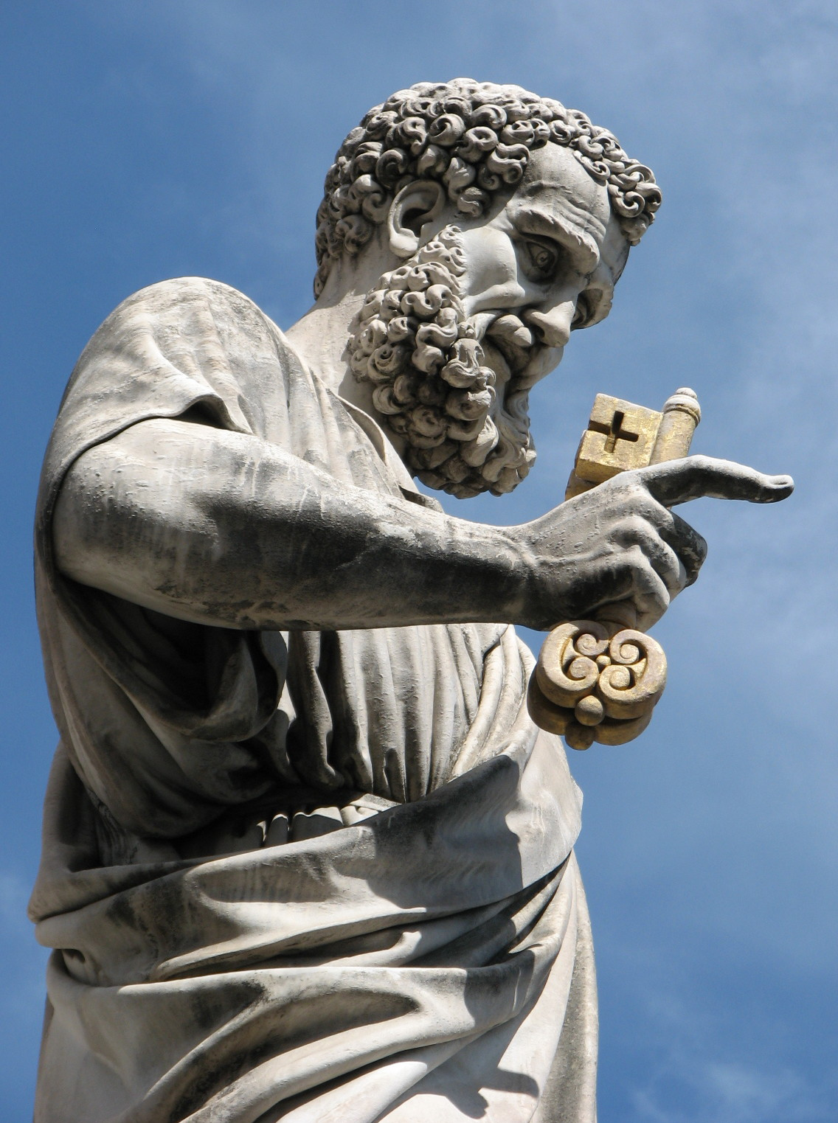
The Creeds
St Peter Catholic Church
RCIA
February 29, 2024
Notes:
http://www.JustCatholic.com

Slide 2
Opening Prayer
Spirit of wisdom and understanding, enlighten our minds to perceive the mysteries of the universe in relation to eternity. Spirit of right judgment and courage, guide us and make us firm in our baptismal decision to follow Jesus' way of love. Spirit of knowledge and reverence, help us to see the lasting value of justice and mercy in our everyday dealings with one another. May we respect life as we work to solve problems of family and nation, economy and ecology. Spirit of God, spark our faith, hope and love into new action each day. Fill our lives with wonder and awe in your presence which penetrates all creation. Amen.

Slide 3
Agenda
Faith Review
What is a Creed?
Genesis of Creeds
A Deeper Dive

Slide 4
Faith and the Creed
Belief + Trust + Assent + Obedience
…..Faith is relationship
We do not have a laundry list of things we believe that equals faith
We do have a written summary of the truths of our faith. We call it “CREED”

Slide 5
What is a Creed?
From the Latin “credo”, meaning “I believe”
Dictionary definition:
A formal statement of religious belief; a confession of faith.
A statement of belief on any subject, religious, political, scientific, or other; especially, a formal statement of religious belief; a “form of words, setting forth with authority certain articles of belief which are regarded by the framers as necessary for salvation, or at least for the well-being of the Christian Church” (Schaff, The Creeds of Christendom, I. i.).

Slide 6
And now, for something completely different….
Notes:
Play video
https://watch.formed.org/videos/what-is-the-creed-and-why-is-it-important

Slide 7
What is a Creed? (cont.)
The Catholic Creeds are a summary of the principal truths of the Church
The Creed should be more than words: it should influence our entire lives
We are not free to pick and choose what parts we believe in, or to interpret the words as we choose

Slide 8
Need Built the Creeds
From the very beginning of Christianity, heresies sprang up
It was necessary to put the tenets of the Faith in writing: hence, the Apostles’ Creed
Various creeds: Apostles’, Nicene, Athanasius
All are valid
Some more detailed than others
A major heresy: Arianism (denied Jesus’ divinity)
Addressed by the Council of Nicaea (A.D.325)
Finished by Council of Constantinople (A.D.381)

Slide 9
Profession of Faith
As in Baptism: it is a statement of what we believe, what we have faith in, and what we will live
Baptismal Rite requires renunciation of Satan and profession of faith
Responding “I Do”….white garment….what does that sound like?
Baptism was seen to be a wedding between baptized and God
By 9th century, the creed was said at every Mass – kind of like continually working at your wedding vows

Slide 10
Profession of Faith
When we recite the Creed, we are making a statement of what we believe, what we have faith in, and what we will live
Belief in all articles of faith is necessary
Organization
Trinitarian
Twelve articles

Slide 11
The Apostle’s Creed
I believe in God, the Father almighty, creator of heaven and earth,
and in Jesus Christ, His only Son, our Lord.
He was conceived by the power of the Holy Spirit and born of the Virgin Mary.
He suffered under Pontius Pilate, was crucified, died and was buried.
He descended into hell. On the third day He rose again from the dead..
He ascended into heaven and is seated at the right hand of the Father
and from thence He will come again to judge the living and the dead.
I believe in the Holy Spirit, the holy catholic Church, the communion of saints, the forgiveness of sins, the resurrection of the body, and life everlasting.
Amen
Notes:
We’re going to use the Apostle’s Creed for our dissection activities now.
You’ll find as we discuss the Creed that RCIA has covered each of the articles in various classes throughout the year. For instance, when we talked about faith we talked about belief, trust, obedience. In the Trinity class we talked about who the three Persons of the Trinity are. We talked about the sacraments of baptism and reconciliation (which is the forgiveness of sins). We talked about Death, Judgment, Salvation, heaven and hell. We had a class on Mary, one on the saints. So, for us, the Creed is basically a wrap-up of what you have learned about Christianity and the Catholic Church this year!
CCC185 through 1065 is the entire profession of faith and all it means, along with the comparison of the Apostolic and Nicene Creeds
There are many facets to the Creeds. Each word and phrase was chosen carefully to transmit the meaning intended…all is explained, along with implications
Each of these pages I’ll give you has a statement from the Apostle’s Creed. Your assignment is to mine the catechism for the deeper meaning for each of these statements. Please work together to peruse the given paragraphs of the catechism and pull out the most salient points for each Creedal statement. This is a very big job, so try to be succinct and still capture the essence of the belief in each statement. I have given you some suggested focus areas, but don’t feel you must cover those, or that you are limited to those. As you do this, consider your own thoughts and ideas as well.
At the end, we will explain to each other what the Church means by the Creed. We will hopefully add our own thoughts and experiences. And we will hopefully always pray the creed in the future with a fuller understanding and deeper, heartfelt expression of our faith.

Slide 12
Closing Prayer
All praise to You, O God, this night For all the blessings of the light; Keep us, we pray, O King of kings, Beneath Your own almighty wings.
Enlighten us, O blessed Light, and give us rest throughout this night. O strengthen us, that for Your sake, We all may serve You when we wake. Amen.

Slide 13
Sources
Catechism of the Catholic Church (CCC)
Ray, Stephen K. and Walters, R. Dennis, The Faith for Beginners - Understanding the Creeds, Catholic Answers, San Diego, 2006.
D’Ambrosio, Dr Marcellino, “I Believe – The Heart of the Catholic Faith” (audio), Ascension Press, 2005
https://www.catholic.com/magazine/print-edition/the-how-and-why-of-the-nicene-creed
Scott Hahn video - https://www.youtube.com/watch?v=URlXFJt_i04
https://watch.formed.org/videos/the-four-marks-of-the-church

Slide 14
