Slide 1
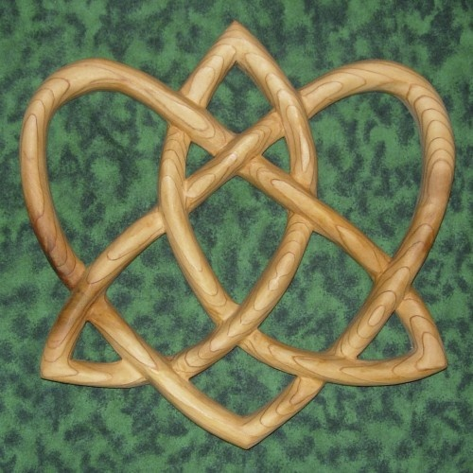
The Blessed Trinity
RCIA
St. Peter Catholic Church Monument
January 4, 2024

Slide 2
Agenda
It’s a Mystery
Introduction to The Blessed Trinity
Who/What is God?
Who/What is Jesus?
Who/What is the Holy Spirit?
Heresies Past and Present
Why Does it Matter?

Slide 3
It’s a Mystery
Truth revealed by God
Truth about which we cannot know everything
This is where faith comes in, not intellectual suicide!

Slide 4
Introduction to The Blessed Trinity
Video: Symbolon Session 1: 15:25 - 19:51
Trinity: Tri + unity
Lateran Council: “We firmly believe and confess without reservation that there is only one true God, eternal, infinite, and unchangeable, incomprehensible, almighty, and ineffable, the Father and the Son and the Holy Spirit: three persons indeed, but one essence, substance or nature entirely simple.” (cf. CCC 202)
Read CCC 234:
Central Mystery of the Catholic Faith
The Blessed Trinity is RELATIONSHIP

Slide 5
Who/What is God?
The Shema (sheh ma’): “Hear, O Israel: the Lord our God is one Lord; and you shall love the Lord your God with all your heart, and with all your soul, and with all your might.”

Slide 6
Who/What is God?
I AM WHO AM (Ex 3:6)
Eternal, not created
Pure spirit/being
Perfect
All-good
All-loving
All-present
All-truth
All-immanent (dwelling within)
All-merciful
All-just
All-holy
All-knowing (omniscient)
All-powerful (omnipotent)

Slide 7
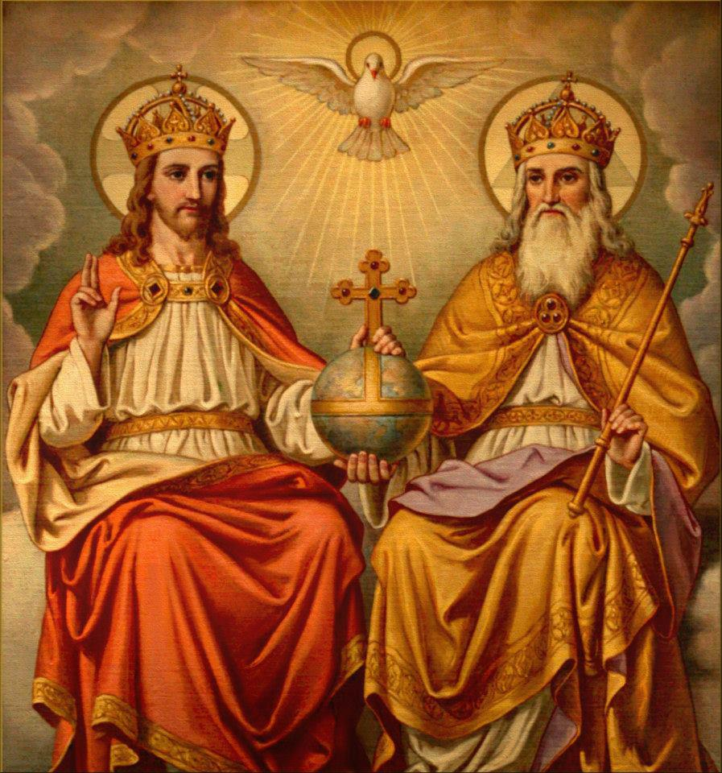
Who/What is God?
God is one divine nature, three divine persons
Person: The composite of characteristics that make up an individual personality; the self.
Nature: the essential qualities or characteristics by which something is recognized
Genesis 1: 26 reveals that God is a community of persons, right?
God is love, and in His love, He sent His Son for our sins and His Spirit to abide with us (1 Jn 4: 8-16)

Slide 8
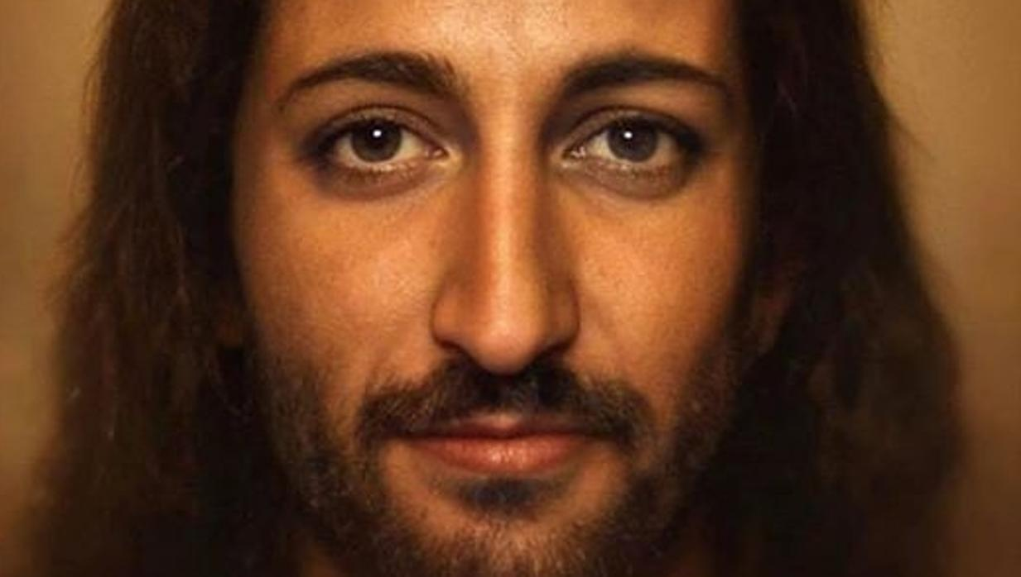
Who is Jesus?
Jesus is The Word of God Made Flesh
Genesis 1: 26 “Let us make human beings in our image, after our likeness.”
John 1:1-14 “In the beginning was the Word….and the Word was with God, and the Word was God…”
Jesus called God Abba, Father
See Matt 11:25-27
The Holy Trinity at Jesus’ conception (Lk 1:3-35)
The Holy Trinity at Jesus’ baptism (Matt:3:13-17)

Slide 9
Who is Jesus?
Nicene Creed: “the only-begotten Son of God, eternally begotten of the Father, God from God, Light from Light, True God from True God, begotten not made, consubstantial with the Father.”
Jesus applied God’s name to Himself: “I AM” (Jn 8:58)

Slide 10
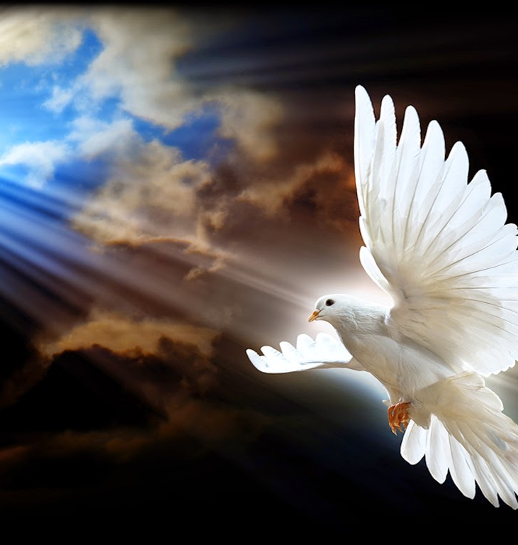
Who is the Holy Spirit?
The Holy Spirit Is the third person of the Blessed Trinity, with His own properties: CCC 258
Proceeds from the Father and the Son (Jn 15:26)
He is the personification of the intense love between the Father and the Son
The Holy Spirit is a less prominent concept in Old Testament

Slide 11
Who is the Holy Spirit?
But then…
The angel, Gabriel, comes from God to ask Mary to bear the Messiah
The cloud that overshadows her is the Holy Spirit and Jesus is conceived
Jesus announced the coming of the Paraclete before He died (John 14:16-17)
The Holy Spirit is now a bold and active person of the Trinity for all of us!
To be clear: the Holy Spirit is not a “force”
The Father sends the Holy Spirit in the name of the Son, and the Son sends the Holy Spirit in person, once he returned to the Father.

Slide 12
Caution
The Trinitarian formula at baptism (Matt 28:19), and in blessings (2 Cor 13:13), reveals the coequality of the three Persons
God is not divisible
Shamrock
Egg
Water/ice/vapor

Slide 13
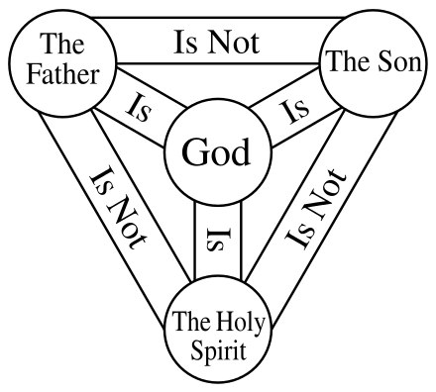
Shield of Athanasius

Slide 14
Trinitarian Heresies, Past and Present
Sabellianism/Modalism
Asserts that God is one person with different “offices” or “modes”
See Jn 17, Jn 14:12, 28; 16:10 , Jn 14:16-17, 26; 15:26; 16:13-15;Acts 2:32-33
Arianism
Asserts that Jesus was not God, but a created being and not divine
See Jn 5:18, Jn 8:58, Jn 20:28, Is 44:6, Rev. 1:17, Rev 2:8, Rev. 22:12-13

Slide 15
Why Does it Matter?
All knowledge we can get of God is useful for our journey to salvation
Helps is become partakers in the divine nature (2 Peter 1:4)
By contemplation of the Holy Trinity, we can arrive at some conception of our own supernatural dignity
Helps us understand who we are
We can enter into that loving relationship more completely, with our God and with each other

Slide 16
Closing Prayer
Glory be to the Father, Who by His almighty power and love created me, making me in the image and likeness of God.
Glory be to the Son, Who by His Precious Blood delivered me from hell, and opened for me the gates of Heaven.
Glory be to the Holy Spirit, Who has sanctified me in the sacrament of Baptism, and continues to sanctify me by the graces I receive daily from His bounty.
Glory be to the Three adorable Persons of the Holy Trinity, now and forever. Amen.

Slide 17
