Slide 1
The Sacrament
of Penance and Reconciliation

Slide 2
PRAYER
The Act of Contrition
O my God, I am heartily sorry for having offended Thee and I detest all my sins, because I dread the loss of heaven and the pains of hell; but most of all because they offend Thee, my God, Who are all good and deserving of all my love. I firmly resolve, with the help of Thy grace, to confess my sins, to do penance, and to amend my life. Amen.

Slide 3
Four Dimensions of Penance
Memorial
Sacrament recalls the times God called the Israelites back and the times Jesus forgave sinners
Celebration
Reflects great joy at God’s mercy and forgiveness
Communion
Restores your fellowship with God, others, and yourself
Transformation
Offers a rebirth as a result of God’s sanctifying grace

Slide 4
Penitent
A person who admits his or her sins, is truly sorry for having sinned, and wishes to be restored to relationship with God and the Church.

Slide 5
Historical Milestones for the Sacrament of Penance
Date | Practice | Outcome
AD 140-150 | Early Christians who committed serious sins were admitted to the Order of Penitents | Performed rigorous penance for years. Sinners could not receive Holy Communion or socialize with Christians. Typically only done once in their lives.
Seventh Century | No bishop available to absolve people in Order of Penitents. Irish missionaries began to hear private confessions. | Sinners confessed their sins, expressed sorrow, and performed a penance before receiving absolution.
End of the Middle Ages | Common advice encouraged confession before each reception of Holy Communion. | Most people avoided receiving Eucharist except on rare occasions.
Early Twentieth Century | Pope Pius X promoted frequent communion for laypeople . | More Catholics began to go to confession, sometimes weekly. A clear emphasis on only mortal sin debarring someone from Communion.
Second Vatican Council | New Rite of Penance emphasized the call to an ongoing covenant of love and friendship. | Celebrates the Mercy of God who continually calls us back to union with him.
Understanding the Sacrament of Penance and Reconciliation

Slide 6
Baptism washed away sin and was thought to be sufficient
Baptism
Humans have an inclination to sin.
People were excommunicated in the early Church for grave sin.
Sin
We turn to this Sacrament when we damage our relationship with God to restore our communion with him
Reconciliation
Regular sacramental practice renews our baptismal promise and reconciliation with God
Eucharist
Understanding the Sacrament of Penance and Reconciliation

Slide 7
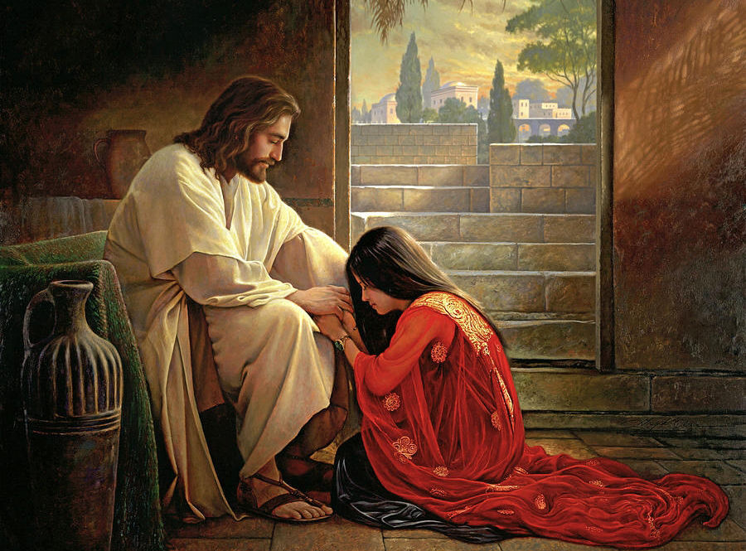
And when he had said this, he breathed on them and said to them, “Receive the holy Spirit. Whose sins you forgive are forgiven them, and whose sins you retain are retained.” (Jn 20:22–23)
Understanding the Sacrament of Penance and Reconciliation

Slide 8
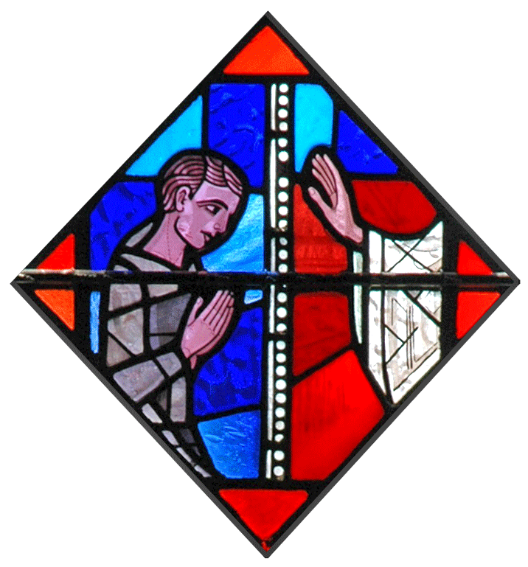
Three ways to celebrate Penance
Private individual confession: This is the “only ordinary way” to be reconciled with God after mortal sin. Can be done anonymously behind a screen or face to face with a priest.
Communal celebration with individual confession and absolution: Commonly done during Advent and Lent at parishes, a communal celebration includes a common examination of conscience and a communal request for forgiveness of sins.
Communal celebration with general confession absolution: Reserved for rare cases of grave necessity by discretion of the bishop.
Celebrating the Sacrament of Penance and Reconciliation

Slide 9
Examination of Conscience
An honest self-assessment of how well you have lived God’s covenant of love, leading you to accept responsibility for your sins and to realize your need for God’s merciful forgiveness.
Understanding the Sacrament of Penance and Reconciliation

Slide 10
Contrition
Heartfelt sorrow for sins committed, along with the intention of sinning no more. This most important act of penitents is necessary for receiving absolution in the Sacrament of Penance.
Perfect Contrition
You have sorrow for sin because you love God and want to be in relationship with him.
Imperfect Contrition
You have sorrow for sin because you fear punishment or perceive the ugliness of sin.
Understanding the Sacrament of Penance and Reconciliation

Slide 11
Mortal sin vs. Venial sin
Venial sin weakens your relationship with God and the Church.
Confession is not strictly required for venial sin, but the Church encourages you to confess these sins as a wayvto admit your need for God’s grace and mercy.
Mortal sin destroys or kills your relationship with God and the Church. If not repented and forgiven by God, mortal sin removes you from God’s Kingdom and leads you to hell.
Confession is required for a return to full communion with God
God
Us
Understanding the Sacrament of Penance and Reconciliation

Slide 12
Journal Question
Think of a time when someone has hurt you or broken your relationship with them by some action. How was this situation resolved?

Slide 13
Sacramental Seal
The secrecy priests are bound to keep regarding any sins confessed to them.
"...It is a crime for a confessor in any way to betray a penitent by word or in any other manner or for any reason" (Code of Canon Law No. 2490)
Understanding the Sacrament of Penance and Reconciliation

Slide 14
Ways of Penance
Understanding the Sacrament of Penance and Reconciliation

Slide 15
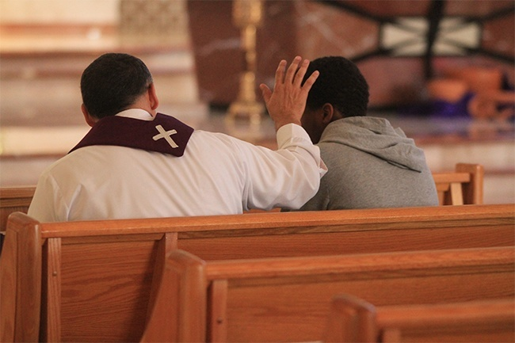
Absolution
“God, the Father of mercies, through the Death and the Resurrection of his Son has reconciled the world to himself and sent the Holy Spirit among us for the forgiveness of sins; through the ministry of the Church may God give you pardon and peace, and I absolve you from your sins in the name of the Father, and of the Son, and of the Holy Spirit. “ (Rite of Penance, 46)
Understanding the Sacrament of Penance and Reconciliation

Slide 16
Sin Weakens or breaks your connection with God and others
The Sacrament of Penance
Reconciled to God
Peace of conscience
Spiritual consolation
Life filled with Grace and Blessings
The Graces of the Sacrament of Penance and Reconciliation

Slide 17
Consequences associated with Sin
 | Kind of Sin Affected | Consequence | Ways to expiate punishment for sin
Spiritual | Mortal | Eternal hell | Confession
Temporal | Venial, Mortal | Time spent in Purgatory for purification and admittance into Heaven | Prayer, fasting, almsgiving, good work or sacrifice, indulgences
The Graces of the Sacrament of Penance and Reconciliation

Slide 18
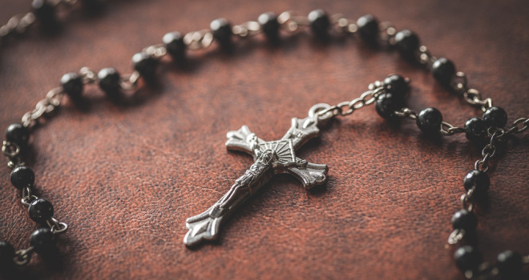
Indulgences
An indulgence is the remission of temporal punishment due to sins already forgiven (CCC 1471)
Plenary Indulgence remits all of one’s punishment. A person must be in a state of grace and intentional about the indulgence
Partial Indulgence wipes out a portion of one’s punishment
The Graces of the Sacrament of Penance and Reconciliation

Slide 19
Excommunication
The Code of Canon Law (1983) specifies that an excommunicated person is forbidden to participate in a ministerial capacity (celebrant, lector, etc.) in the Sacrifice of the Mass or in any other form of public worship; to celebrate or to receive the sacraments; to celebrate the sacramental; to exercise any ecclesiastical office or ministry; and to issue any act of governance (#1331.1)
The purpose of excommunication is to shock the sinner into repentance and conversion so they realize the gravity of their sins.
If excommunicated for a few grievous sins the ban can only be lifted by the Pope (1367, 1370, 1378, 1982, 1388).
The Graces of the Sacrament of Penance and Reconciliation

