Slide 1
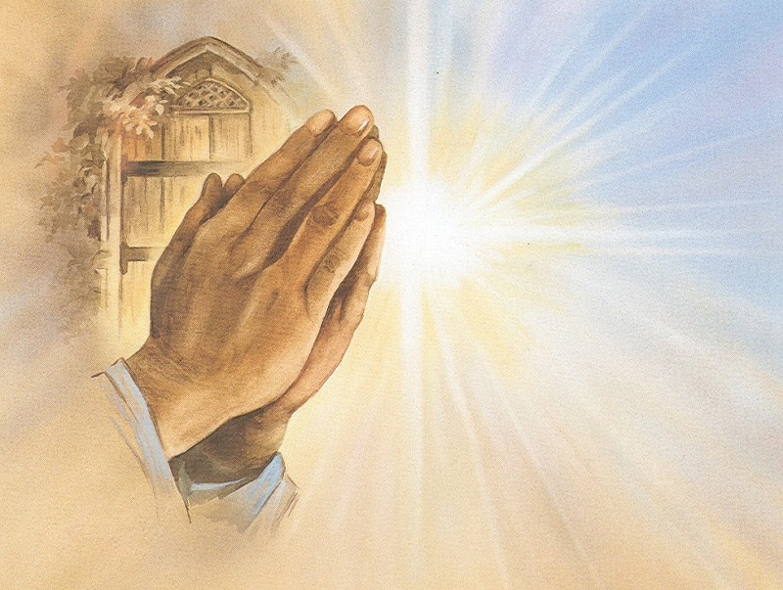
PRAYER
ST. PETER RCIA
October 19, 2023

Slide 2
Opening Prayer
Glory be to the Father, to the Son, and to the Holy Spirit, as it was in the beginning, is now, and ever shall be, world without end, Amen.
Holy Father, as we begin to discuss prayer tonight, what it is and how to do it, help us always remember that we can do nothing without you, who strengthens us in all things, and that includes prayer. Lord, help us to pray!
Glory be to the Father, to the Son, and to the Holy Spirit, as it was in the beginning, is now, and ever shall be, world without end, Amen.

Slide 3
AGENDA
What is prayer?
Why do we pray?
How do we pray?
Does God Answer?
The Lord’s Prayer

Slide 4
What Is Prayer?

Slide 5
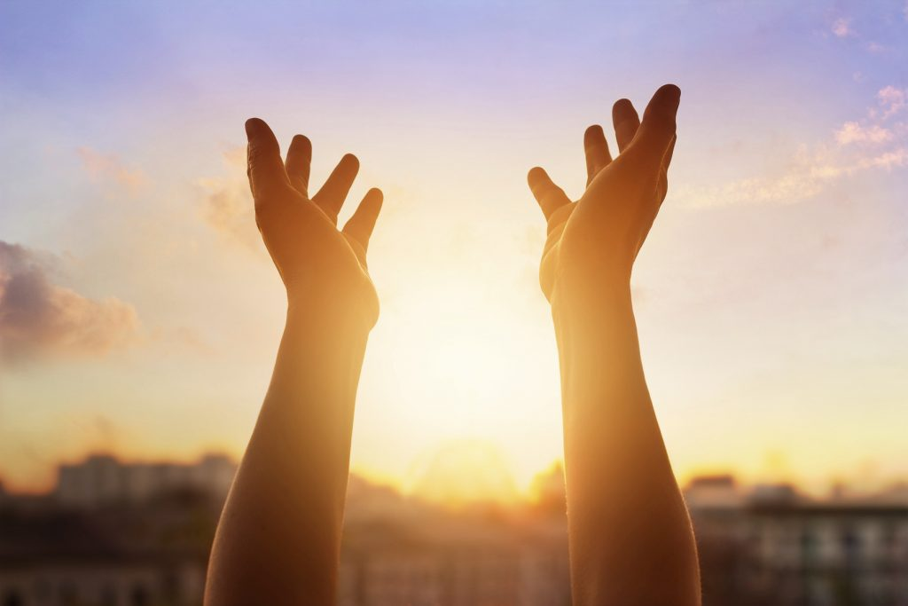
from St. Thèrése of Lisieux
“For me, prayer is a surge of the heart; it is a simple look turned toward heaven, it is a cry of recognition and of love, embracing both trial and joy.”

Slide 6
Prayer is…
“..the raising of one’s mind and heart to God…” (CCC 2559)
…relationship with God (CCC2558); a a relationship of the children of God with their Father, with his Son Jesus, and with the Holy Spirit (CCC 2565)
a conversation with God, communication, which implies talking and listening
God’s gift to us
Our surrender to God

Slide 7
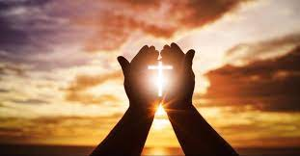
Prayer as….
Love
The most personal thing we do
A powerful tool

Slide 8
A Rich Tradition, Throughout History
Scripture
Ps 145:5- Meditation of God’s majesty and wonderful works
Sir 6: 37- Meditation on God’s law leads to insight and wisdom
Mt 11: 25-30- Jesus prays to the Father and invites us to come and rest in him
Eph 5: 18-20- Pray in the Spirit using Psalms, hymns and songs to give thanks go God
Catechism of the Catholic Church CCC Section 4, 2558-2758
2564-2565: Prayer comes from the heart and is a communion with God
2653-2654: Prayerfully reading and meditation on Sacred Scripture
2697-2699: Prayer at al times requires the decision to pray at specific times in various ways.

Slide 9
Why do we pray?

Slide 10
Reasons to Pray
Blessing and Adoration
Contrition
Petition/supplication
Intercession
Thanksgiving
Praise

Slide 11
How Do We Pray?

Slide 12
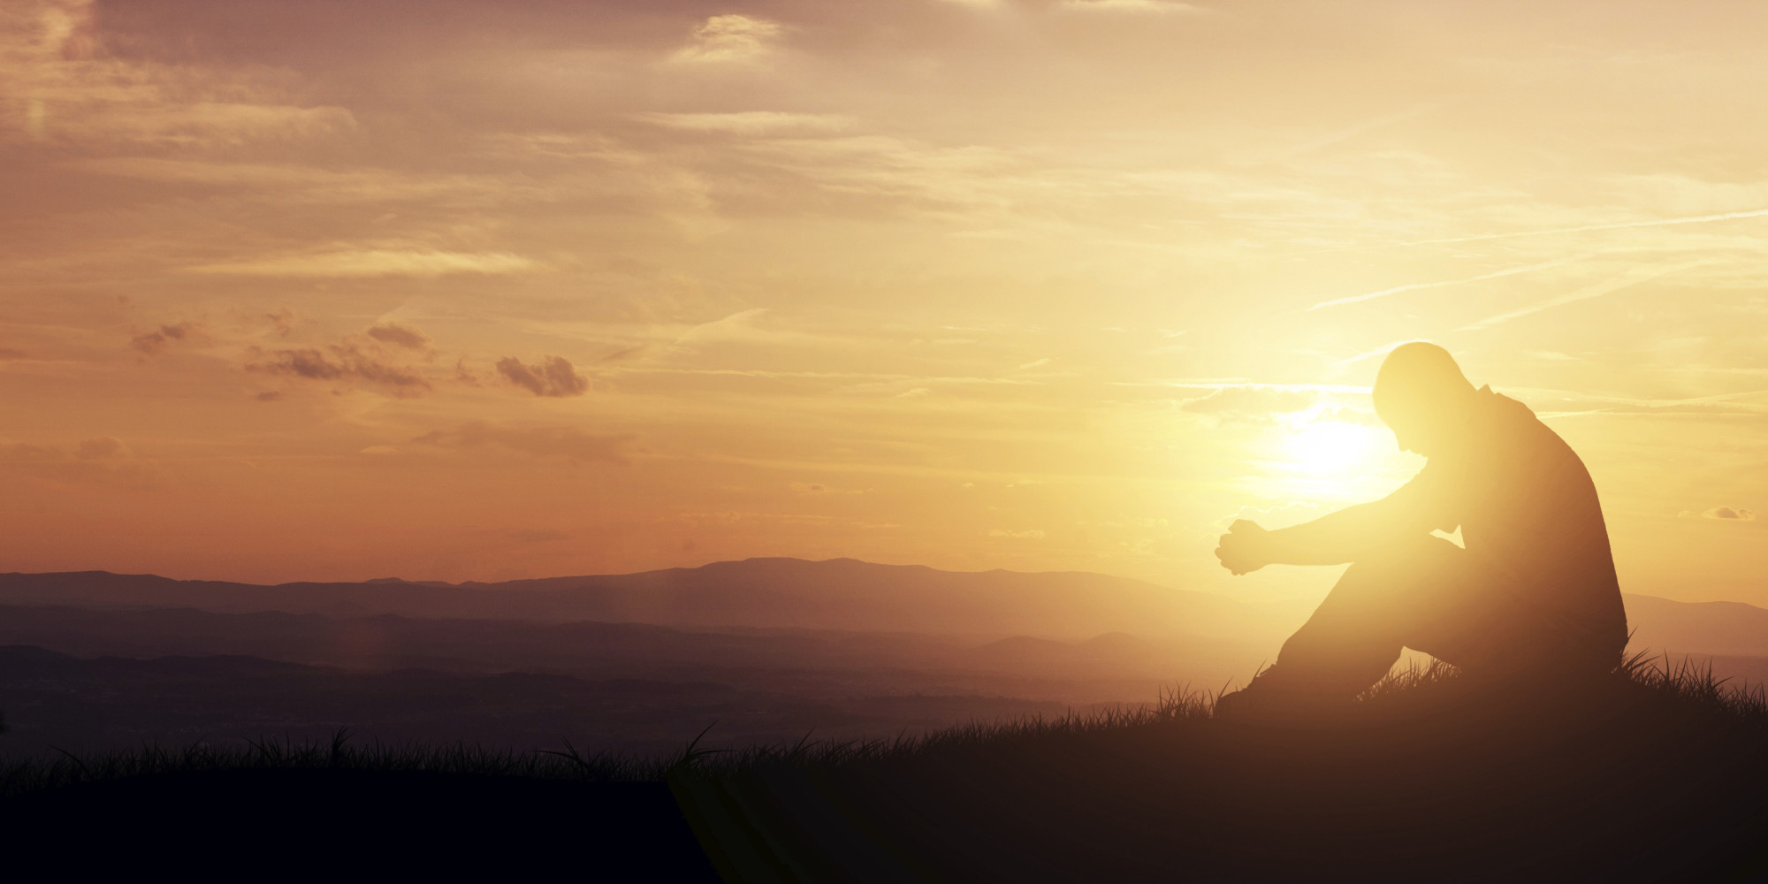
Types of Prayer
Vocal
Meditative
Contemplative

Slide 13
Some Fundamental Formal Prayers You Should Learn
Our Father (Pater Noster) CCC 2759-2865
Glory Be (Gloria Patria) Liturgical
Hail Mary (Ave Maria) CCC 2673-2679
Act of Contrition Traditional
Apostle’s and Nicene Creeds Begins after CCC 184
Hail Holy Queen Traditional
Memoraré

Slide 14
The Matter of Prayer
ACTS
Adoration
Contrition
Thanksgiving
Supplication
Petition
Intercession
The Christian family is the first place of education in prayer
The family is the domestic church
(CCC 2685)

Slide 15
Settings and Posture
Settings (CCC 2691)
The Church: proper place for liturgical prayer of the parish community
Personal Prayer:
Prayer corner: with Scriptures, icons, candles, etc
Monasteries and shrines: locations that offer intense personal prayer opportunities
Anywhere (CCC 2743)
“Never cease praying” 1 Thes 5:17
Physical Posture
Kneeling: one of the most reverential postures (Lk 22:41, Acts 9:40, 20:36, 21:5, etc)
Standing
Folded hands
Prostrate
Music
Praying at the Hour of Jesus death (3 pm) is powerful (Mt 23:44, Acts 3:1)

Slide 16
Other Forms of Prayer

Slide 17
Liturgy
Prayer is integral to Catholic liturgical worship
Liturgy: Public participation of the Church in the work of God
Liturgical prayer
Formal, vocal prayer offered publicly and in community
Work of the common priesthood
Earliest form in Exodus (Ex 25)
Didache
Liturgy of the Hours
Hymns, Psalms, prayers, readings prayed at set times every day
The “prayer of the Church”

Slide 18
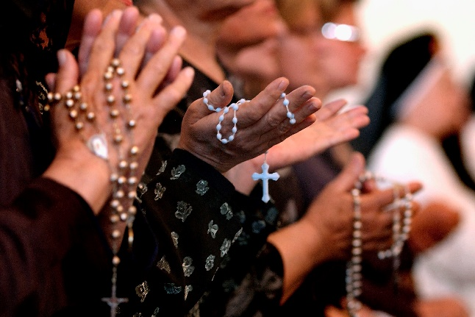
Devotions
Devotions
Non-liturgical prayer
Vatican II: spiritual life “…is not limited to participation in the liturgy”
Should be in harmony with the liturgy
Some varieties
Rosary (more later)
Eucharistic adoration
Lectio Divina
Reading, meditation, prayer, contemplation
Stations of the Cross
Novenas

Slide 19
Fasting and Penance
Fasting means denying oneself
Can be in reparation, supplication, to grow closer to God
Can take many forms, but often means food: meals, types of food, etc.
Penance
Making amends
Often prescribed by a priest
Sometimes self-imposed

Slide 20
Does Prayer Work?

Slide 21
Jesus, Teach Us to Pray
Conversion of heart
Once committed to conversion, we learn to pray in faith
Story of the Monk and the Tea
Does God answer?

Slide 22
The Challenges of Prayer
See CCC 2725-2745
Prayer can be a battle against ourselves, and/or against the tempter who tries to turn us away from union with God
Difficulties
Distraction: our attention wanders, requires vigilance
Dryness: we don’t always experience warm feelings and God’s comfort
Lack of Faith: most common issue, our failure to trust God
Discouragement: our prayer seem not to be answered
Sloth: spiritual laziness weakens our will to pray
Lukewarmness
Antidotes: sacraments, detachment, vigilance, childlike trust in God, perseverance

Slide 23
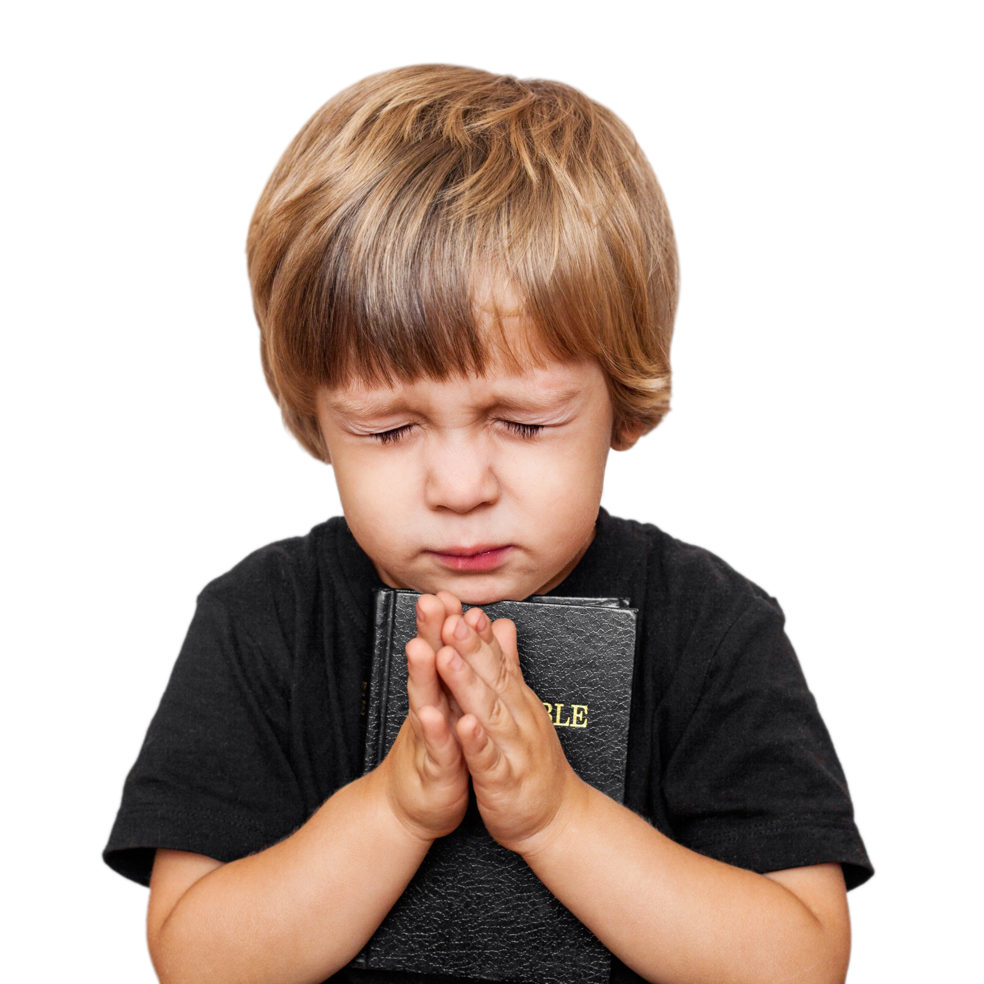
The Lord’s Prayer
CCC 2759-2865

Slide 24
Introduction
Read CCC 2761
St. Augustine: “Run through all the words of the holy prayers (in Scripture) and I do not think that you will find anything in them that is not contained and included in the Lord’s Prayer”
In the Eucharistic liturgy of the Mass the Lord’ Prayer is the prayer of the whole Church (CCC 2770)

Slide 25
Our Father, Who art in heaven Hallowed be Thy Name
NOTE: “Our” and “Father”
We are adopted children of God through Baptism when we become part of the Body of Christ (CCC 2782)
We approach God in humility and trust
Our Father is not elsewhere - He is present in the hearts of the just
Hallowed = honored, holy

Slide 26
Thy kingdom come Thy will be done On earth as it is in heaven
Thy Kingdom
Thy Will

Slide 27
Give us this day our daily bread
We must rely on and trust in God for everything
Daily
Bread

Slide 28
and forgive us our trespasses As we forgive those who trespass against us
Our hope in Christ's salvation is firm, but…
His grace cannot penetrate the scabbed hide of of a merciless heart!
Be honest in prayer

Slide 29
Lead us not into temptation but deliver us from evil. Amen.
Lead us not
Deliver us
Amen

Slide 30
Doxology
For thine is the kingdom, the power and glory now and forever.

Slide 31
Scripture References
1 Kgs 17:17-24
Neh 1:4-6
Sir 35:16-17
Rom 8:26
Phil 4:6
Col 4:2-4
Rv 7:9-12
Mt 7:7-11
Mk 1:35-36
Lk 18:9-14
Jn 14-13-14
Jn 15:7
“Praying Hands” Albrecht Durer, 1508

Slide 32
Prayer Resources
Bible
Magnificat (https://us.magnificat.net)
Our Daily Visitor (https://www.mydailyvisitor.com)
Blogs
Commentaries
Study bibles
The usual caution: make sure it is full Catholic. Ask if you are not sure.

Slide 33
Closing Prayer

