Slide 1
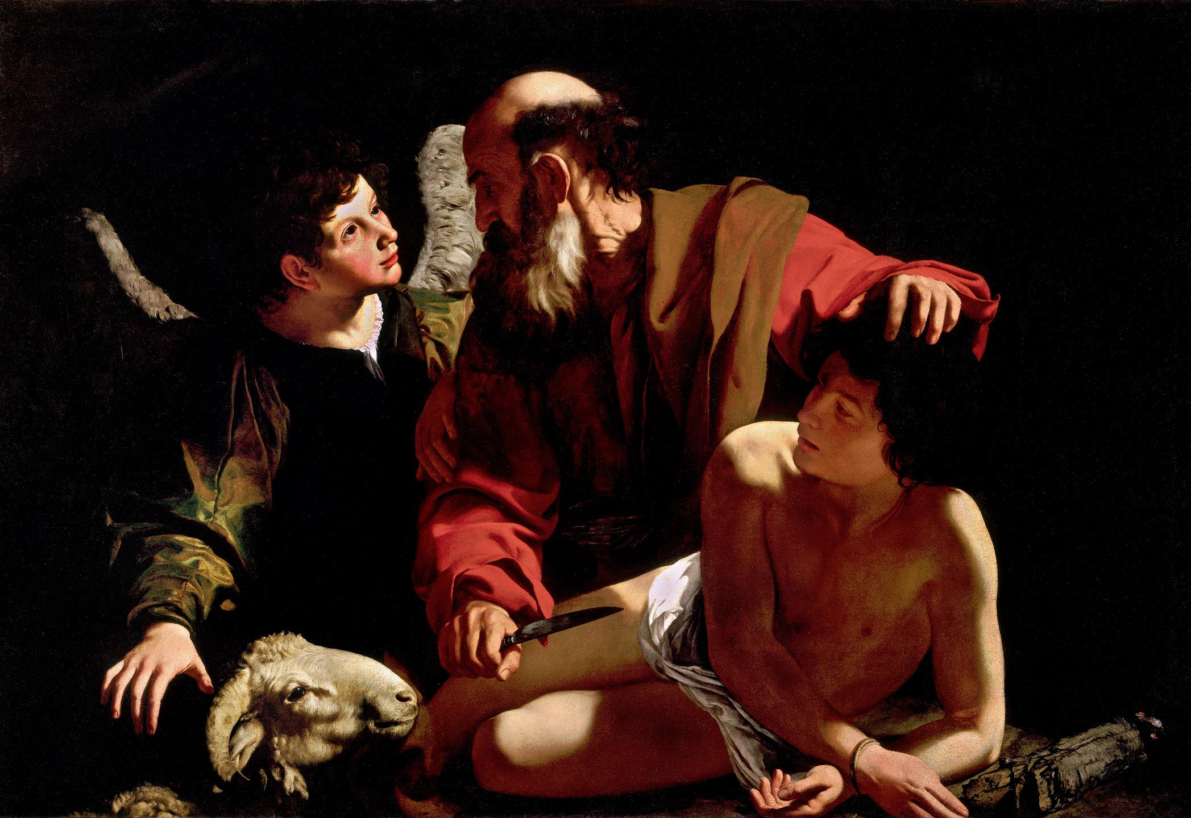
The Akedah of Isaac
INSIGHTS ON THE SACRIFICE OF ABRAHAM FROM JEWISH, CHRISTIAN, ISLAMIC, AND WORLD LITERATURE& ART
DEACON RICK BAUER▪ TAPPING INTO THEOLOGY ▪ MARCH 2022
Notes:
Welcome to our presentation this evening. Tie in with Dylan.

Slide 2

Introduction: Who Was (and Is) Abraham?
“On the day when Our Father Abraham passed away from the world, all the great people of the nations of the world stood in a line and said, “Alas for the world that has lost its leader, and alas for the ship that has lost its pilot.”
—Talmud
By faith Abraham obeyed when he was called to go out to a place that he was to receive as an inheritance. And he went out, not knowing where he was going. By faith he went to live in the land of promise, as in a foreign land, living in tents with Isaac and Jacob, heirs with him of the same promise. For he was looking forward to the city that has foundations, whose designer and builder is God.
—Hebrews 11:8–10 (ESV-CE)
Notes:
Abraham is recognized as being in the Hall of Fame in three monotheistic religions of the world. The oldest source for the story of Abraham is in the biblical book of Genesis, where it occupies about 14 chapters, or roughly 20 pages. If you are unfamiliar with this story, or it has been a while, it would be a wonderful Lenten experience to read it now, in a modern accessible translation.
In summary, and it is important to understand the background leading up to our focus this evening, Abraham’s saga is the deceptively simple tale of a person to whom God, suddenly and without any preparation, makes some rather extravagant promises. This childless man, whose wife is infertile is to be the father of a great nation; he will become famous and blessed, in fact a source or byword for blessing for many, and his descendants will be given the land of Canaan, to which he is commanded to journey, leaving his homeland in Mesopotamia (modern-day Iraq) and his family of origin behind. Much fo the drama in these early chapters of the story derives from the questions, how will this man whose wife has never been able to conceive a child and now is advancing in years ever beget the great nation that is at the center of the promise? The wealth associated with the promise comes quickly, but the son who will be Abraham’s heir does not, and this casts into doubt both the reliability of the promise and the God who made it.
When at long last Abraham does gain a son, it is not through his primary wife, but, at her suggestion, through an Egyptian slave who serves as a surrogate mother for her mistress. His name is Isaac, which in Hebrew is “He laughs”, recalling the laughter both Abraham and Sarah had at the though of God’s promise reiterated a year ago. Delighted not only by Isaac’s birth but also surprised by joy itself, Sarah credits God with the gift of laughter. She marvels at the gracious gift of a child in old age, a wondrous antidote to barrenness and decay, a miraculous seed of renewed spring incongruously from withering flesh. “He who laughs” now refers also to God, who as made me laughter. Speaking better than she knows, Sarah pronounces comedy divine.
The resolution and laughter is short lived, for no sooner is Abraham’s ostensible heir Ishmael born, God makes the astounding promise that the infertile wife, Sarah, now 89 years old, will give birth to the promised son after all, and this it is this son who will inherit not only the promises of blessing and great nationhood, as will also happen to Ishmael, the first son born of the seed of Abraham, but that Isaac, unlike Ishmael, will inherit the covenant, the berit of God.
Much of the rest of the story of Abraham focuses on the relationship between these two sons (and that of their mothers as well), until finally Ishmael and his mother Hagar are removed from the household and Hagar procures an Egyptian wife for her son Ishmael, confirming as it were the divine prediction that his would not be Abraham’s primary lineage. That status has been reserved for Sarah’s son Isaac, who is born not through the course of nature byu through a miracle.
But the story does not end there, or even happily, for God again, suddenly and without warning, commands Abraham to sacrifice this child, the son he loves and on whom he has staked his life, as a burn offering on an as-yet-unspecified mountain in a distant land. This is called “The Binding of Isaac” in most Jewish traditions, the translation of “binding” in Hebrew is Akedah. In Christian traditions, it is mainly known as “The Sacrifice of Abraham.” Whose perspective is more important—Abraham, Isaac, or even Sarah, the mother—is a matter of some conversation.
Just to sum up the Akedah for our purposes this evening, once again Abraham obeys God’s inscrutable will. At the last minute, God interrupts the sacrifice, having determined that Abraham obeys even when that means acting against his own self interest and paternal love. Isaac survives.
There are many other details. But to this day in the Jewish liturgy, we speak of “the God of Abraham, the God of Isaac, and the God of Jacob”, referring tin the last two phrases to the special son and grandson through whom, according to the biblical narrative, the Jewish people come into existence.

Slide 3
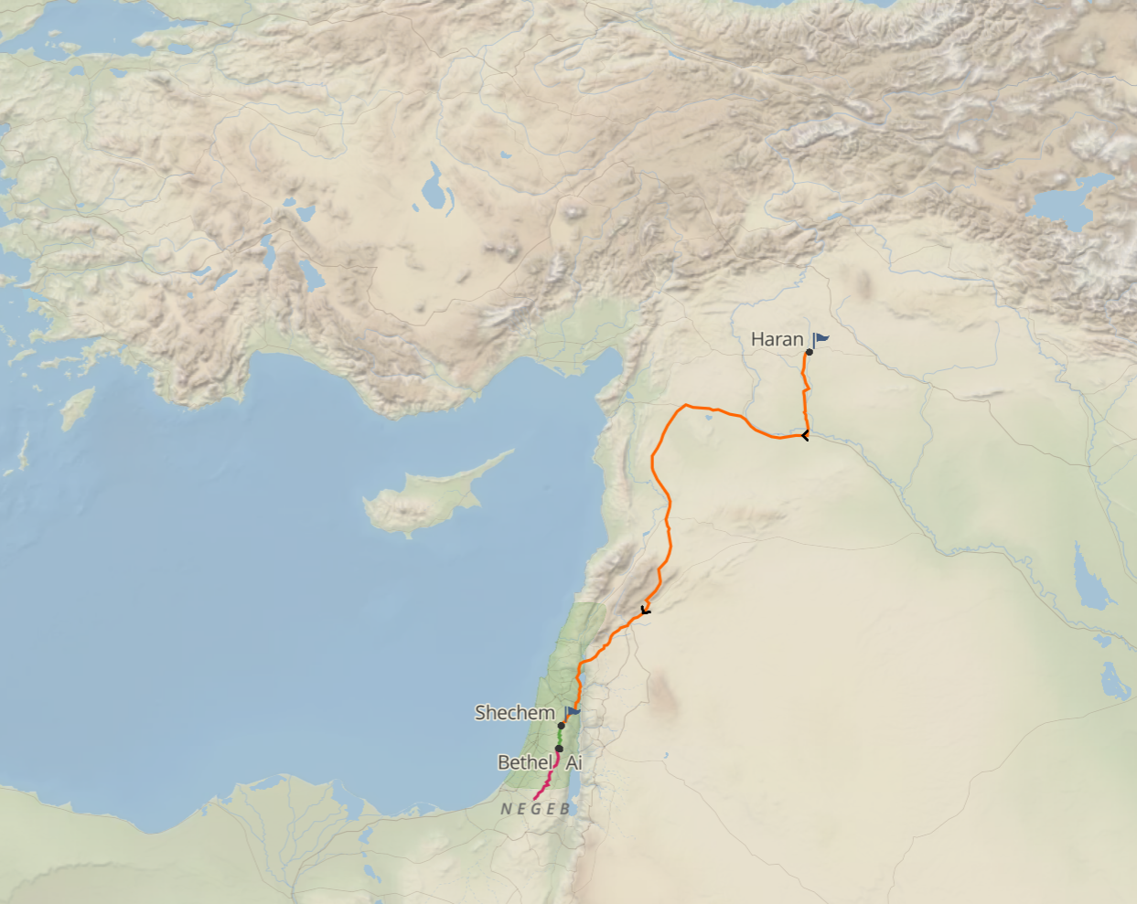
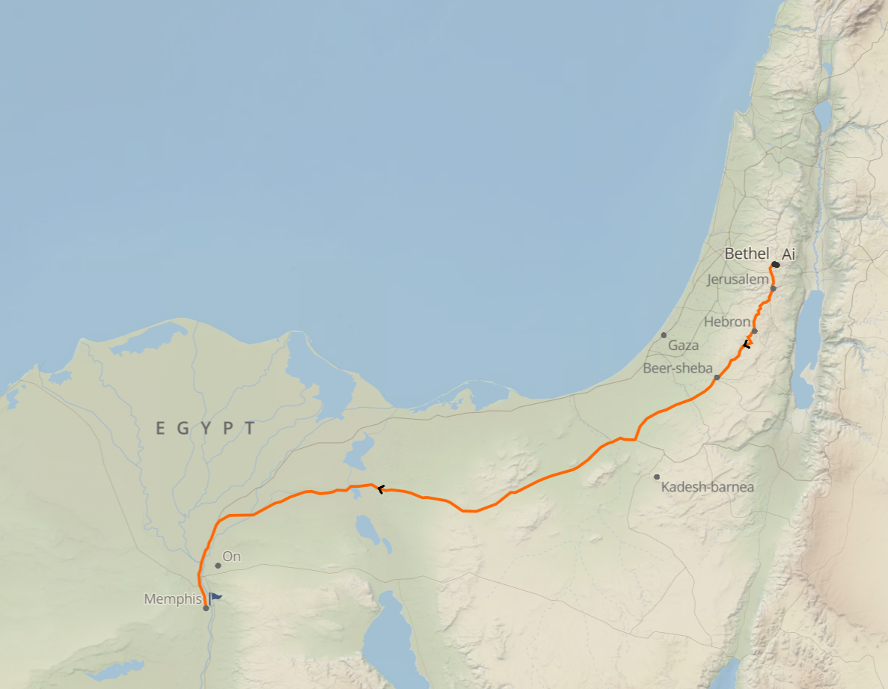
Abram Emigrates to Canaan; Abram and Sarai Emigrate to Egypt

Slide 4
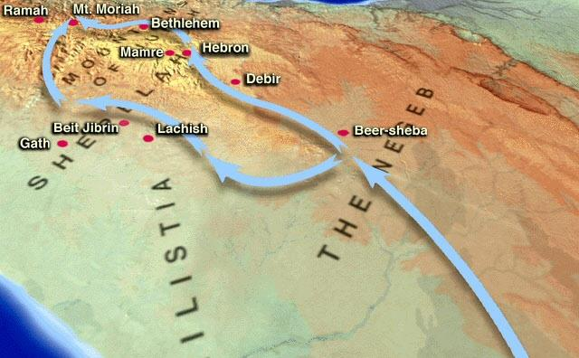
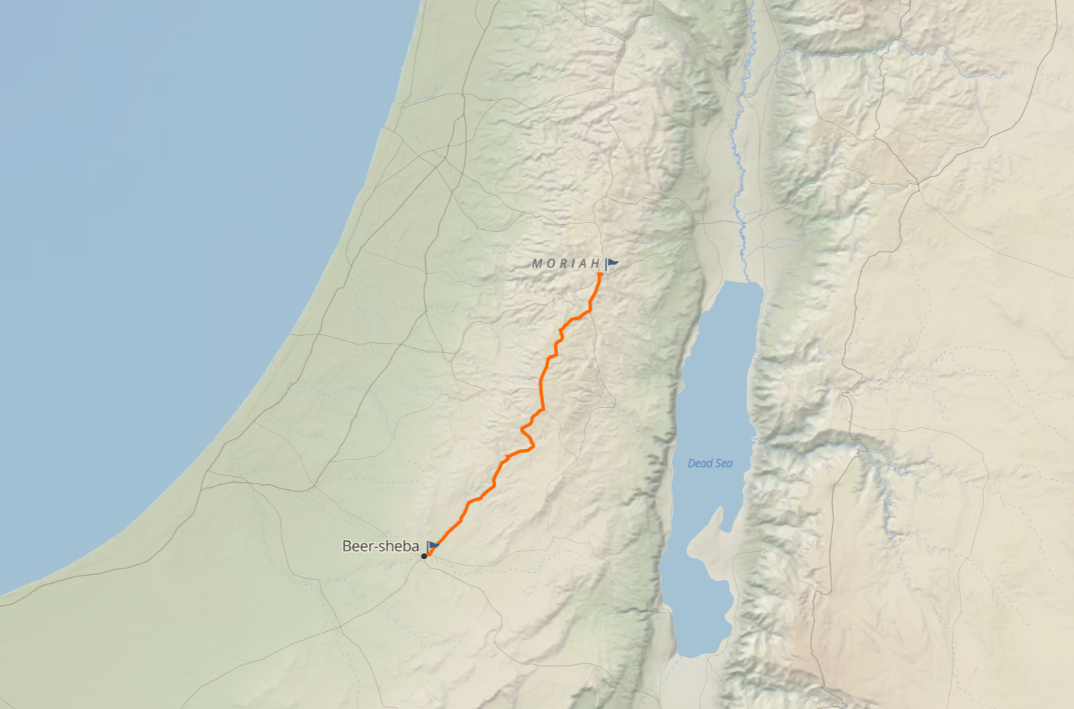
Abraham and Isaac Travel to Mt. Moriah?
Abraham lived at Beersheba, close to Abimelech. It is thought that he journeyed to Mt. Moriah by the route through the Shephelah rather than through the mountains of Judah, from which he had earlier withdrawn, for that road was easier to travel and bordered the plain of the Philistines, with whom he was friendly.

Slide 5
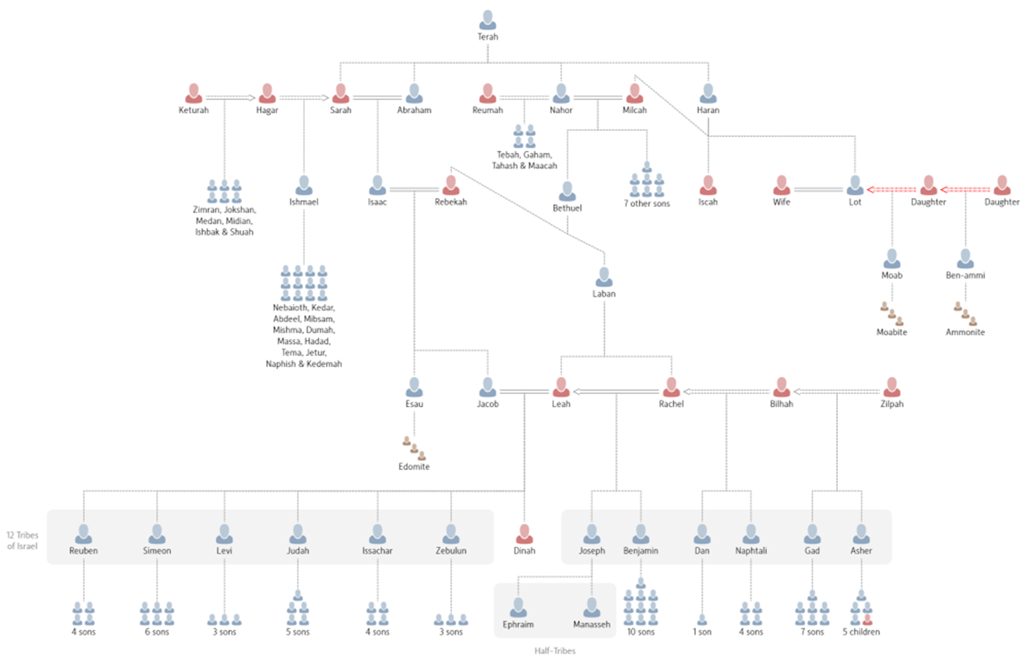
The Descendants of Abraham

Slide 6
The Abrahamic History
11:27–32 Genealogical introduction
12:1–9 Call of Abram and first journey
12:10–20 In Egypt
13:1–18 Abram and Lot separate
14:1–24 Abram rescues Lot
15:1–21 Covenant with Abram
16:1–16 Covenant of circumcision
17:1–27 Divine visitation
18:1–15 Abraham’s intercession for Sodom
18:16–33 Destruction of Sodom and Gomorrah
19:1–29 Lot’s daughters’ incest
19:30–38 Abraham and Abimelech
20:1–18 Isaac born; Ishmael leaves
21:1–21 Birth of Ishmael
21:22–34 Covenant with Abimelech
22:1–19 Testing of Abraham
22:20–24 Genealogy of Nahor
23:1–20 Purchase of burial ground
24:1–67 Betrothal of Rebekah
25:1–11 Conclusion

Slide 7
Who Has a Claim to Be Abraham’s Descendants?
Jewish
Christian
Muslim
Each group has a case within its own faith community
Notes:
In the context of Judaism, one thus cannot speak very long or very adequately about God without speaking about the people Israel, the people descended from Abraham, Isaac, and Jacob; conversely one cannot speak very long or very adequately about the people Israel without speaking about the God of Israel
Something analogous can be said about Christianity and Islam, but not about any other monotheistic religion.
The rise of Christianity in the first century AD posed a different sort of challenge to Judaism and elicited a different sort of response. Which community today can lay just claim to the promises made to Abraham’s descendants, and what is that community obligated to practice?

Slide 8
Abraham in the New Testament: A Study
The Gospels:
  Genealogies (authenticity, legal standing)
The Epistles:
  The role of Faith and Law
  Galatians 3:5-9
  Romans 4:3; 9-25
  James 2:23
The Example of Abraham
  Hebrews 11:8-19

Slide 9
Abraham in the Writings of St. Paul
He [Abraham] received the sign of circumcision as a seal of the righteousness that he had by faith while he was still uncircumcised. The purpose was to make him the father of all who believe without being circumcised, so that righteousness would be counted to them as well, and to make him the father of the circumcised who are not merely circumcised but who also walk in the footsteps of the faith that our father Abraham had before he was circumcised.
—Romans 4:11–12 (ESV-CE)

Slide 10
Abraham in the Writings of St. Paul
Does, then, the one who supplies the Spirit to you and works mighty deeds among you do so from works of the law or from faith in what you heard? Thus Abraham “believed God, and it was credited to him as righteousness.” Realize then that it is those who have faith who are children of Abraham. Scripture, which saw in advance that God would justify the Gentiles by faith, foretold the good news to Abraham, saying, “Through you shall all the nations be blessed.” Consequently, those who have faith are blessed along with Abraham who had faith.
—Galatians 3:5-9

Slide 11
The Akedah in our Faith Traditions: Christian
The key, according to St. Paul is not physical birth and circumcision, but faith, and therefor both Gentiles and Jews—the uncircumcised and the circumcised—qualify equally for “descent” from Abraham if they have faith.
Ritual circumcision, a requirement for men converting to Judaism, would therefore not be required of Christians at all.
The faith of Abraham the Gentile made him righteous in God’s eyes even before circumcision made him into Abraham the first Jew.

Slide 12
The Akedah of Isaac: A Reflection
Abraham’s sorrow (22:1–8)
  The order (22:1–2): God commands Abraham to sacrifice his son Isaac as a burnt offering.
  The obedience (22:3): Along with Isaac and two servants, Abraham heads out for the land of Moriah.
  The ordeal (22:4–8)
    Isaac’s question (22:7): “Father? … Where is the lamb for the sacrifice?”
    Abraham’s answer (22:8): “God will provide a lamb, my son.”
Isaac’s submission (22:9–10): He allows Abraham to bind him on the altar.
God’s substitute (22:11–24)
  The nature of Abraham’s offering (22:11–13): He is commanded to offer up a nearby ram instead of Isaac.
  The name of Abraham’s God (22:14): Abraham calls that place “Yahweh Yir’eh” (“The Lord Will Provide”).
  The number of Abraham’s descendants (22:15–19): The angel of the Lord again promises Abraham that his descendants will be as numerous as the stars of the sky and the sand on the seashore.

Slide 13
Abraham in the Early Church
Since indeed Abraham, having followed, in keeping with his faith, the commandment of God’s word, did with a ready mind give up his only begotten and well-beloved son, for a sacrifice unto god, that God again might be well pleased to offer Abraham’s whole seed His only begotten and dearly-beloved son to be a sacrifice for our redemption.
—Irenaeus, Against the Heresies, 4:5, 4, in Kugel, Traditions, p. 306.
And on this account Isaac carried the wood on which he was to be offered up to the place of sacrifice, just as the Lord Himself carried His own cross. Finally, since Isaac himself was not killed—for his father had been forbidden to kill him—who was that ram which was offered instead, and ny whose foreshadowing blood the sacrifice was accomplished? For when Abraham had caught sight of him, he was caught by the horns in a thicket. Who then did he represent but Jesus, who, before He was offered up, had been crowned with thorns.
—Augustine, City of God, 16, 32.

Slide 14
Christian Literary Interpretations of the Akedah
Relatively few in the Church Fathers
Development of a Typology (end of the First Century AD)
  Epistle of Barnabas (details by Melito, Bishop of Sardis (160-170 AD)
  Origin (185-251 AD)
There is a Typology Between Isaac and Christ, but it is not Exact
Notes:
It may be useful to summarize the views expressed in the writings of the church fathers. Firstly, there are only a few explicit references to the story in the New Testament, suggesting that it does not play an important role. Abraham’s faith is seen in terms of obedience and trust in response to suffering; the significance of the Sacrifice of Isaac lies in supporting the authors’ exhortations to remain faithful to the Christian Gospel. From the end of the first century CE onward, we find the development of a typology. Beginning with the Epistle of Barnabas, developed in detail by Melito (Bishop of Sardis 160-170 CE) and Origen (185-251 CE), the story of Isaac was compared to the story of Jesus. Typology was used by Christians to support a number of assertions such as the view that biblical events foretold the coming of Christ. Similarities between Isaac and Jesus were highlighted; both carry wood to the place of slaughter; both assent to the will of God; both are led to the sacrifice by their fathers.
In Christian literary tradition, there is an emphasis on the fact that Jesus did die while Isaac did not. The Sacrifice of Isaac was itself a model of the sacrifice to come, a pale shadow of the future event. Jesus died; Isaac was saved. This type of exegesis emphasized the efficacy of the Christian Gospel and, at the same time, replied to Jews who emphasized the Sacrifice of Isaac as atoning in its own right. In addition, the Sacrifice of Isaac became bound up with early Christian liturgy. It was (and still is) used in the Eucharist ceremony, in the Easter liturgy and in the prayer for the dying. Finally, there exists a modest literary tradition, which portrays Sarah playing a more significant role. This tradition is found primarily in Syriac writings where she is described by Ephrem, for example, as willing to give up her son. Ephrem compares Sarah to Mary and points to a number of parallels including both questioning God, both having miraculous births and both giving up their son.

Slide 15
Isaac: Son of Abraham, a Type of Christ
“Figuratively speaking, he did receive him back”, that is, by way of a symbol and type of the resurrection. Put to death by his father's zeal, he came back to life at the word of the one who prevented the slaughter. In him the type of the saving passion was also prefigured. Hence the Lord also said to the Jews, “Your father Abraham rejoiced at the prospect of seeing my day; he saw it and was glad.”
—Interpretation of Hebrews 11, Theodoret, Bishop of Cyrrhus) 393-466AD, commenting on Hebrews 11:19

Slide 16
The Types: Isaac and Christ
Isaac and Jesus were “only, beloved” sons of a righteous father; Ishmael had been sent away in Genesis 21:14 [Genesis 22:2].
Both Isaac and Jesus are identified as the “son of Abraham” [see Genesis 21:3; 22:2; Matthew 1:1].
Both were offered in sacrifice [Genesis 22:2; John 1:29; Matthew 27:35; Mark 15:24; Luke 23:33; John 11:50; 19:17-18].
The sacrifice was offered in the land of Moriah – Jerusalem [Genesis 22:2; 2 Chronicles 3:1; Matthew 16:21-23].
Both sons carried the wood for their own sacrifice [Genesis 22:6; John 19:17]
Both were “bound” and placed on top of the wood [Genesis 22:9; John 19:18-19; Philippians 2:8].
Both willingly allow themselves to be offered in sacrifice [Genesis 22:7-8; Colossians 2:6-8].
Both sons were “resurrected” or “given back” to their fathers on the third day. Isaac was essentially “dead” to his grieving father when God commanded him to sacrifice his son. On the “third day” God provided another sacrifice, and his son was restored. God's son died on the Cross and was resurrected on the third day. [Genesis 22:4; Matthew 16:21; 17:23; 20; 19; Mark 9:31; 10:34; Luke 9:22; 18:22; 24:7, 44-47; Acts 10:40; 1 Corinthians 15:4].

Slide 17
Typology (an imprint, tuptos)
Typology is the method Christian students of the Bible use to understand the historical relationships between people and events recorded in Sacred Scripture. Typology guides the Biblical student to look at each event and person in salvation history as linked to what preceded in the Biblical record and linked to what will come, uniting the reader to the divine mystery of the progression of God's plan for the salvation of mankind. The word "typology" is taken from the Greek word "tupto", which means “to beat”. In Greek this word can be used to refer to the imprint carved by a matrix.
This is not merely a “Christian” approach to understanding the unfolding history of Scripture. This same methodology was also used by the Old Testament prophets and by Jesus of Nazareth who not only compared His mission to the words of the prophet Isaiah repeatedly in the New Testament [see Luke 4:18-19 when He quoted from Isaiah 61:1-2] but He also compared Himself and His Passion to the mission and experiences of the Prophet Jonah.
Every liturgical event transcends time. In celebrating these past events we live them in the present and in the union of past and present we are oriented toward the future promises associated with the sequence of events. Both Eucharist and the Jewish Passover points toward the promised Communion of Saints at the end of time and prepares us for the fulfillment and completion of the history of man.
Notes:
In using the typological approach to the study of the Bible one investigates and compares the similarities and the differences between events and the lives of individuals in the Biblical record of salvation history and how these individuals and events impress an imprint on the Biblical record that can be compared - one event to another or one individual to another.
In addition, the Old Covenant Holy Days of Obligation are “types” that point to the Passion and Resurrection of the Christ as well as to His promised Second Advent. The Old Covenant feast of Passover is expressed typologically in the Eucharist. All the events of the Old Covenant feasts expressed in the liturgy of the chosen people made the people relive the past events of the Exodus experience in the present of each new generation of covenant believers just as our New Covenant Holy Days make us relive past events, placing them in the context of the present to each event is real and present for each generation. This included the sacrifice of the Lord on Calvary which is real and present in each and every Eucharistic celebration around the world at every hour of the day.

Slide 18
The Akedah in our Faith Traditions: Jewish
The Akedah is a story that is almost never referred to again after Genesis 22 in the rest of the Hebrew Bible.
The Akedah grew in importance in the late Second Temple period and became central to the theology of the rabbis in the first several centuries after the birth of Christianity
Was this development a natural evolutionary process?
Was it the response to a father who was willing to sacrifice his beloved son and the son who was willing to lay down his life in obedience and love—a story that had itself developed in part with the Aqedah as a template?

Slide 19
The Test: Jewish Perspectives on the Akedah
His [Abraham’s] eyes shed tears that fell into Isaac’s eyes because of his fatherly compassion: nonetheless, his heart rejoiced to do the will of his Creator.
—Midrash
Abraham did not hasten to kill Isaac out of fear that god might slay him or make him poor, but solely because it is man’s duty to love and to fear God, even without hope of reward or fear of punishment
—Maimonides, Guide to the Perplexed, in Leibowitz, Bereshit, p. 189.

Slide 20
As so often in the relationship of Judaism with Christianity (and later with Islam as well), we are not dealing with a straightforward instance of parent-religion and a child-religion, but rather with complex patterns of dependence and mutual influence in traditions that are all evolving over time. Neither of these two religious faiths has a sense of sola scriptura. The Jewish rabbinical traditions function in a similar developmental model as the evolving traditions and magisterial writings of the Catholic Church, which can both touch on common beliefs or take divergent directions from them.

Slide 21
Midrash on the Akedah
“And Isaac said . . . ‘Behold, the fire and the wood, but where is the lamb for the burnt offering?’” (Genesis 22:7). In that instant, fear and dread terror fell upon Isaac, when he saw in Abraham's hand nothing at all fit for an offering. So, suspecting what was intended, he asked, “Where is the lamb for the burnt offering?” Abraham replied, “The Holy One has chosen you.” Isaac said, “If He has so chosen, my life is given to Him, but I grieve for my mother.” Nevertheless, “they went both of them together” (Genesis 22:8)—one to bind, the other to be bound; one to slaughter, the other to be slaughtered.
Hayyim Nahman Bialik and Yehoshua Hana Ravnitzky, eds., The Book of Legends/Sefer Ha-Aggadah: Legends from the Talmud and Midrash, trans. William G. Braude (New York: Schocken Books, 1992), 41.

Slide 22
The Akedah in our Faith Traditions: Islamic
Islam (which arose in the 7th century AD), focuses on Abraham more than does either Judaism or Christianity.
Christianity, like Judaism, teaches that “descent from Abraham” (however it is understood) is essential; that is not necessary in Islam, since the Prophet Muhammad is the greatest of all prophets, the final link in a series of prophets from Adam through Abraham until Muhammad
The Muslim claim is that Islam is the restoration of “the religion of Abraham” (Qur’an 2:135), a religion that was long distorted and misinterpreted by Jews and Christians alike.
While the Qur’an exhibits wide and deep indebtedness to the Hebrew Bible and the New Testament (and affirms respect to these documents as scriptures), it omits passages that Jews and Christians consider essential, and it encompasses materials those two communities lack.
Notes:
Islam regards Abraham as a link in the chain of prophets that begins with Adam and culminates in Muhammad. Ibrāhīm is mentioned in 35 chapters of the Quran, more often than any other biblical personage apart from Moses.[100] He is called both a hanif (monotheist) and muslim (one who submits),[101] and Muslims regard him as a prophet and patriarch, the archetype of the perfect Muslim, and the revered reformer of the Kaaba in Mecca. Islamic traditions consider Ibrāhīm the first Pioneer of Islam (which is also called millat Ibrahim, the "religion of Abraham"), and that his purpose and mission throughout his life was to proclaim the Oneness of God. In Islam, Abraham holds an exalted position among the major prophets, and he is referred to as "Ibrahim Khalilullah", meaning "Abraham the Beloved of God".
Besides Ishaq and Yaqub, Ibrahim is among the most honorable and the most excellent men in sight of God. Ibrahim was also mentioned in Quran as "Father of Muslims" and the role model for the community.[1

Slide 23
The claim that Abraham is a source of reconciliation or unity among these three major religious traditions increasingly called “Abrahamic” is as simplistic as it is widespread. Abraham has functioned historically more as a point of differentiation among these three religious communities than a node of commonality.
Notes:
It is better to discuss Abraham (and by extension, the Akedah) as three different groups with different perspectives than to disrespectfully regard each’s beliefs as superficially distinct. In Islam, for example, it is Ishmael, not Isaac, who is commanded to be offered. There is a difference in denigrating the Jewish people (as St. JPII regarded as “our older brothers in the faith”) than disagreeing with them about the scripture. As my late father used to say, “to disagree with honorable people is not to dishonor them.”

Slide 24
“It is surely the case that Jews, Christians, and Muslims have more in common than most of their adherents recognize, and one important item they have in common is a tendency to reflect on the figure of Abraham as he appears in their respective collections of authoritative literature. But those collections differ, the Abraham who appears in each of them is distinctive in important ways, and although interreligious concord is devoutly to be desired, the patriarch is less useful to that end than many think.”
—Jon Levenson, Inheriting Abraham; The Legacy of the Patriarch in Judaism, Christianity, and Islam

Slide 25
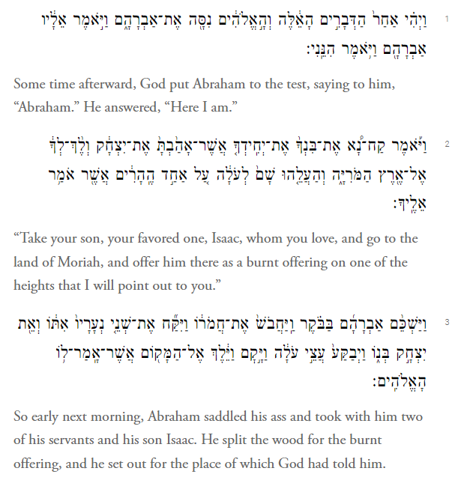
The Text:
Genesis 22:1-3
Key words and phrases
22:1 “Tested” (Nasa)
22:1 “Here I am” (Hineni)
22:2 “Take” (Lech-lecha!); cf. Genesis 12:1 (the call of Abraham, same exact words)
22:2 “your son, your favored one, Isaac, whom you love” (HB)
22:2 τὸν υἱόν σου τὸν ἀγαπητόν Genesis 22:2 (LXX) ; see Luke 20:13, τὸν υἱόν μου τὸν ἀγαπητόν; Luke 20:13, Nestle Aland Greek NT, 28th edition) ~ “your son, the beloved”
Notes:
The introduction, “After these things God tested Abraham,” is of great moment, both from a dramatic and a theological perspective. It serves to cushion the listener from the full impact of the horrific command to Abraham, and it diverts attention from the question whether Isaac will be sacrificed to whether Abraham will stand up to the test. “After these things” suggests that some time has elapsed between this trial of Abraham and the events recorded in chap. 21 (cf. 21:34, “Abraham dwelt … many days”). It may well be that Isaac is now to be envisaged as at least a teenager, just as Ishmael was when expelled from Abraham’s household; in both narratives they are called “lads” (נער; cf. 22:12; 21:12).
Tested” ( נסה). “ “Testing” shows what someone is really like, and it generally involves difficulty or hardship. The queen of Sheba tested Solomon with riddles p 104 (1 Kgs 10:1); Daniel and his companions were tested by being put on a simple diet (Dan 1:12, 14). God is often said to test Israel through hunger and thirst in the wilderness (Exod 15:25; 16:4; 20:20; Deut 8:2, 16), through false prophets (Deut 13:4 [3]), or through foreign oppression (Judg 2:22; 3:1, 14). The purpose of such trials is to discover “what was in your heart, whether you would keep his commandments or not” (Deut 8:2; cf. Exod 16:4), “to humble you … to do you good in the end” (Deut 8:16; cf. Heb 12:5–11). The use of the term here hints that Abraham will face some great difficulty but that he will ultimately benefit from it. This is the only time God is said to have tested an individual, but pace Westermann, this is no proof of the lateness of this text. Early non-religious usage (e.g., 1 Kgs 10:1) certainly covers individuals.
Gordon J. Wenham, Genesis 16–50, vol. 2, Word Biblical Commentary (Dallas: Word, Incorporated, 1994), 103–104.Perhaps a few words are in order here about Jewish commentary on texts, we have first the Mishnah (compiled in the 2nd century AD) and the Gemara.
The Mishnah or the Mishna (/ˈmɪʃnə/; Hebrew: מִשְׁנָה, " study by repetition", from the verb shanah שנה‎, or "to study and review", also "secondary")] is the first major written collection of the Jewish oral traditions which is known as the Oral Torah. It is also the first major work of rabbinic literature.
According to Rabbinic Judaism, the Oral Torah (Hebrew: תורה שבעל-פה) ) was given to Moses with the Torah at Mount Sinai or Mount Horeb as an exposition to the latter. The accumulated traditions of the Oral Law, expounded by scholars in each generation from Moses onward, is considered as the necessary basis for the interpretation, and often for the reading, of the Written Law. Some conservative Jews do not recognize the oral Torah as binding.
In the three centuries following the redaction of the Mishnah, rabbis in Palestine and Babylonia analyzed, debated, and discussed that work. These discussions form the Gemara. The Gemara mainly focuses on elucidating and elaborating the opinions of the roughly 120 authors of the Mishnah, called the Tannaim.
The Gemara expanded on Genesis 22:2, explaining that it reports only one side of a dialog. Rashi, the great medieval Jewish commentator, has both sides of the dialogue that Abraham was imagined to have said. God told Abraham, “take your son,” but Abraham replied, “I have two sons!” God said, “Your only one,” but Abraham replied, “Each is the only one of his mother!” God said, “Whom you love,” but Abraham replied, “I love them both!” Then God said, “Isaac!” The Gemara explained that God employed all this circumlocution in Genesis 22:2 so that Abraham's mind should not reel under the sudden shock of God's command. (Babylonian Talmud Sanhedrin 89b.)
Several features of the narrative serve to keep the reader’s attention focused directly on the inward struggle of Abraham as he carried out the Lord’s request—all, we might add, without any mention of the actual thoughts of Abraham’s mind. First, there is the abruptness of the Lord’s request within the narrative. Apart from the remark in v.1 that the narrative represented a test of Abraham, the reader is given no advanced warning of the nature of the request nor of its severity. Nothing in the preceding narratives would have hinted at this sort of request. The reader, in other words, is as surprised and shocked by the Lord’s request as Abraham himself would have been. Second, the reader is given no further explanation of the request. The whole of the request is made up of three simple imperatives (v.2): “Take” (qaḥ-nāʾ), “go” (weleḵ), and “sacrifice him” (wehaʿa lēhû). Furthermore, the reader is given no reason to believe that Abraham himself had any further explanation.

Slide 26
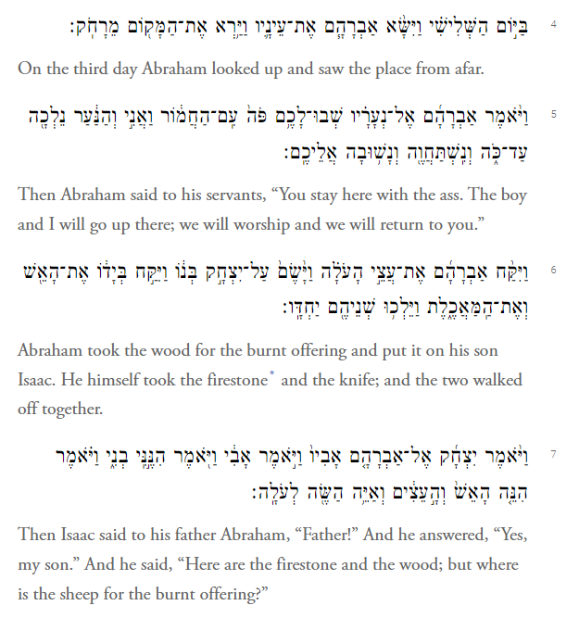
The Text:
Genesis 22:4-7
Scene 3: Dialogue at the foot of the Mountain
V. 5 “You stay here” to the servants
“We will worship and we will return to you”: meaning?
Unloading from the donkey to Isaac (how old is he here?)
Notes:
v. 4 “On the third day.” Three days is a typical period of preparation for something important (cf. 31:22; 40:20; 42:18). Westermann notes that the mountain of God to which the Israelites sought to travel was three days’ journey (Exod 3:18; 5:3). Indeed, the phrase “on the third day” occurs twice in the Sinai pericope (Exod 19:11 [2x], 16).
“He looked up and saw.” To “look up” before seeing usually intimates that what is to be seen is of great significance (cf. 18:2; 24:63; 33:1, 5; 43:29), in this case “the place.” “From afar”; cf. 37:18 and especially Exod 20:18, 21; 24:1, where Israelites stand or worship “from afar” before Mount Sinai. “We are left to imagine the pang that shot through the father’s heart when he caught sight of it” (Skinner, 329).
5 Abraham’s first words since setting out are perplexing. Why does he not want his servants to accompany him? Is the way too rough for the donkey? Did he not want the lads to see the sacrifice? Did he fear they might interfere? Was a donkey too unclean to take to a sanctuary? Had God simply told him to leave them? All these possibilities are open and remain unresolved. The parallel with the Mount Sinai experience may again be noted: at Sinai only Moses was allowed to come to the top of the mountain; the people had to stay at the bottom (Exod 19:20, 24; 24:1–2).
There are at least three ways of taking “we may return to you.” First, it could be a white lie to disguise the true nature of the sacrifice. It is clear from Isaac’s question in v 7 that Abraham has not been very explicit about the nature of the sacrifice he is undertaking. Evidently he must have said he was going to offer a burnt offering at God’s special request but never said who the victim would be. So one could suppose that here he is simply continuing to allow his entourage to continue under the illusion that he intended to make a normal animal sacrifice, albeit at a special site. Second, it could be read as implying that he does not intend to sacrifice Isaac after all, that he cannot see himself going through with it, and that he will disobey God’s command. Third, it may be read as an affirmation of faith, that although he has been told to sacrifice Isaac, yet somehow the promises made to him that “your descendants will be named through Isaac” would be fulfilled.

Slide 27
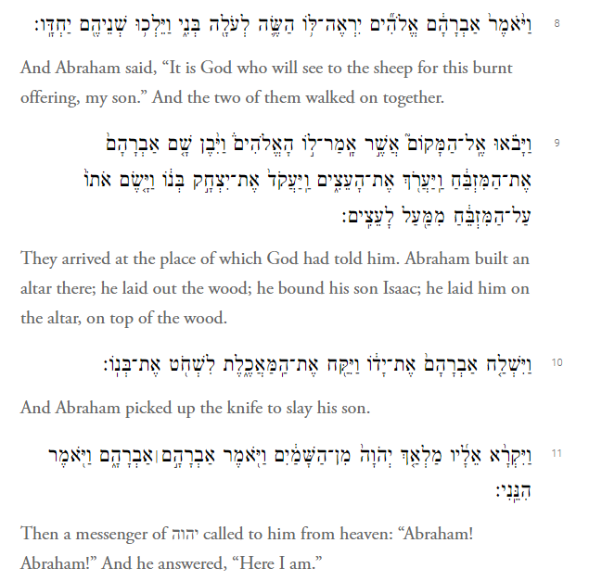
The Text:
Genesis 22:8-11
Scene 4: Dialogue between Abraham and Isaac climbing the mountain.
Does Isaac ever realize what is going to happen?
V. 9–10 Scene 5: After four short preparatory scenes, the narrative pace suddenly slows for the climactic scenes on the mountaintop
V.11: Abraham! Abraham! (imperative). Hineni again (like v. 1)
Notes:
V6-8 This most touching scene reveals a little of the feelings of Abraham and Isaac on their way. “The pathos of the dialogue is inimitable: the artless curiosity of the child, the irrepressible affection of the father, and the stern ambiguity of his reply can hardly be read without tears” (Skinner, 329–30). But it is also a gem of OT literary art. Note how the scene is framed by “So they went both of them together” (vv 6, 8), suggesting both their isolation and their companionship as they climb alone up the mountainside.
Furthermore, this remark “lets one suspect that the boy may have broken the oppressive silence only after a while. And after the conversation the statement is repeated. One sees that the final part of the way was traversed in silence” (von Rad, 236), “the most poignant and eloquent silence in all literature” (Speiser, 165).
On the face of it, Isaac’s question, “Where is the sheep?” suggests a naiveté that makes his future death the more heart-rending. This impression is reinforced by his docile acceptance of Abraham’s reply, which shows Isaac trusting entirely his father’s good intentions. Or was he sharp enough to see through his father’s enigmatic answer and realize that he was the intended sacrificial lamb? If so, his silence is again impressive, for it implies his total obedience to his father. Either way, Isaac is shown to have those qualities of perfection always looked for in sacrificial victims (cf. Lev 1:3). And either way, our appreciation of the trustful love that existed between father and son is enhanced.
So much is unsaid, and we still wonder how old Isaac really is. Is he as the texts infers after being born, a full 27 years old? If so, the question he asks in v. 7 is probably one that needs no answers.
Imagine this thought: Isaac knows however. His eyes have clouded, crouched backward darkly. The sheep is me. He had finally hoped it might be one of the servants, till they left the slaves behind. The man knows the boy knows, thinks he’ll surrender. He has not even posted the slaves as guards to make sure he can be tied up and offered.
The boy is going to run. About-face and run for your life. The way is just behind him, a quick trail down. He will, and will escape. He is seeing, this instant, that his father offers it—his only chance—that is father is too old to hold even him, that his father has worn too many clothes. He could make it if he left right now.
10 “Reached out his hand.” Reaching out the hand often indicates that the next act is of great moment (cf. 3:22; Exod 3:20; 9:15; Deut 25:11). For the second time “the knife” is mentioned to emphasize the horror of the action. “Slaughter” (שׁחט) is a sacrificial term (Lev 1:5, 11) usually indicating cutting the p 110 throat. “His son.” By drawing attention to the relationship of Abraham and Isaac, the full awfulness of the deed is once again underlined. The unthinkable is about to happen.
Gordon J. Wenham, Genesis 16–50, vol. 2, Word Biblical Commentary (Dallas: Word, Incorporated, 1994), 109–110.

Slide 28
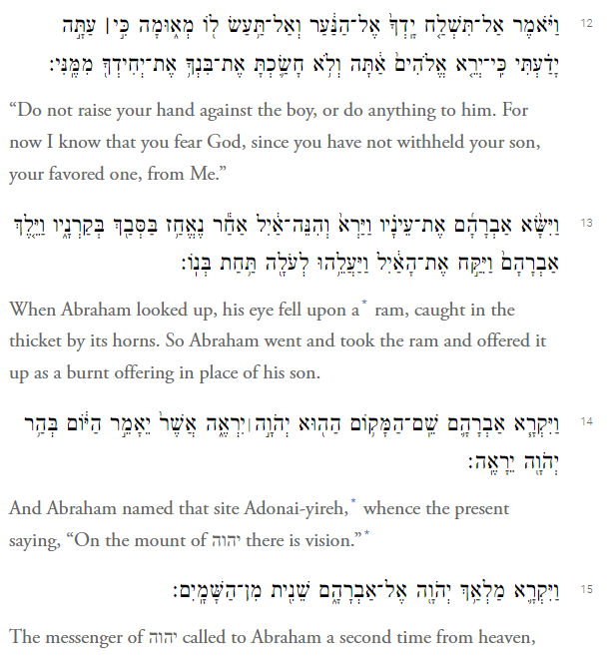
The Text:
Genesis 22:12-15
V. 12: Do not lay, do not do anything
“Now I know”
Abraham’s eyes fell upon a ram
Notes:
The parallelism, “Do not lay … Do not do anything,” gives the prohibition a quasi-poetic flavor and emphasizes both its pressing nature and its joy.
“Now I know”; cf. 18:21, where likewise the mention of God knowing is used more in the sense of confirming his knowledge.
To “fear God” or “the LORD” is a very common expression in the OT and means to honor God in worship and in an upright life. Thus Abraham was worried about the behavior of the people of Gerar because he thought they had no fear of God (20:11), while Joseph tries to reassure his brothers that he will treat them fairly because he fears God (42:18). Perhaps the best parallel to this passage is Job 1:1, 8; 2:3, in which Job is described as “blameless and upright, one who feared God, and turned away from evil.” Like Abraham, he also underwent a mysterious test of his loyalty to God.
13 Note how the narrative says nothing about Abraham’s reply or Isaac’s release. Abraham’s obedience proved, the story moves straight on to the substitute offering.
This time, as Abraham looks up, he sees not the fateful mountain (cf. v 4) but “a ram just caught in a thicket.” The narrative emphasizes what Abraham saw; no sooner had the angel spoken than he looked and noticed the ram being caught. His subsequent action invites comparison with Noah. As soon as Noah left the ark, he offered sacrifice. Similarly, as soon as Abraham had unbound his son, he offered a sacrifice instead of his son. In both instances, the motives of the sacrifice are implied rather than explained.

Slide 29
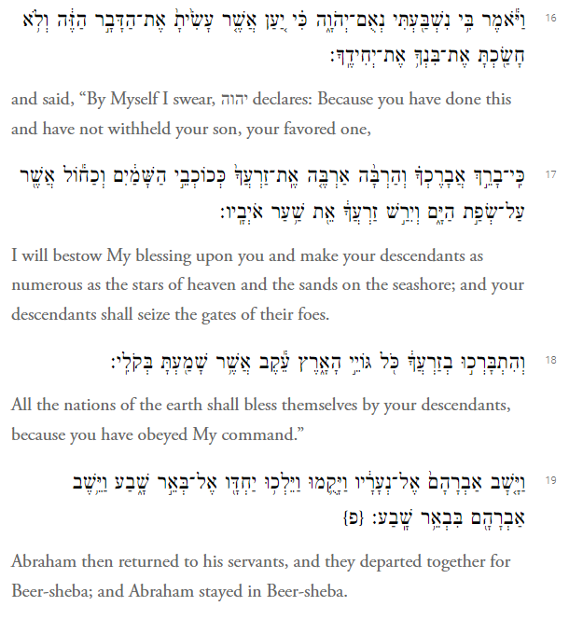
The Text:
Genesis 22:16-19
V. 16 “By myself I swear”
V.18 “All the nations will find blessing”
Notes:
16 “By myself I swear.” This is the first and only divine oath in the patriarchal stories, though it is frequently harked back to (24:7; 26:3; 50:24; Exod 13:5; often in Deuteronomy). Note the preceding “by myself,” which gives the oath a special solemnity and weight (Jer 22:5; 49:13; Amos 4:2; 6:8; Heb 6:13–18).
“It is because” (יען אשׁר, only here in Genesis) draws special attention to the cause of God’s renewed promise, “you have … your only child,” here repeating v 12 (cf. v 2). The meritoriousness of Abraham is reaffirmed by the final clause, “because you have obeyed me.”
17 “I shall really bless you.” The name Abraham is regularly associated with blessing (12:2–3; 14:19; 17:16, 20; 24:1, 35), but this is the only time in Genesis that the I
infinitive absolute of ברך “really” is used to reinforce the verb, so making the contents of this promise surpass all others.
18 “All the nations will find blessing.” Here the hithpael of ברך is used instead of the niphal as in 12:3; 18:18. There may be no difference in meaning (see Comment on 12:3), or it may be combining the remark in 12:2, “you shall be a blessing,” i.e., people will say “May God bless me like he has blessed Abraham,” with 12:3, “All the families … will find blessing in him.” Here there is another change to the earlier formulation: “in your descendants” instead of “in you.” This implies that the world has already been blessed through Abraham, yet more blessing is to come through his descendants. And all “because you have obeyed me.”
Gordon J. Wenham, Genesis 16–50, vol. 2, Word Biblical Commentary (Dallas: Word, Incorporated, 1994), 112.

Slide 30
The Sacred Text: Genesis 22
Reading through the Hebrew Text
Key Words
Overall Literary Structure
The Power of Less (Auerbach, Kierkegaard, Alter)
Notes:
No other story in Genesis, indeed in the whole OT, can match the sacrifice of Isaac for its haunting beauty or its theological depth. So much is packed into so p 113 few words that our lengthy comments have not done it justice. Here we cannot explore again all the intricacies of this narrative. Rather, I shall simply keep to the main track and indicate how it has continued to inspire reflection by Christians and Jews down to the present day.
The opening “after these things” puts the story into context. It harks back to the momentous developments in chap. 21, when at long last against all human odds the promised Isaac was born. This joyful event was soon followed by one of the most bitter experiences in Abraham’s life. Bowing to his wife’s will endorsed by God, Abraham had to expel his firstborn son Ishmael. Wandering in the wilderness, Ishmael and his mother had nearly died, but in the nick of time the angel pointed them to a well that saved them from dying of thirst. Meanwhile, Abraham and Isaac had prospered, so much so that earlier inhabitants of the land made a treaty with Abraham guaranteeing him and his descendants water rights in perpetuity.
Against this background of success, the opening comment “God tested Abraham” warns the reader that the coming narrative will strain Abraham’s faith and obedience to the uttermost in order to reveal his deepest emotional attachment. Is he willing to love God with all his heart, mind, and soul? Does he trust and obey simply because it pays him to do so: in the words of the Satan of Job, “Does Job fear God for nought? Hast thou not put a hedge about him …? Thou hast blessed the work of his hands, and his possessions have increased in the land” (Job 1:9–10).
But like Job, Abraham was unaware that his trial was a test; for him it was totally real. Though the comment “God tested Abraham” alters the reader’s view of what follows, it must not obscure the awful situation Abraham found himself confronted with—torn between his faith in the divine promises and the command that promised to nullify them, between his affection for his only surviving son and heir and his love for God.
God’s command is introduced with unusual gentleness, “Please take,” and fully acknowledges Abraham’s paternal devotion to his son, “your son, your only child, whom you love,” and the hopes he had placed in him, for his very name Isaac was a reminder that he was the child in whom and through whom the oft-repeated promises of land, nationhood, and blessing would be fulfilled. By beginning in this vein, God endorses the propriety of Abraham’s love for Isaac and his faith in the promises; at the same time it reminds us of the costliness of the command about to be given.
“Go by yourself … which I shall tell you.” The gentle tone with which God began is suddenly replaced by an uncompromisingly stern command couched in terms that closely echo 12:1: “Go by yourself from your country … your father’s house to the country that I shall show you.” But hard as that command was, it was easy to carry out compared with “offer him there as a burnt offering.” On that occasion, the order to break with the past was at least sweetened by promises of a glowing future, of a new land, numerous descendants, and blessing to all nations. Here the command has no such incentives attached to it; indeed, to carry it out would seem to vitiate any chance of these oft-repeated promises ever being fulfilled. The only glimmer of hope in the command is the name of the mountain, Moriah, which Abraham will later discover means “the LORD will provide, or appear,” but when he is told to go there, this is completely obscure to him.
p 114 But without delay, “early in the morning,” Abraham straightway saddles his donkey and calls two of his servant lads and Isaac to leave. Then when they are ready to go, he suddenly goes to cut the wood for the sacrifice—not the most sensible order of proceeding. Can he not think clearly, or was he trying to hide the nature of his journey until the last possible moment to avoid awkward questions from those left behind, such as Sarah? Or is cutting wood the most painful part of the preparations, which he must leave until the last possible moment? His motives are left unexplained; the narrator gives just a hint about how Abraham felt and then reminds us of the main point, his obedience: “He set out and went to the place which God had told him about.”
This last comment shows that God has told Abraham more than is recorded here. This is confirmed by what follows: “On the third day Abraham looked up and saw the place in the distance.” Evidently he knew what to look out for and what to do when he reached its foot, even though the divine instructions are not recorded. The narrator’s terse economy of style, cutting out all unnecessary repetition, matches the single-mindedness of Abraham, whose overriding objective is to do the will of God. But the narrator again hints at his feelings: Abraham did not just see the mountain; he “looked up and saw the place in the distance.” Looking up prior to seeing indicates that the thing seen is of special importance. Abraham sees the place “in the distance,” reminding us that his agony was long and drawn out.
The last stage of the journey is also to be the hardest and the loneliest. For the final climb to the mountaintop, Abraham and Isaac must go on alone, Isaac now carrying the wood on his back which hitherto the donkey had carried. As Abraham had tried to avoid telling the rest of his household back in Beersheba, he now avoids giving a full explanation to the two most trusted servants who had accompanied him thus far. He simply but enigmatically states, “Stay by yourselves … so that we can worship and return.”
In the light of the command to sacrifice Isaac, it is odd that he says “We shall return.” Is this economy with the truth a smokescreen hiding the true plan from the servants and Isaac? Is Abraham perhaps having second thoughts about sacrificing his son? Or does he hope that somehow Isaac will return as a result of divine intervention? His remark leaves us to speculate, and the narrator does nothing to stop us, for in times of crisis wildly incompatible thoughts are liable to succeed each other in quick succession.
But whatever his innermost feelings, Abraham presses on up the mountain alone with his son Isaac in silence. He may have succeeded in concealing the real purpose of the journey from his household and from his servants up to this point, but now Isaac breaks the silence with a question that pierces to the heart of the situation, “My father … where is the sheep for the burnt offering?” Its innocent naiveté makes it the more poignant. How can Abraham avoid saying the unspeakable truth? His reply may be construed as a masterpiece of pious evasion, “God will provide himself a sheep for the burnt offering, my son,” as an affirmation of faith, as a prophecy, or as a prayer, “May God provide.…” It cannot be construed that he is planning to back out, as “we shall return” might have suggested. If Abraham was tempted to disobey, he has now put such thoughts behind him. This remark, “God will provide,” is a turning point in the narrative p 115 (see Form/Structure/Setting), so it seems meant to be understood as a statement of faith, as prophecy, or as prayer.
To Isaac it must have sounded like evasion, but he said nothing and went on up the mountain. “The two of them went together.” We are forced to conclude that he was naive and totally trusted his father, or that he now realized what was planned, yet he continued on up the mountain with his father. Either way he was a perfect, blameless sacrificial victim.
Finally they reach the top, “the place which God had told them about.” Lest in the horror of the final scene we forget why Abraham is doing this, the narrator reminds us: he was obeying God. There an altar has to be built, and the wood must be laid on the altar. This was a real sacrifice according to proper ritual procedures, and there was plenty of time for Isaac to realize, if he had not before, what was going to happen and to run away. But he did not. In fact, he allowed himself to be bound before Abraham cut his throat. This action above anything else indicates his consent. The OT nowhere speaks of sacrificial animals having their legs bound before slaughter, and if Isaac had been reluctant to be sacrificed, it would have been easier for Abraham to have cut his throat or stabbed him rather than tie him up first and then place him on the altar. But he was tied, indicating his own willing submission to God’s command revealed to his father.
Then at the very last minute with Abraham’s hand poised to cut Isaac’s throat, the angel of the LORD yells from heaven, “Abraham, Abraham … do not lay your hand on the lad.” He has passed the test—“Now I know that you fear God”—he has put obeying God above every other consideration, and that, as Proverbs says, is the beginning of wisdom (Prov 1:7). Like Job, he has shown himself to be a man who was “blameless and upright, one who feared God, and turned away from evil” (Job 1:1; cf. Gen 17:1).
But divine endorsement of Abraham’s piety is by no means the end of the story. Before the ordeal, the reader has been told that it was but a test, which led us to anticipate Abraham’s success in facing it. And Abraham makes no comment himself. Was he just relieved, or had he believed all along that God would somehow rescue Isaac? Or had he no time to say anything?
As often, we are left to speculate. But if the angelic command did not surprise Abraham, the sudden snagging of a ram in the thicket did. He looks on its capture as God’s perfectly timed provision. His ambiguous “God will provide a sheep” (v 8) has been fulfilled more completely and exactly than he had anticipated. Now he knows why the mountain is called Moriah: it means “the LORD will provide,” or as others have said, “In the mountain of the LORD he may be seen.” He has discovered that God draws near those in deepest distress.
But the angel calls again. God’s opening injunction quoted his very first command: “Go by yourself to the country … that I shall show you” (12:1). Then the LORD had first made the promises of descendants, covenant, and blessing to the nations. But up to this point in Abraham’s trial, nothing has been said on these topics. So the angel now, for the last time in Abraham’s career, reiterates them with more force than ever before.
For the first and last time in Genesis, the LORD swears an oath in his own name guaranteeing what he is about to say, a guarantee reinforced by the formula “declares the LORD.” From now on, the LORD promises that he will not simply bless Abraham but really bless him. His descendants will be so numerous that they will be compared not just to the stars but to the sand on the seashore. And they will not merely inherit the land; they will conquer it, “possessing the gate of your enemies.” But more than that, Abraham’s descendants, as well as Abraham himself, will be a source of blessing to “all the nations of the world.” And all this will happen, “because you have done this thing and have not withheld your son, your only child.” “Because you have obeyed me,” all the promises first made to Abraham decades earlier are now augmented and guaranteed by the LORD unreservedly. In this way, Abraham’s long pilgrimage of faith, which has not been without its lapses from true piety, is brought to a triumphant conclusion. God’s test had put Abraham on the rack. Yet torn between his love for his son and his devotion to God, he had emerged victorious with his son intact and his faithful obedience rewarded beyond all expectation.

Slide 31
Genesis 22:1 הִנֵּֽנִי Hineni: Here I Am, Ready”
Definition: demonstrative participle. lo! behold! — lo! behold! a. pointing to persons or things. b. introducing clauses involving prediction: (a) with ref. to the past or present, it points generally to some truth either newly asserted, or newly recognized. When the proposal is to be of the nature of an entreaty or request, הִנֵּה־נָא is often used, instead of the simple הִנֵּה. (b) with ref. to the future. here it serves to introduce a solemn or important declaration; and is used esp. with the ptcp. in predictions or threats.
E.A. Speiser’s translation in his commentary (Anchor Bible Commentary) on Genesis has simply one word—”Ready.” It has a military flavor, as a soldier reporting to a military leader.

Slide 32
Questions and Interpretations
Abraham is commanded to sacrifice his only beloved son.
Isaac is not a young child but a na’ar, a young man. The servants with Abraham’s party are also called by the same term.
Genesis makes quite clear that God never actually intends for Isaac to be put to death. This is only a test.
Finally, it is important not to overlook the significance of the fact that Isaac is sacrificed, not just anywhere, but on one of the mountains of Moriah (Gen 22:2–4).
Notes:
First, Abraham is commanded to sacrifice his only beloved son. Three times in Genesis 22 Isaac is called the “one and only” son of Abraham (Hebrew yahid ) and identified as the “son . . . whom you love” (Gen 22:2). The rare Hebrew term yahid literally means “unique, singular”, but was translated “beloved” (Greek agapētos) in the Septuagint. Later on in the New Testament, Jesus Christ will be identified with two similar terms: he is the “only-begotten” (Greek monogenēs) son of God ( Jn 3:16), the “beloved [Greek agapētos] Son” with whom God is well-pleased (Mt 3:17).
For one thing, the same Hebrew term is used for Isaac and for Abraham’s servants: he is a “young man” (Hebrew na’ar) (see Gen 22:3). Even more telling, Isaac carries sufficient wood up the mountain to burn up the body of a sacrificial animal. Such a heavy load would be impossible for a child to carry and much heavier than that of his father, who has only the fire and the knife. Already in antiquity Jewish interpreters deduced from these narrative clues that Isaac was no longer a child but a young man, stronger than his elderly father.2 As a young man, then, as soon as he realized what his father was about to do, he could have overpowered the frail Abraham. However, Isaac voices no objection and makes no effort to resist; hence, although he is not killed, he does willingly offer himself in sacrifice. It is a death Isaac freely accepts (thus justifying the expression, “sacrifice” of Isaac, even though he lives).
Third, Genesis makes quite clear that God never actually intends for Isaac to be put to death. Instead, the entire drama is meant to test the faith of Abraham. For example, God’s opening command to Abraham to “Go . . . to a mountain I will tell you” reuses Hebrew words of his earlier call: “Go . . . to a land I will show you” (Gen 22:1; 12:1 [author’s trans.]). In this way, the Hebrew text signals that the sacrifice of Isaac is a kind of microcosm of Abraham’s entire faith journey begun in his call from Ur of the Chaldeans. In contrast to the moments of doubt and hesitation in the intervening years, when the test of sacrificing Isaac comes, Abraham obeys without question, as at the beginning of his journey. In Genesis 12, he undertook a journey that parted him from the family of his past; here in Genesis 22, he undertakes a journey that will part him from his family of the future, his descendants through Isaac. Abraham journeys three days to the land of Moriah, then climbs a mountain there with Isaac, but is stopped by the angel of God from killing Isaac at the very last moment. Because Abraham passes the test of faith, God elevates the final promise of universal blessing to the level of a covenant.
4. In the Hebrew Scriptures, this will later be identified as the site upon which King Solomon would build the Temple in Jerusalem: “Then Solomon began to build the house of the Lord in Jerusalem on Mount Moriah “(2 Chron 3:1). The reason this cultic and geographical connection with the Temple is important is because in the Genesis account itself, there is an explicit emphasis on the significance of the mountain where Isaac is sacrificed as the place of future covenant blessing. Indeed, in the wake of the binding of his only beloved son, Abraham gives the locale a prophetic name: So Abraham called the name of that place The Lord will provide [Hebrew YHWH yireh]; as it is said to this day, “On the mount of the Lord it shall be provided.” (Gen 22:14) As the Hebrew Scriptures will later make clear, the “mount of the Lord” here is the Jerusalem Temple mount; there is a wordplay on “Jerusalem” (Hebrew yiru-shalem) and the Hebrew word for “see to it” or “provide” (yireh) (compare Ps 76:1–2). In some streams of later Jewish tradition, the animal sacrifices offered at the Jerusalem Temple were regarded as memorials or re-presentations of the sacrifice of Isaac, the rationale being that the blood of bulls and goats was not effective in itself but symbolized the truly meritorious self-offering of the forefather of the entire nation.

Slide 33
10 Minute Break
Refreshments Available!

Slide 34
Religious and Artistic Insights on the Akedah
The Akedah in Religious Art
  Christian
  Jewish
  Islamic
The Power of Language: Anglo-Saxon Translation (later!)
The Power of Poetry and Music: You Want It Darker (Leonard Cohen) Hineni

Slide 35
The Sacrifice of Isaac in Early Christian Art
The Sacrifice of Isaac was a very popular subject for early Christian art as illustrated by the church father, Gregory of Nyssa: “ I have seen many times the likeness of this suffering in painting and not without tears have I come upon this sight, when art clearly led the story before the sight.” (Gregory of Nyssa, On the Son of God and the Holy Spirit , (Patrologiae Graecae (PG) 46.573).
St Augustine also said, “The deed is so famous that it recurs to the mind of itself without any study or reflection, and is in fact repeated by so many tongues, and portrayed in so many places, that no-one can pretend to shut his eyes or his ears from it.” (Augustine, Reply to Faustus the Manichaen 22.73.)
Notes:
Scholars now accept that in ancient times the artist played a significant role in portraying the biblical story. The Targum Pseudo-Jonathan mentions that figurative art in synagogues was approved as long as it was used not for idolatrous purposes but only for decoration: “You shall not set up a figured stone in your land, to bow down to it, but a mosaic pavement of designs and forms you may set in the floor of your places of worship, so long as you do not do obeisance to it.” Figurative art was also a significant part of everyday life in the early Church. Like the rabbis, the church fathers were concerned about the idolatrous nature of art in places of worship but they were not as hostile to art as was originally assumed. For example, Church Historian Tertullian, like RabbI Gamaliel II states that figurative representation was not forbidden because it was not idolatrous. This probably informs what became a controversy over statues later in the church.

Slide 36
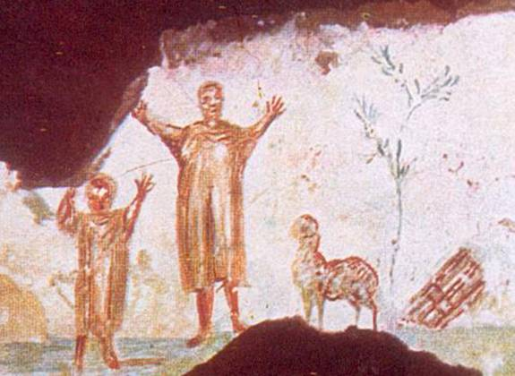
The Sacrifice of Isaac in Early Christian Art
In the third century CE Callixtus catacomb in Rome, Abraham and the child Isaac are offering thanks for their deliverance. In the foreground, to their right stands the ram, erect and proud.

Slide 37
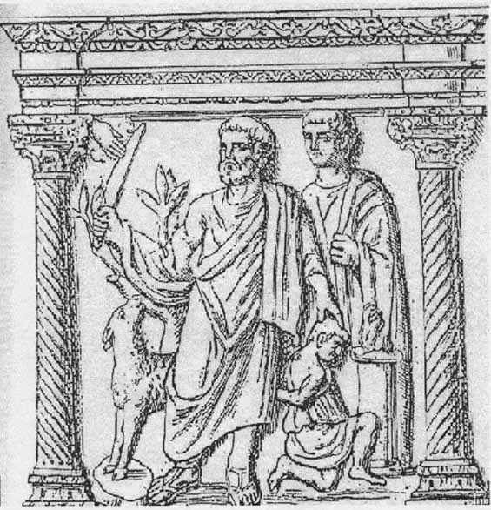
The Akedah in Christian Sarcophagi
The Mas d’Aire Sarcophagus from the third century is the earliest. It shows the child Isaac, bound and kneeling. Abraham grasps his hair from behind and raises the knife to strike. Abraham’s eyes are not on Isaac but the ram, which is standing at his side (almost nuzzling him). The ram appears eager to be sacrificed.
Notes:
The Mas d’Aire Sarcophagus from the third century is the earliest. It shows the child Isaac, bound and kneeling. Abraham grasps his hair from behind and raises the knife to strike. Abraham’s eyes are not on Isaac but the ram, which is standing at his side (almost nuzzling him). The ram appears eager to be sacrificed.
The two sixth-century Byzantine mosaics from 6th century Ravenna both associate the Sacrifice of Isaac with the offerings of Abel and Melchizedek, which are linked to the liturgy of the Eucharist. For example, in San Vitale we find a portrayal of the mosaics of Cain and Melchizedek sharing a church altar near which are placed the bread and wine. Nearby appear the three angels announcing the promise of a son while Abraham offers them a calf and Sarah stands in the doorway of a tent. To the right is a representation of the Sacrifice of Isaac.
Isaac is kneeling on the altar and Abraham’s sword is raised but the hand of God prevents the sacrifice. At Abraham’s feet is the ram looking at Abraham, striking a christological pose. These mosaics flank the real church altar where the Eucharist was celebrated. The biblical figures are linked by the following prayer:
Be pleased to look upon these offerings with a gracious and favourable countenance, accept them even as you were pleased to accept the offerings of your just servant Abel, the sacrifice of Abraham, our patriarch and that of Melchizedek, your high priest – a holy sacrifice, a spotless victim. In early Christian liturgy, the Sacrifice of Isaac is mentioned during the offertory prayers, associated with epiclesis (a petition for the descent of the Holy Spirit upon the bread and wine), alongside Abel, Noah, Moses and Aaron, and Samuel.
Thus in early Christian art, artistic interpretations of the Sacrifice of Isaac illustrate deliverance (sometimes referring to the Eucharist). Images are found in funereal art because the story was understood in relation to death and resurrection. The ram is significant in artistic interpretation, not because of any christological significance, but because of its allusion to deliverance. Finally, it is worth noting that typology is rarely found in artistic interpretation during this period, and when it is found it is associated with liturgy, not literature.

Slide 38
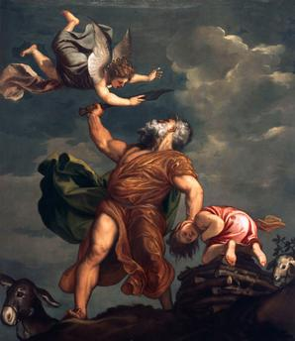
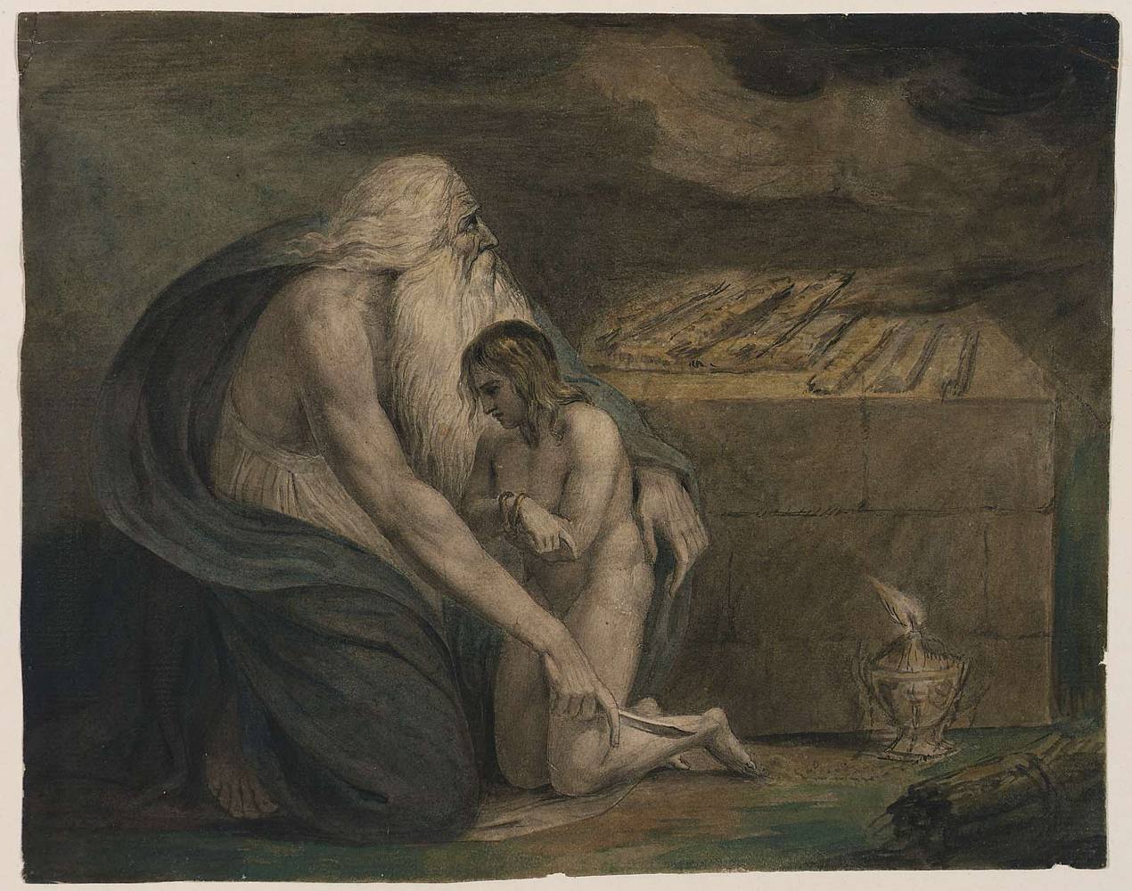
Images of the Akedah in Later Christian Art
“Abraham sacrifices Isaac” (c.1542/43). Titian, real name Tiziano Vecelli c. 1476-1576.
William Blake (28 November 1757 – 12 August 1827) was an English poet, painter, and printmaker. 1783

Slide 39
The Sacrifice of Isaac in Early Jewish Art
The Sacrifice of Isaac was a very popular subject for early Christian art as illustrated by the church father, Gregory of Nyssa: “ I have seen many times the likeness of this suffering in painting and not without tears have I come upon this sight, when art clearly led the story before the sight.” (Gregory of Nyssa, On the Son of God and the Holy Spirit , (Patrologiae Graecae (PG) 46.573).
St Augustine also said, “The deed is so famous that it recurs to the mind of itself without any study or reflection, and is in fact repeated by so many tongues, and portrayed in so many places, that no-one can pretend to shut his eyes or his ears from it.” (Augustine, Reply to Faustus the Manichean 22.73.)

Slide 40
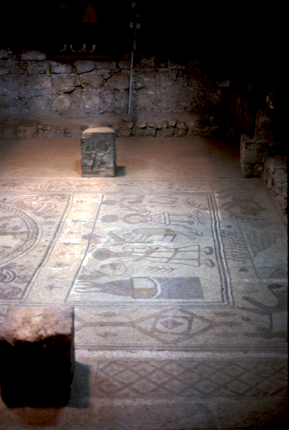
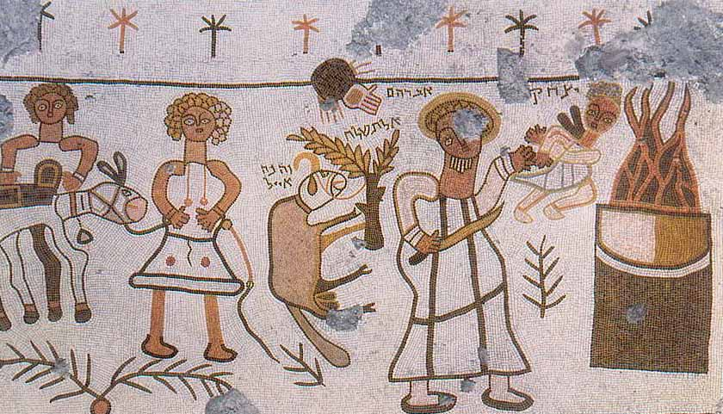
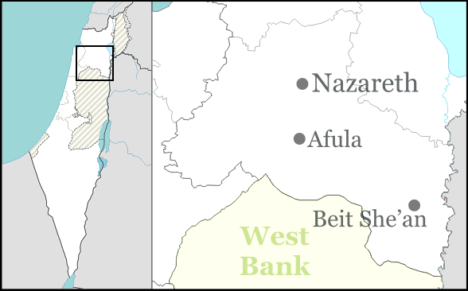
In the 6th century synagogue at Beit Alpha, Abraham throws Isaac into the fire on the altar while the hand of God prevents the sacrifice. A large ram, which is tied to a tree stands erect. The ram, following the biblical story, is caught by one horn and tied to a tree.
Notes:
The ram is significant to the artist because it is even bigger than the tree! The fact that early Jewish literary tradition, except in a few instances, does not refer to the role of ram, is especially noteworthy when we see that later rabbinic writings such as Pirkei de Rabbi Eliezer of the eighth century discuss the ram in detail. This development might be viewed as having been influenced by artistic interpretations such as depictions of the ram looking for Abraham. Since this literary development occurred much later than the artistic representations, we could justly argue that the literary interpretation is based upon the artistic.
As we look at the mosaic, above is the hand of God and perhaps the most remarkable figure is the child Isaac, floating beyond Abraham’s fingertips. Does Abraham hold him close, or at arm’s length in preparation for the loss? Isaac is suspended and his arms are crossed but not bound, swinging precariously between the flames of the sacrifice and his obedient father. The trial is still Abraham’s – but not unequivocally for we focus on the helpless, dangling figure of the son.
The ambiguity of the mosaic raises the question of Isaac’s willingness. It is well known that the rabbis emphasised Isaac’s voluntary obedience by describing his maturity and giving his age as 37 years. The artistic portrayal of Isaac as a child suggests that he has little active role in the sacrifice. It is even possible to view him as a reluctant participant. Once again, we can see that artistic interpretation possesses its own emphasis, significantly different from the literary interpretation.

Slide 41
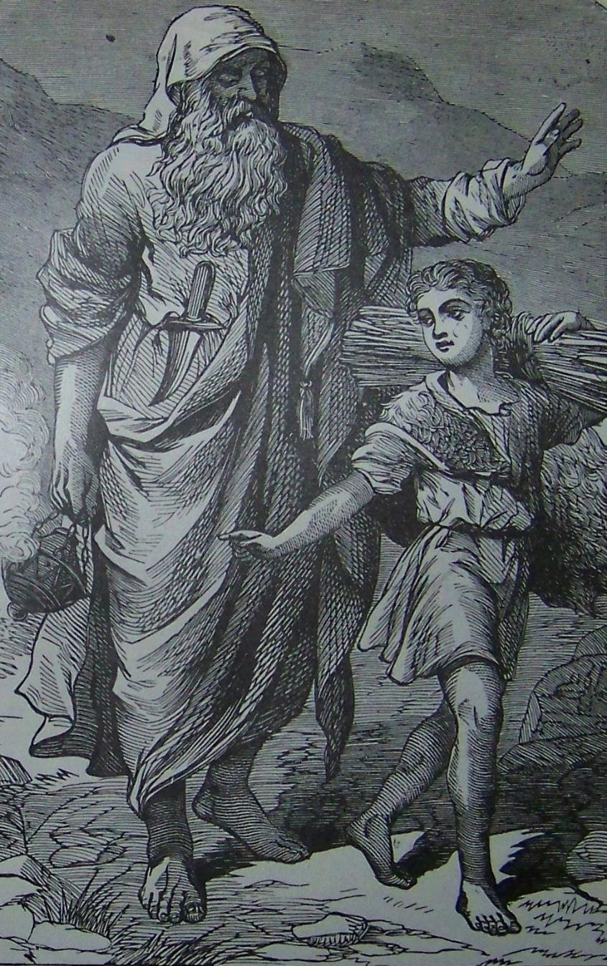
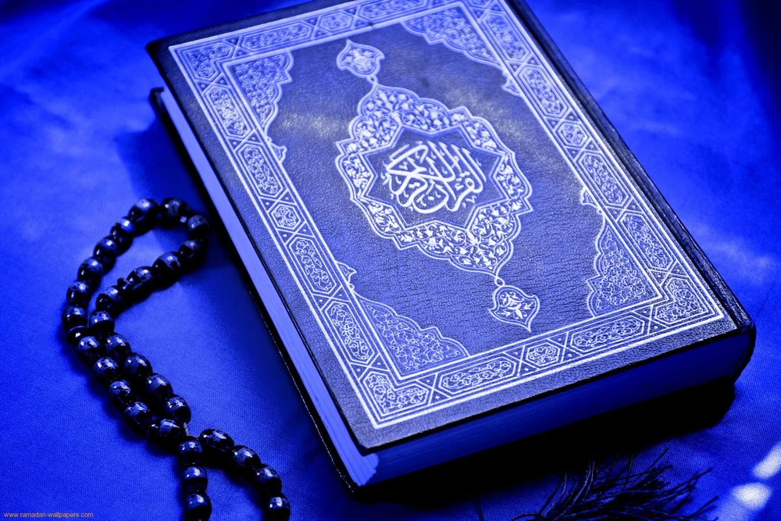
Islamic Artistic Rendering

Slide 42
Summary of Early Jewish and Christian Art
Jewish and Christian artistic interpretation shares a striking amount in common. Images such as the portrayal of the childlike Isaac, the hand of God and the centrality of the ram all indicate interaction between the artistic exegetes.
An investigation of the biblical story from the perspective of the artist also shows interpretations, which vary from the biblical text such as the ram being tied to a tree (rather than caught by its horns in a bush).
We should not be surprised to discover that Christian artistic interpretation sometimes follows the same pattern as Jewish (and vice versa ). This indicates a positive interaction between Jew and Christian and, as such, provides a good example of Jews and Christians working together in ancient times.

Slide 43
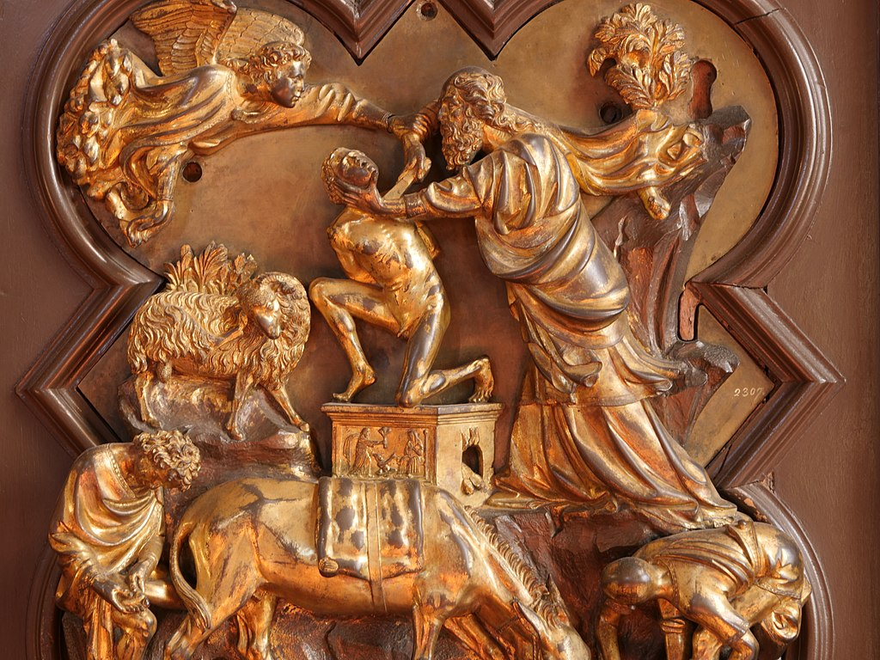
Sacrifice of Isaac, c. 1401 Brunelleschi, Bargello, Florence
Notes:
In Brunelleschi’s panel, Abraham grips Isaac violently by the neck with his left hand and with his right presses the knife against his neck. Abraham does not look at his son but stares at the angel who stays his arm. Caravaggio uses a three-quarter length format to draw us into the action. His angel is a strong youth whose extended arm leads the eye to Abraham’s hand and to the knife. The blade catches the light and stands out against Isaac’s pale flesh. As in the Brunelleschi panel Caravaggio has Abraham stare back at the angel. His expression is intense but very hard to read. More than the violent act intimated below by the cluster of hands, it is Abraham’s enigmatic expression which will hold the viewer’s attention. The angel points in the direction of the ram but also towards the landscape behind and the sky at dawn. The landscape could be one Caravaggio knew near Rome and the building on the hill looks like a church, linking the event on the mountain with contemporary faith in Christ.

Slide 44
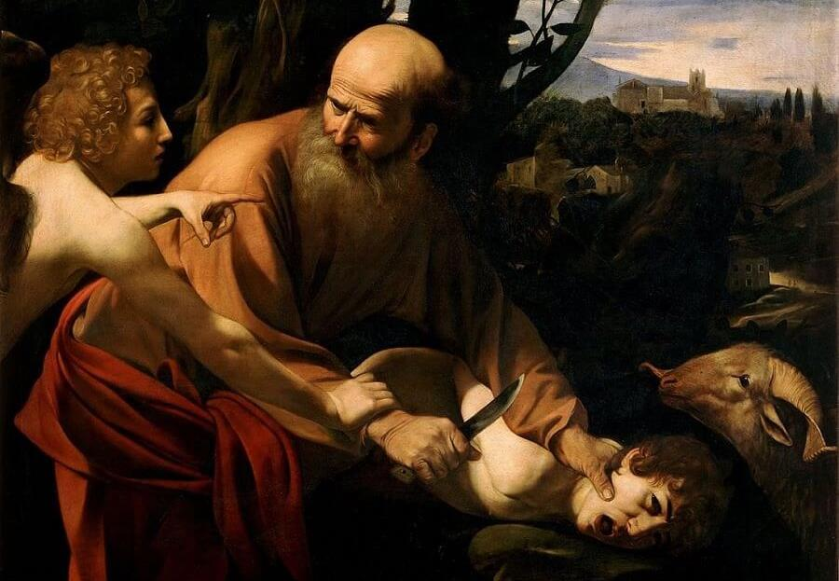
“Sacrifice of Isaac”, c. 1603, Caravaggio, Uffizi, Florence
Notes:
Caravaggio shows the terrible moment when Abraham has put forth his hand and taken the knife to slay his son (Gen 22:10). But an angel on the left stays his hand and points to a the ram on the right. From very early on Christians understood this story to prefigure the sacrifice of Christ. “The sacrifice of Abraham” is mentioned in the First Eucharistic Prayer and a number of depictions of this scene are to be found in the catacombs of Rome. Caravaggio’s version does not spare us from the terror of Isaac and the violence of Abraham’s grip. However, the most arresting element is the expression of Abraham. In fact, there are echoes of a famous relief in bronze of the same subject by Brunelleschi. In 1401 Brunelleschi submitted a trial panel of this scene for the Baptistry doors in Florence. He didn’t get the commission, but the panel survives.

Slide 45
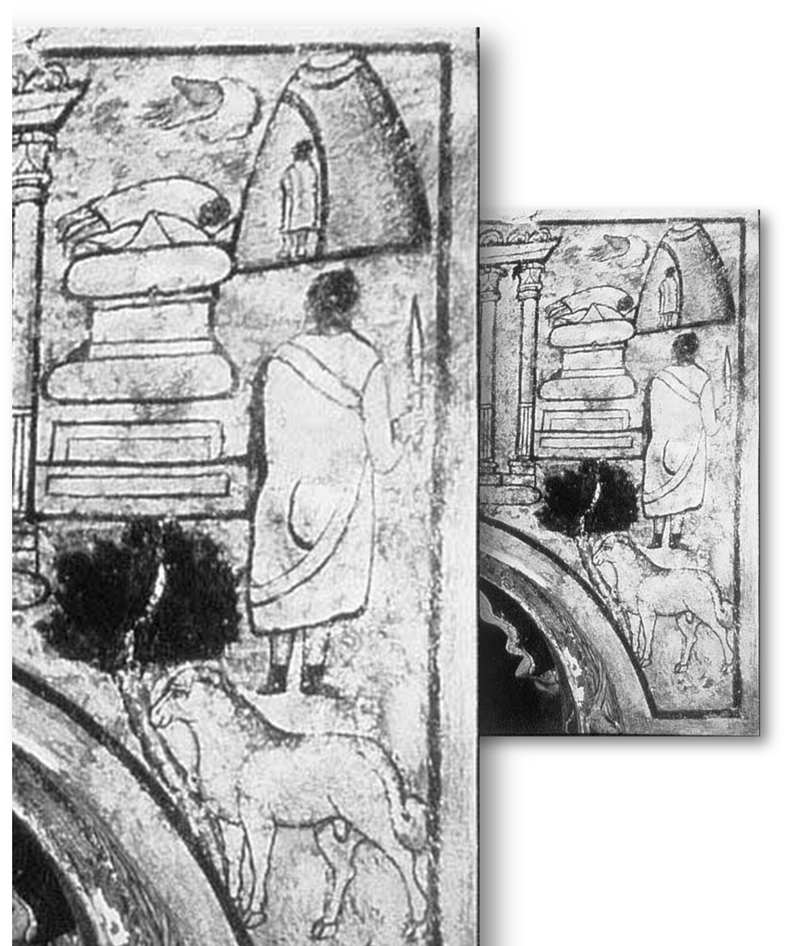
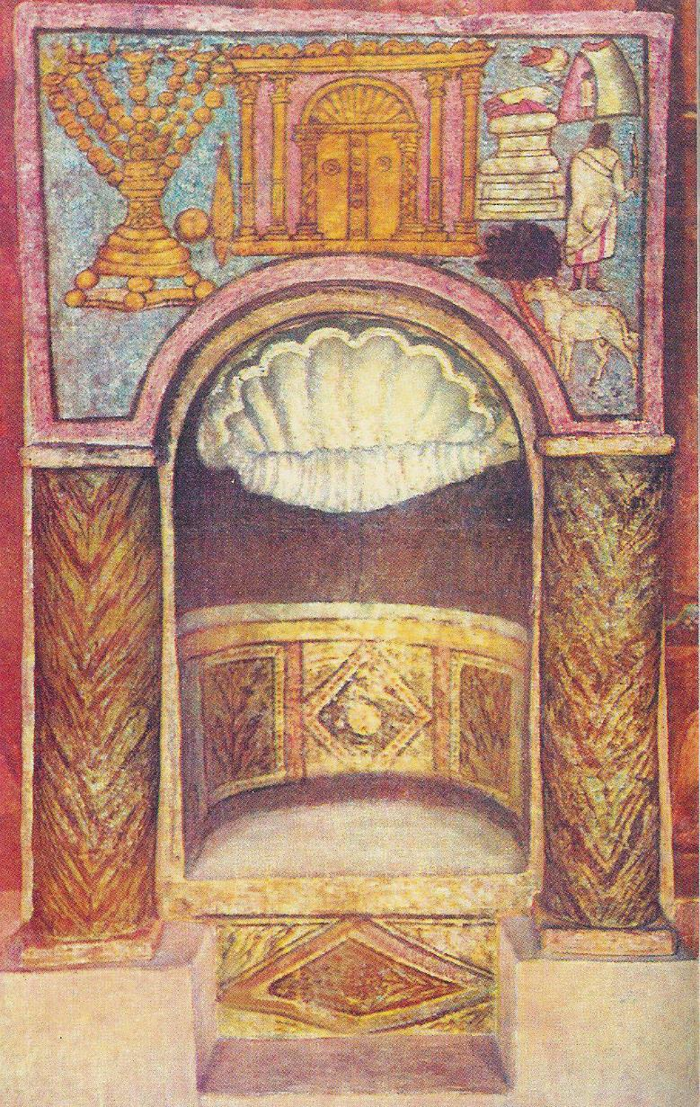
The Akedah in Dura-Europos (Syria), a third century city, which contained 16 temples catering to the needs of an eclectic pantheon of Roman, Greek and Persian gods.
The city also contained a modest Christian chapel (probably a house-church) and a synagogue in which there were more than 30 biblical scenes covering the four walls of a 40 ft room.
At left, close-up of the Akedah from top-right of image..
Dura Europos synagogue ca. 3rd century.

Slide 46
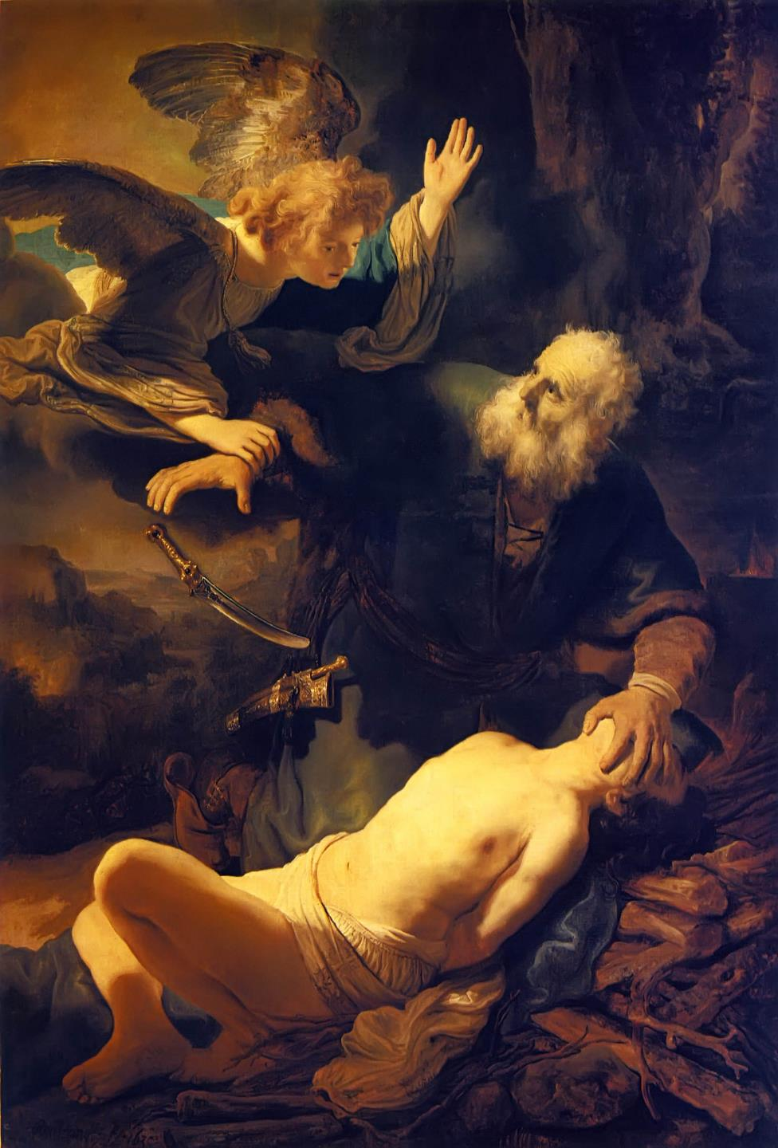
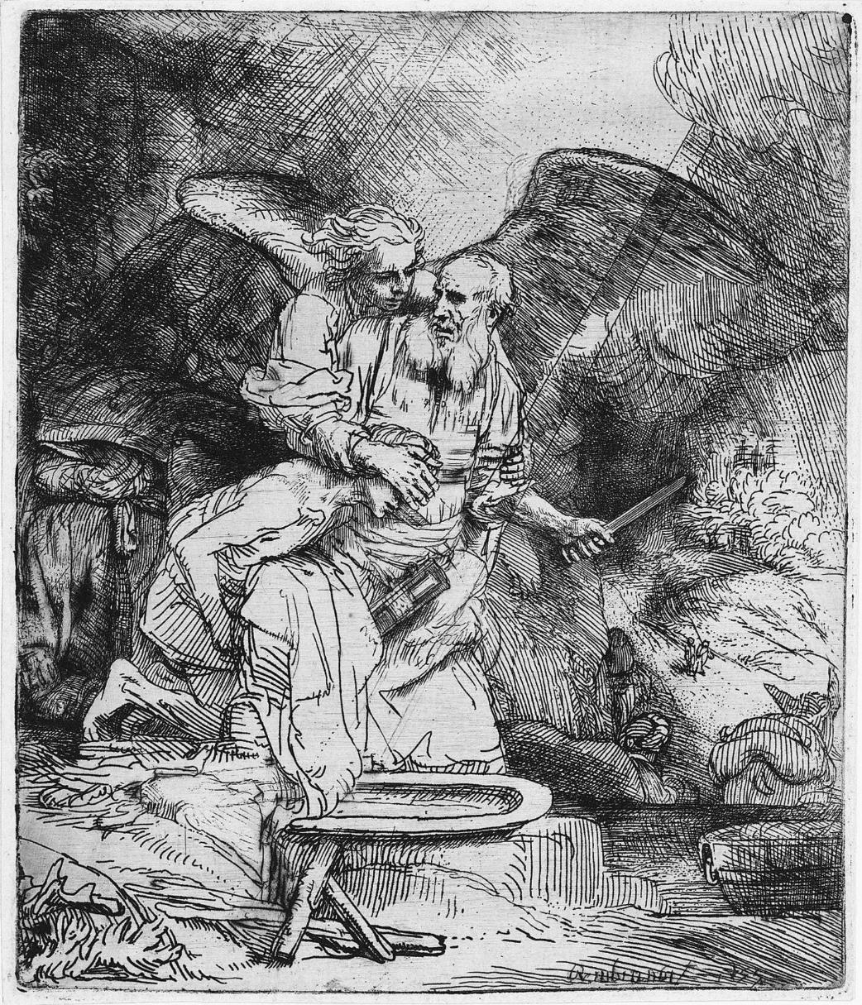
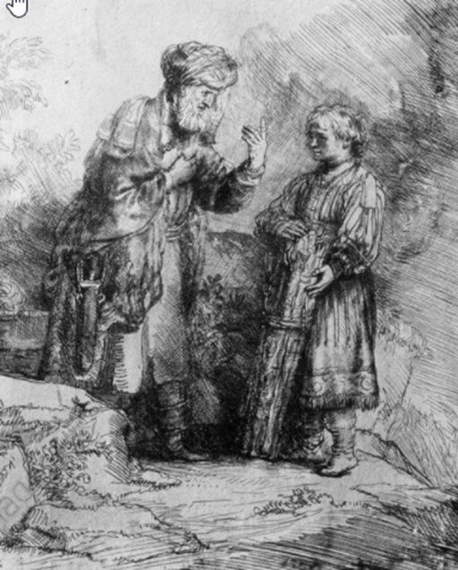
Abraham’s Sacrifice, 1655.
Rembrandt van Rijn (Dutch, 1606-1669).
‘The Sacrifice of Isaac’, 1635.
(Photo by Art Media/Print Collector/Getty Images)
Notes:
Rembrandt’s etching titled Abraham’s Sacrifice displayed above and his earlier painting known as the Sacrifice of Isaac are a study in contrasts. They depict two strikingly different appreciations of one of the most enigmatic tales in the Bible[iii] known as the Akedat Yitzchak (Binding of Isaac) or simply as the Akeidah.
As Rembrandt’s title for the etching implies, it is a visual representation of the sacrifice made by Abraham. It is not called the sacrifice of Isaac and it does not purport to view the scene from Isaac’s point of view, whose eyes are covered. Rather, it is portrays Abraham’s act of devotion to G-d, as demonstrated by his seeming willingness to sacrifice his beloved son and only heir Isaac[v].
A closer analysis of the etching and the Biblical text reveal a number of anomalous aspects of Rembrandt’s depiction. For example, it does not show Isaac bound, placed atop wood arranged on the Altar and ready to be ritually slaughtered, as described in the Biblical text. Instead, Isaac is unbound and leaning on Abraham’s lap, in the seemingly protective grasp of Abraham’s right hand.

Slide 47
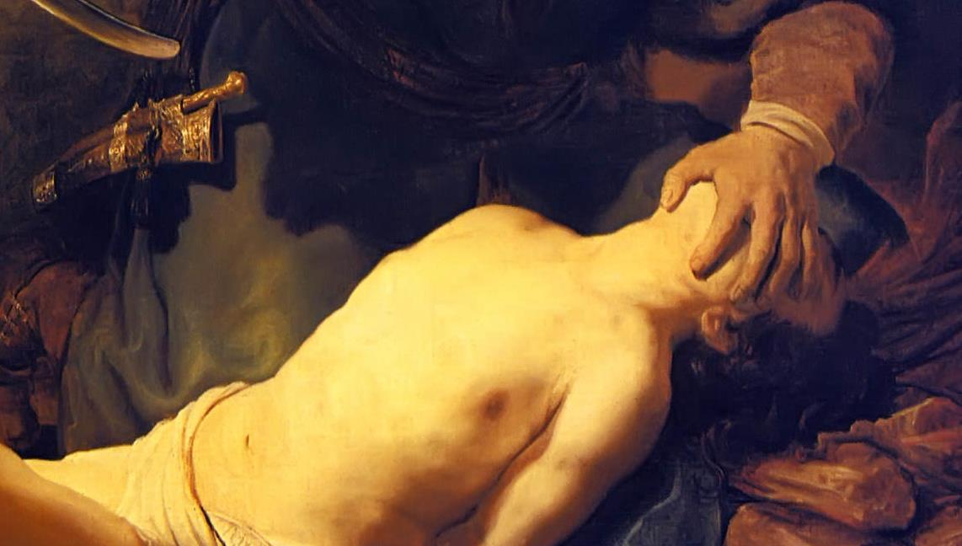
The Abraham’s Hand Over Isaac’s Eyes
‘The Sacrifice of Isaac’, 1635. (Photo by Art Media/Print Collector/Getty Images)
Notes:
In 1914, Rabbi Abraham Isaac Kook, who would later become the first Ashkenazi chief rabbi of the State of Israel, visited the National Gallery in London. His aesthetic sensibilities were aroused by the artistic grandeur that he encountered there. He was particularly transfixed by Rembrandt’s paintings: “…the light in his pictures is the very light that was originally created by God Almighty.” (Jewish Chronicle of London, September 13, 1935)
Rembrandt van Rijn’s prodigious activity in painting biblical scenes reflects his love of and intimate knowledge of the Bible. His biblical scenes are not merely an exercise in historical painting, they contain his own passion and intensity as well as a remarkable degree of his innovative biblical interpretation.
But what is Rembrandt communicating through Abraham’s left hand? Why does he cover the face of his child? Does the murderous hand asphyxiate the boy and position his neck for slaughter? Or does Abraham cover Isaac’s face to spare him the sight of his father committing an unthinkable act? Or could it be that at the moment of terror, Abraham, the compassionate father, utterly dedicated to upholding the divine commandment to slaughter Isaac, is nonetheless unable to look his beloved son in the eye? Abraham’s face displays everything we would expect: confusion, shock, and total lack of comprehension. Having girded himself for this death march, he is taken aback when called to a sudden halt. How did Abraham reconcile this withdrawal of the divine command with the original directive? If it was not to be consummated, what then was the purpose of this difficult and perplexing ordeal?

Slide 48
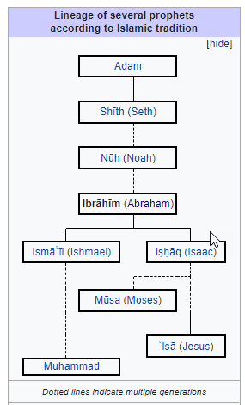
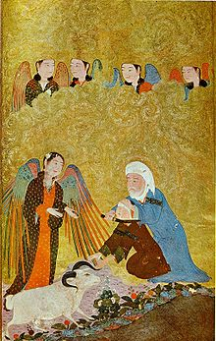
Islamic Imagery
Notes:
Tabari's account
The classical Quranic exegete and historian Tabari offered two versions, whom Abraham was ordered to sacrifice. According to the first strand, Abraham wished for a righteous son, whereupon an angel appeared to him informing him, that he will get a righteous son, but when he was born and reached puberty, he must be sacrificed for God. Later, the angel appeared to Hagar to inform her about the upcoming child. When Ishmael was grown, someone appeared to Abraham, invites him to keep his vow.[31]
When Ishmael was grown, someone appeared to Abraham in a dream and said to him: "Keep your vow which you made! God bestowed upon you a boy by Hagar so that you may sacrifice him" So he said to Ishmael: "Let us go offer a sacrifice to God!" So he took a knife and some rope and went with him until they reached a place in the mountains. The boy said to him: "Oh father! Where is your sacrifice?" He replied: "Oh my son, I saw in a dream, that I will slaughter you. So pay attention to what you see". He said, "Oh my father, do what you have been commanded; you will find me, Insha-Allah(if God wills), one of the patient". Ishmael then said to him: "Make tight my bonds, so that I will not struggle to pull back your clothes so that none of my blood will be shed on them for Hagar will see it and be grieved. Hurry! Pass the knife over my throat so that death will be easy for me. When you come to Hagar, greet her'. Abraham began to approach him and, while crying, tied him up. Ishmael too was crying such that the tears gathered by the cheek of Ishmael. He then drew the knife along his throat but the knife did not cut, for God had placed a sheet of copper on the throat of Ishmael. When he saw that, he turned him on his forehead and nicked him on the back of the head just as God has said in Quran 37:103: When they had both submitted and he flung on his forehead, that is they had submitted the affair to God. A voice called out: 'Abraham, you have fulfilled the vision!" He turned around and behold, there was a ram. He took it and released his son and he bent over his son saying: "Oh my son, today you have been given to me". That comes in God's saying in Quran 37:107: We ransomed him with a great sacrifice.
The second strand, provided by Tabari, states that Abraham was about to sacrifice his son Ishmael, and Iblis appeared in form of a man to prevent the sacrifice.
Iblis (Satan), who had taken on the form of a man, said: "Where are you going, O Shaikh?" He replied: " I am going to these mountains because I must do something there'. Iblis said: "By God, I have seen that Shaytan has come to you in a dream and ordered you to slaughter this little son of yours. And you intend to do that slaughtering!" Thereupon Abraham recognized him and said: "Get away from me, enemy of God! By God, I will most certainly continue to do what my Lord has commanded". Iblis, the enemy of God, gave up on Abraham but then he encountered Ishmael, who was behind Abraham carrying the wood and the large knife. He said to him: "O young man, do you realize where your father is taking you?" He said: "To gather wood for our family from the mountains". He replied: "By God, his actual intention is to sacrifice you!" He said: "Why?!" Iblis replied: "He claims that his Lord has ordered him to do so!" Ishmael replied: "He must do what his Lord commands, absolutely!" When the young man had rebuffed him, Iblis went to Hagar, the mother of Ishmael who was still at home. Iblis said to her: "Oh mother of Ishmael! Do you realize where Abraham is going with Ishmael?" She replied: "They have gone to gather wood for us in the mountains". He said: "He has actually gone in order to sacrifice him!" She replied: "It cannot be! He is too kind and too loving towards him to do that!" Iblis said: "He claims that God has ordered him to do that!" Hagar said: "If his Lord has ordered him to do that then he must submit to the command of God!" So the enemy of God returned exasperated at not being able to influence the family of Abraham as he wished.

Slide 49
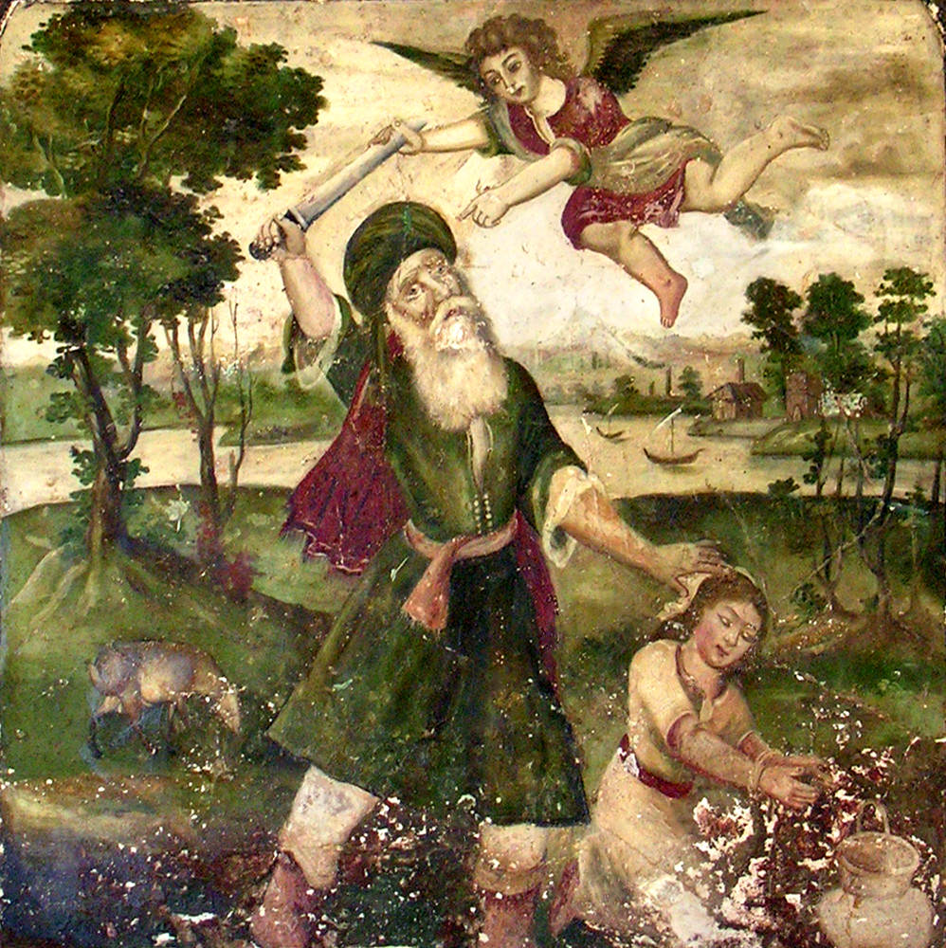
The Akedah of Ishmael
Abraham and the Binding of Ishmael, 18th century. Fresco, Haft Tanan(Seven Tombs) Mausoleum, Shiraz, Iran.

Slide 50
Post-Enlightenment Interpretations of the Akedah
The entire story of the Akedah is not only absurd but downright dangerous to modern sensibilities.
God has always tested His people (Deuteronomy 8:11-20, Judges 2:22; Zechariah 13:9; Jeremiah 9:7)
  I will no longer drive out before them any of the nations that Joshua left when he died, in order to test Israel by them, whether they will take care to walk in the way of the LORD as their fathers did, or not.”
  And I will put this third into the fire, and refine them as one refines silver, and test them as gold is tested. They will call upon my name, and I will answer them. I will say, ‘They are my people’; and they will say, ‘The LORD is my GOD.’ ” Zechariah 13:9 (ESV-CE)
Notes:
For many modern readers, the idea that God tries and tests the faithful is offensive. We tend to think of loving parents as those who protect rather than expose to such a dangerous test. I remember getting off the bus at West Point in July of 1973, my hair flowing over my shoulders, ready to engage on a wonderful test that would allow me to wear a sharp uniform and play football for free. What could go wrong?
I have been teaching in universities and seminaries for over 20 years, and never have I been admonished to put students to the test; encouraging their self-esteem seems to be the great preoccupation. Everyone is a winner, right. My son’s 3rd grade Science Fair---walking through the gym looking at all the exhibits, and somewhat discouraged that every submission got a blue ribbon. I was angry! After all, I had worked very hard on that thing! ☺
But the scriptural traditions we affirm look at things differently. We just completed a liturgy for the first Sunday of Lent, in St; Luke’s gospel, that has Jesus taken out into the wilderness to be tested by the devil. This was nothing new for a son of Israel.

Slide 51
Hineni
In a world full of distractions, the proper way to translate “Hineni” today is “I am fully present.” I am fully present in my life. I am fully present with my family. I am fully present in my job. I am fully present when I am in conversation with you. I am fully present as a servant of God. This means paying closer attention to the sacred duties I assume and trying to live on higher ground. I am fully present as a Christian, as a Deacon and Servant of Jesus Christ. I am fully present as a citizen of the world, partnering for it’s betterment, mourning for its tragic evil and disasters, providing comfort and aid as I am able. Being fully present today — with the challenges and distractions of technology — cannot be assumed. It is hard work; an aspiration.
Notes:
‘‘Hineini” means “here I am” but the power of the phrase is far greater. It is the acceptance of a charge; taking on a task or responsibility. Hinieni. Like my ancestors before me, I am here. Hinieni. It has a sense of solemn obligation.

Slide 52
You Want It Darker, Leonard Cohen
Play song at YouTube: https://www.youtube.com/watch?v=YD6fvzGIBfQ

Slide 53
Concluding Thoughts
The meaning of Isaac as the typos of Christ, especially during Lent and Holy Week.
The Akedah is a Sacramental Pre-sentation of The Mt. Moriah/Calvary sacrifice of Jesus on the Cross.
God ends the test because He knows something now that would be against the nature of a test to know any other way, something about the faithfulness of Abraham.
Modern notions about taking the life of another due to a dream about God demanding such are unfair comparisons. We are told from the very beginning by the narrator that this is a test. This is (only) a test.
“Don’t try this at home” is good guidance for anyone.
Notes:
The dynamic of renunciation and restoration powerfully depicted in the Akedah at Mount Moriah echoes throughout the New Testament. The trail of Abraham enacts the promise of Christ: he who loses his life for my sake shall gain it. The akedah represents a losing of life for Abraham. He can no longer invest his hopes in the natural power of fertility, something that allows him to continue life through his son Isaac. Even as he binds his son to prepare to lose him, Abraham gains. Isaac returns to Abraham as the natural son made spiritual by the power of God’s promise. Abraham no longer depends on Isaac’s physical survival in order to have a future in the covenant, because he has received him as a gift rather than a child to cling to.
It is this giving up that resonates with our Lenten observance when we look to Christ. The Good Friday events enact what God commands but at the last minute forestalls in Genesis 22, and Easter Sunday completes the restoration of Isaac to Abraham. In baptism, our captivity to sin is itself taken captive. Our bondage to worldly hopes is bound, as it were, in Christ. Just as Isaac is bound for sacrifice on Mount Moriah, the Lamb of God who takes away the sin of the world is bound for sacrifice on the Moriah not of the earthly temple sacrifices, which could never fully take away sin, but on the new Mt. Moriah, Mount Calvary in the sacrifice of Jesus.

Slide 54
The Akedah and Me: A Reflection
Why does God test humans? When has God tested me? How did I do?
What exactly is the test in Genesis 22? Is it a test of Abraham’s absolute and unquestioning faith and obedience or is it a tst of man’s willingness to test God (as Abraham did with the planned destruction of Sodom and Gomorrah)?
Where was Sarah? What might be different about this story if God had commanded Sarah to sacrifice Isaac?
Do you think it will ever be possible for Isaac to forgive his father? To forgive God? Or are we projecting our own feelings into the story?

Slide 55
Bibliography
Auerbach, Erich. Mimesis: The Representation of Reality in Western Literature. Princeton University Press, 1953.
Alexander, T.D. From Paradise to the Promised Land: An Introduction to the Pentateuch. Baker Academic Books, 2002.
Bergsma, John and Brant Pitre. A Catholic Introduction to the Bible: Old Testament. San Francisco, Ignatius Press, 2018
Cotter, David W. Genesis: The Berit Olam Studies in Hebrew Narrative & Poetry. Collegeville, Minnesota: The Liturgical Press, 2003.
Goldingay, John. Genesis: Baker Commentary on the Old Testament. Grand Rapids, Michigan: Baker Academic, 2020.
Hamilton, James M. Typology: Understanding the Bible’s Promised-Shaped Patterns. 2023, Zondervan Academic.
Kass, Leon R. The Beginning of Wisdom: Reading Genesis. New York, Free Press/Simon & Schuster, 2003.
Kierkegaard, Soren. Either/Or. 1848.
Koller, Aaron. Unbinding Isaac: The Significance of the Akedah for Modern Jewish Thought. Lincoln, Nebraska: University of Nebraska Press, 2020.
Levenson, Jon D. Inheriting Abraham: The Legacy of the Patriarch in Judaism, Christianity, and Islam. Princeton University Press, 2012.
… The Death and Resurrection of the Beloved Son: The Transformation of Child Sacrifice in Judaism and Christianity. Yale University Press, 1993.
Lohr, Joel n. Chosen and Unchosen: Conceptions of Election in the Pentateuch and Jewish-Christian Interpretation. Winona Lake, IN: Eisenbrauns, 2009.
McKean, James. Genesis: The Two Horizons Old Testament Commentary. Grand Rapids, William B. Eerdmans Publishing, 2008.
Middleton, J. Richard. Abraham’s Silence: The Binding of Isaac, the Suffering of Job, and How to Talk Back to God. Grand Rapids, MI: Baker Academic Press, 2022.
Moyers, Bill. Talking About Genesis: A Resource Guide. New York, Doubleday, 1996.
Reno, R.R. Genesis: Brazos Theological Commentary on the Bible. Grand Rapids, MI: Brazos Press/Baker Publishing Group, 2010.
Sarna, Nahum. Understanding Genesis: The World of the Bible in the Light of History. New York, Schocken Books, 1966.
… Genesis: The Jewish Publication Society Torah Commentary. Philadelphia, JPS Press, 1989.
Von Rad, Gerhard. Genesis: Old Testament Library. Philadelphia: Westminster Press, 1973.
Waltke, Bruce. Genesis: A Commentary. Grand Rapids: Zondervan, 2001.
Westermann, Claus. Genesis 12-36: A Commentary. Minneapolis, MN: Augsburg-Fortress Publishing, 1981

