Slide 1
Lesson 4
…one, holy, catholic, apostolic church…
The Deposit of Faith:
Sacred Tradition

Slide 2
Outline
Objective: to understand the role of Sacred Tradition within the Catholic Church
Sacred Tradition
  Scripture basis
  Interrelationships & definitions
  Examples
Liturgical Year
Introduction to Prayer

Slide 3
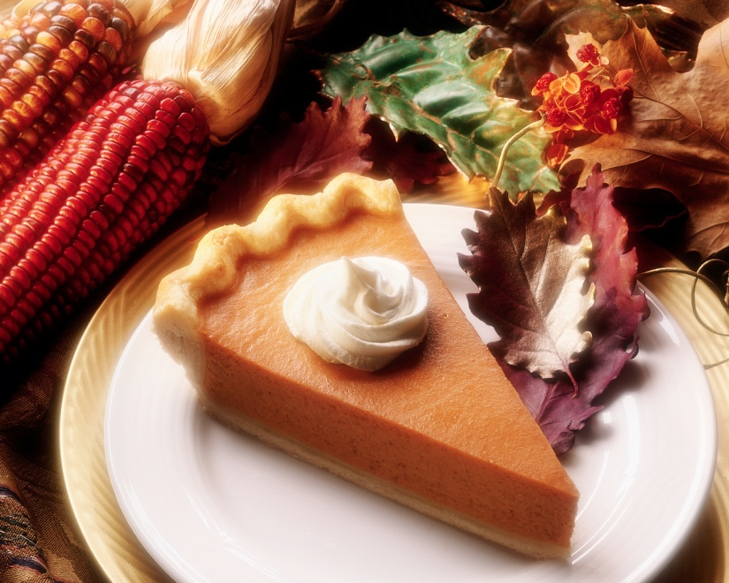
BIG T or little t?

Slide 4
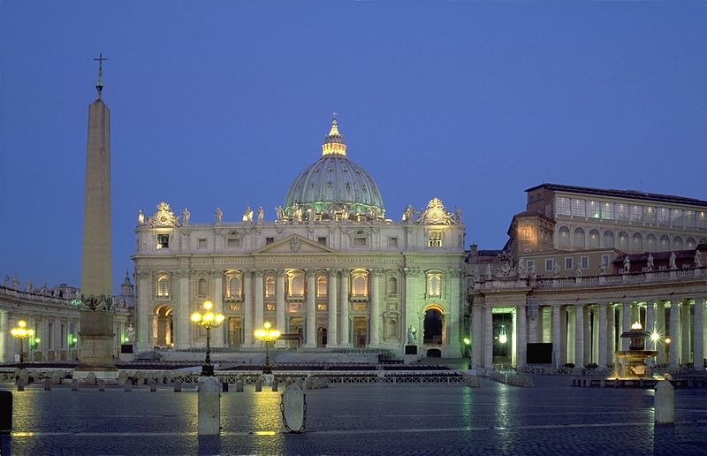
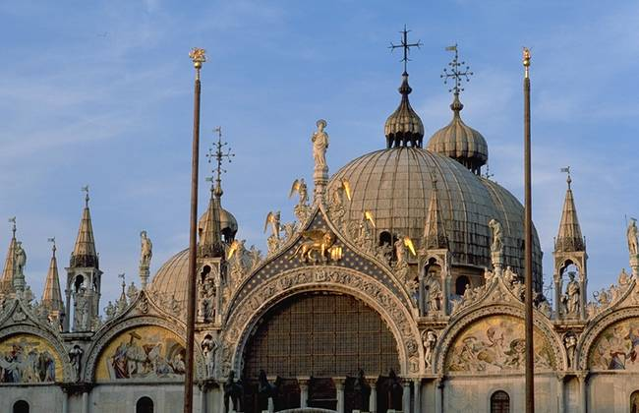
Scripture Time
St Peter Basilica, Rome
St Mark’s Basilica, Venice

Slide 5
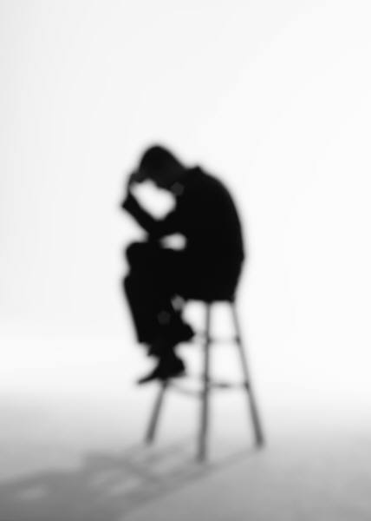
3 Legs of the Table
Sacred Scripture
Sacred Tradition
Magisterium
Tradition is:
  The living transmission of the entirety of revelation by the successors of the Apostles under the guidance and protection of the Holy Spirit

Slide 6
Legal Stuff
“…no new public revelation is to be expected before the glorious manifestation of our Lord Jesus Christ.” (CCC 66)
“The Son is his Father’s definitive Word; so there will be no further Revelation after him.” (CCC 73)
  For you & I: Scripture is written and complete
“Yet even if Revelation is already complete, it has not been made completely explicit; it remains for Christian faith gradually to grasp is full significance over the course of the centuries.” (CCC 66)
  For you & I: We (the people of God) still have to figure it out

Slide 7
History
Jesus’ Ministry
Ministry of the Apostles
  Tradition Begins to be Formed
  Acts 15: 28-29
  1 Cor 11: 2
Writing of the New Testament
Early Church and Subsequent Development of Sacred Tradition
Controversy and Disagreement
ONE
HOLY
CATHOLIC
APOSTOLIC

Slide 8
Definitions
Doctrine / Dogma: Revealed teachings of Christ which are proclaimed by the fullest extent of the exercise of the Church’s Magisterium (CCC glossary)
  Doctrine: Usage in CCC relates to teachings
  Dogma: Usage in CCC relates to truths
Deposit of Faith: Entirety of revelation contained in Sacred Scripture and Sacred Tradition
  All that God has revealed to us

Slide 9
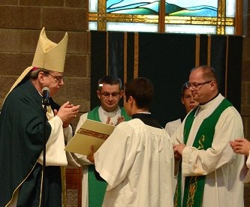
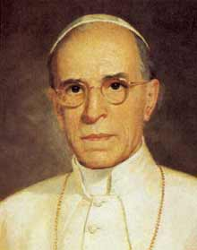
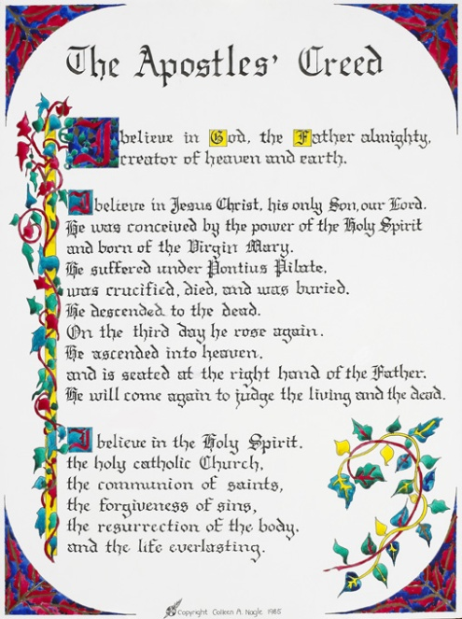
Examples
  Duty to obey & respect bishop
  Holy Orders
Apostles Creed
  Counter heresy of Docetism (denying Jesus’ humanity)
Date of birth
Sabbath
Bible formation
Papal Infallibility
Liturgy
Pope Pius XII
1950, Assumption of Mary

Slide 10
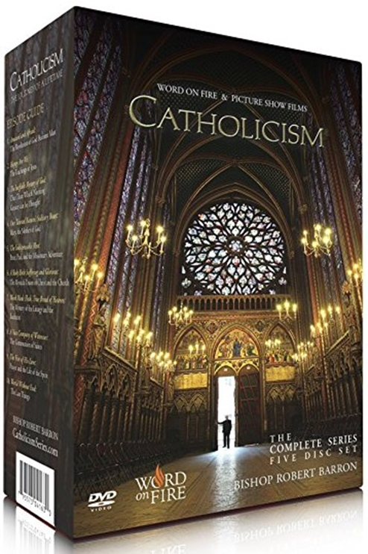
Movie Time

Slide 11
Where to from here?
“There is an organic connection between our spiritual life and the dogmas. Dogmas are lights along the path of faith; they illuminate it and make it secure.” (CCC 89)
“Therefore, brothers, stand firm. Hold fast to the traditions you received from us, either by our word or by letter.” (2 Thes 2:15)

Slide 12
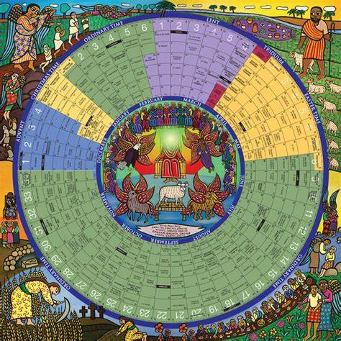
The Liturgical Year

Slide 13
Liturgical Seasons
Season | Advent | Christmas | Ordinary Time | Lent | Triduum | Easter | Ordinary Time
Length | 4 weeks | ~12 days | Varies depending on year | 40 days | 3 days | 50 days | 34 weeks when both periods combine
Purpose | Preparation | Celebration of Jesus among us | Proclamation of the Kingdom of God | Preparation; repentance; spiritual renewal | Holiest 3 days of the year | Celebration of the Resurrection | Nothing ordinary about Ordinary Time
Things to notice / do | Omission of Gloria |  | Begins with Baptism of the Lord and ends with the Feast of Christ the King | Begins with Ash Wednesday Fasting and abstinence Omission of Gloria | Holy Thursday: White Good Friday: Red

Slide 14
Other Occasions
Holy Days of Obligation
Determined by region
US has:
  January 1: Mary, Mother of God
  Fortieth day after Easter: Ascension (Diocese of Colorado Springs celebrates on a Sunday)
  August 15: Assumption of the Blessed Virgin Mary
  November 1: All Saints
  December 8: Immaculate Conception
  December 25: Nativity of Our Lord Jesus Christ
Feast days
Many feast days commemorate saints who glorified Christ in their lives on earth and now share His glory in the Kingdom of Heaven. Their feast days usually correspond to the date of death, the birth of the saint into eternal life.
Purpose
Color
  Red for Martyrs
  White/Gold

Slide 15
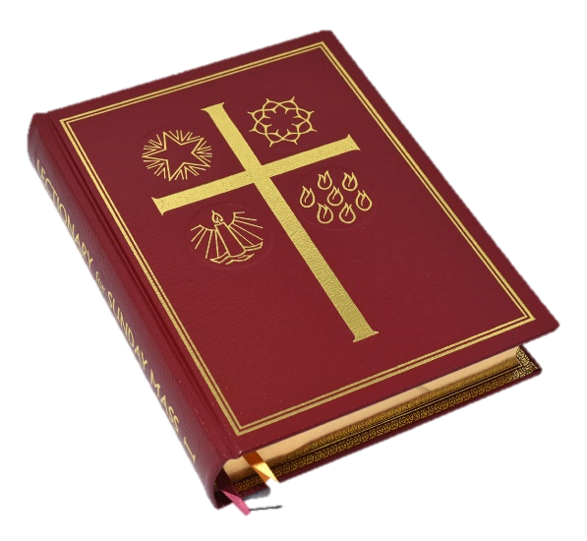
Liturgical Cycles
Mass has 3 (daily) or 4 (Sunday) readings (including Responsorial Psalm)
Cycle of Sunday readings
  A: Mark, B: Matthew, C: Luke
Cycle of weekday readings
  1, 2
2021: Year B, Weekdays Cycle 1
2022: Year C, Weekdays Cycle 2
Note that we share the liturgical cycle of readings with the Episcopal/Anglican and Lutheran churches
Almost all of the bible is covered over 3 years

Slide 16
Prayer
Lifting of the mind and heart to God
Prayer is our relationship of love with God
Through prayer, we seek to know him and open ourselves completely to His Holy Will
Characteristics:
  Natural to want to converse
  Essential to create a relationship
  We pray as children of a loving Father

Slide 17
Prayer
Kinds
Matter
Vocal
Meditation
Contemplation
ACTS
Adoration
Contrition
Thanksgiving
Supplication
  Petition
  Intercession
Prayer is integral to Catholic liturgical worship
More on Prayer later in the course

Slide 18
Takeaways
Sacred Tradition preserves the fullness of revelation, oral & written
Scripture, Tradition & Magisterium are connected
Sacred Tradition is Scriptural
The Church is liturgical
Prayer is a central part of liturgy and daily life

Slide 19
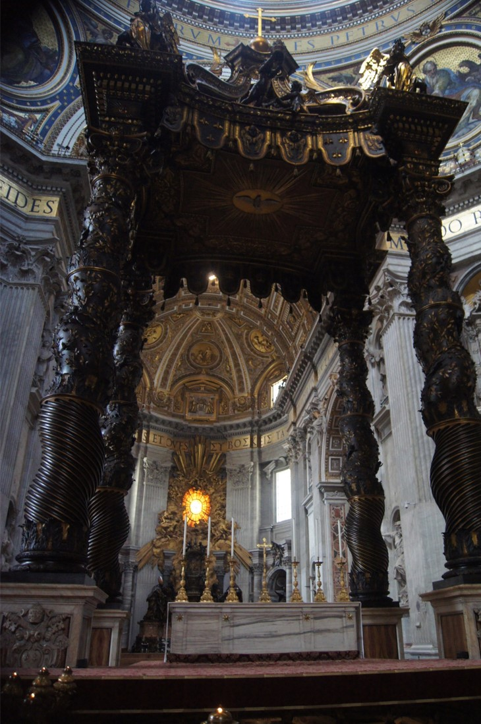
Questions?

