Slide 1
Lesson 25
Holy Week Prep
“My God, my God, why have you abandoned me?”
Psalm 22
Notes:
Teaching Notes:
References:
Terms:

Slide 2
Schedule
Apr 10th: Passion / Palm Sunday
Apr 12th: Chrism Mass
Apr 14th: Holy Thursday
Apr 15th: Good Friday
Easter
Notes:
Teaching Notes:
Review: +05 - +10
References:
Terms:

Slide 3
Passion Sunday
Color: Red
Palms
Opening Procession: Lk 19:28-40
Readings:
Is 50:4-7
Phil 2:6-11
Passion Lk 22:1-49

Slide 4
Chrism Mass
Procession of Clergy
Renewal of Priestly Promises
Our role is to pray for the priests and bishop
Blessing of the Oils
Holy Chrism
Oil of the Sick
Oil of the Catechumens

Slide 5
Holy Thursday: Mass of the Lord’s Supper
Color: White / Gold
Gloria is Sung (hasn’t happened during Lent)
Readings
Ex 12:1-8, 11-14 (Passover)
Psalm 116: what’s unique about this?
Refrain is from New Testament (1 Cor 10:16)
1 Cor 11:23-26 (Command to Remember Last Supper)
Jn 13:1-15 (Last Supper)
Washing of the Feet
Offertory: Presentation of the Holy Oils
Stripping of the Altar
Pange Lingua & the Adoration Procession

Slide 6
Washing of the Feet

Slide 7
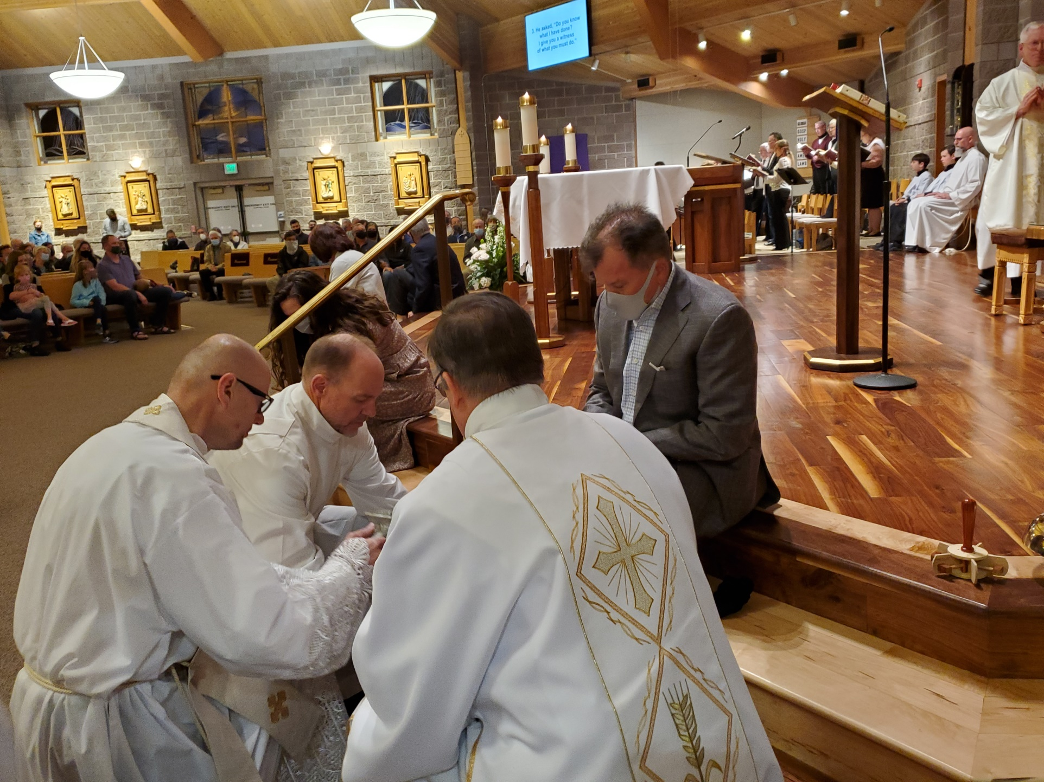

Slide 8
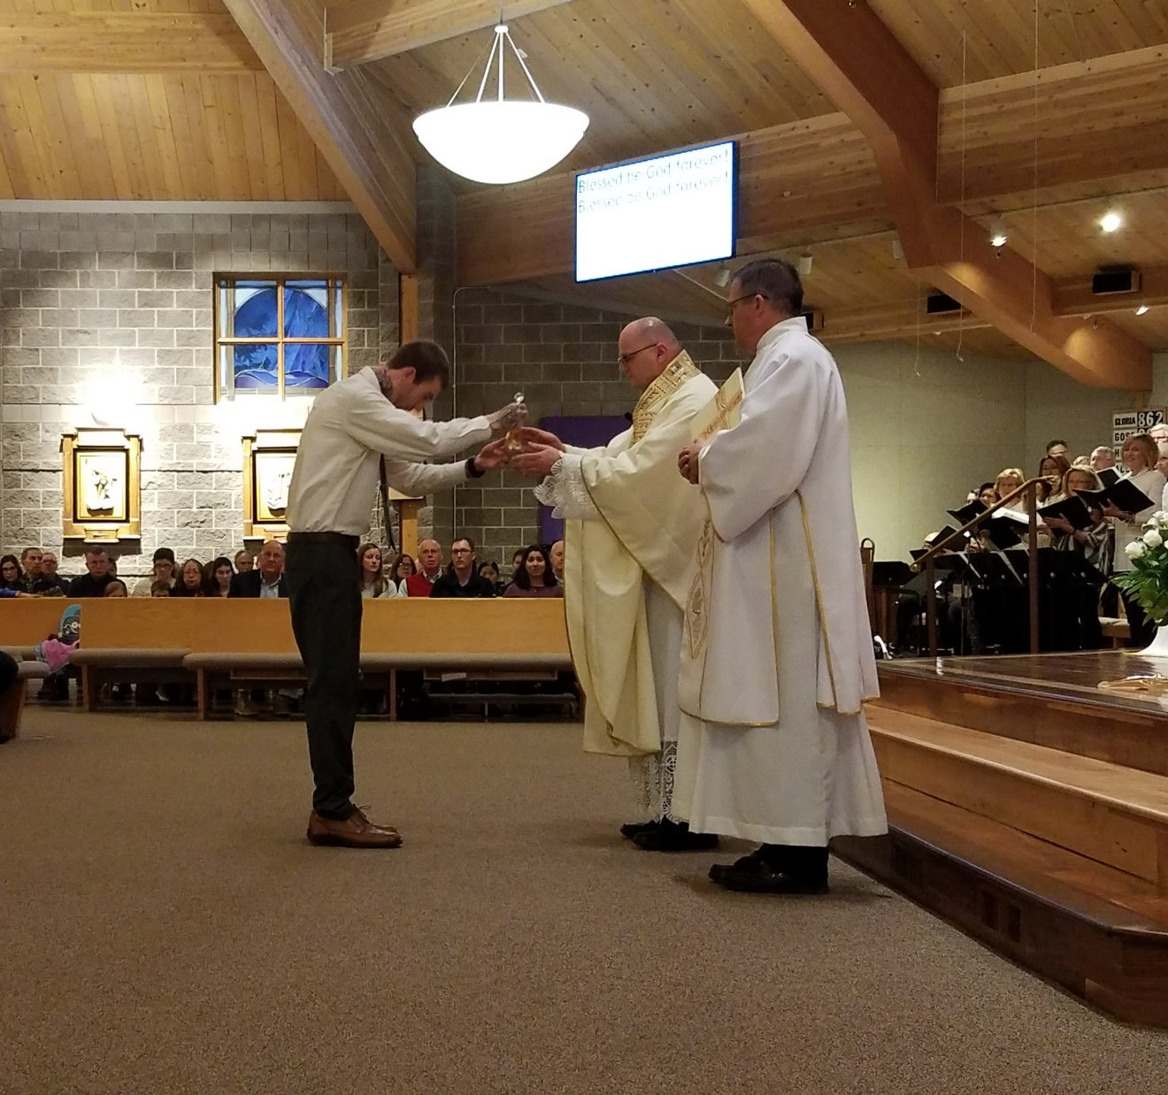
Presentation of the Oils

Slide 9
Incense

Slide 10
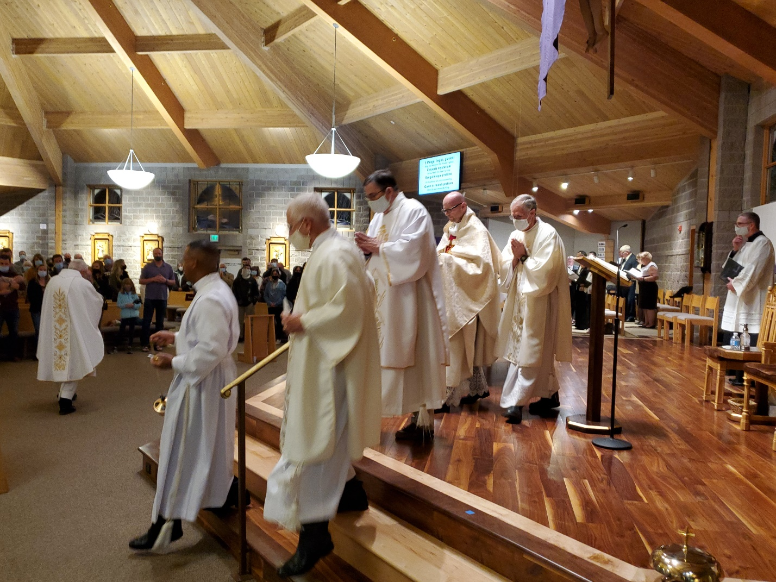
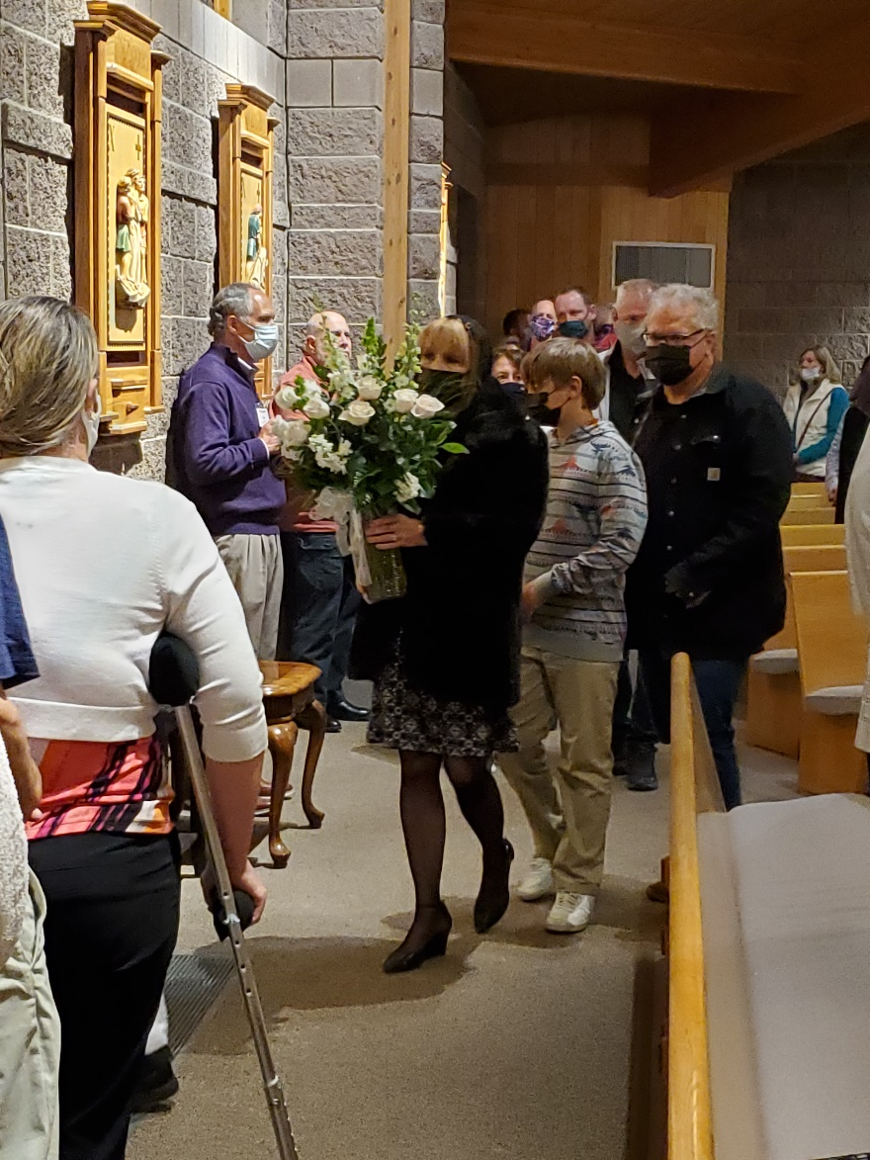

Slide 11
Adoration in the Gym

Slide 12
Good Friday
Color: Red
Clergy procession and prostration
Readings
Is 52:13-53 (suffering servant)
Psalm 31 (again with NT refrain)
Heb 4:14-16, 5:7-9 (obedience of Jesus)
Jn 18:1-19, 42 (Passion narrative)
Solemn Intercessions
Veneration of the Cross
Communion Service

Slide 13
Clergy Prostration

Slide 14
Solemn Intercessions
For the Holy Church
For the Pope
For all orders and degrees of the faithful
For catechumens
For the unity of Christians
For the Jewish people
For those who do not believe in Christ
For those in public office
For those in tribulation

Slide 15
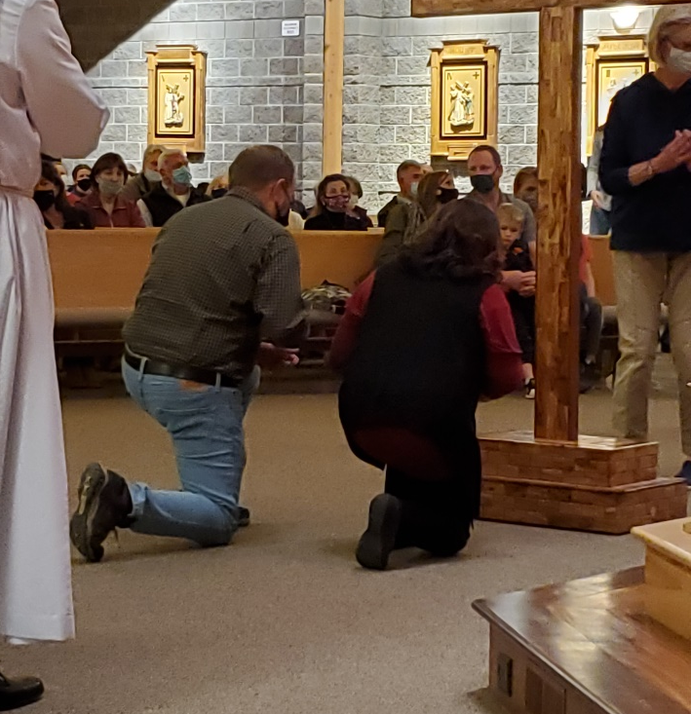
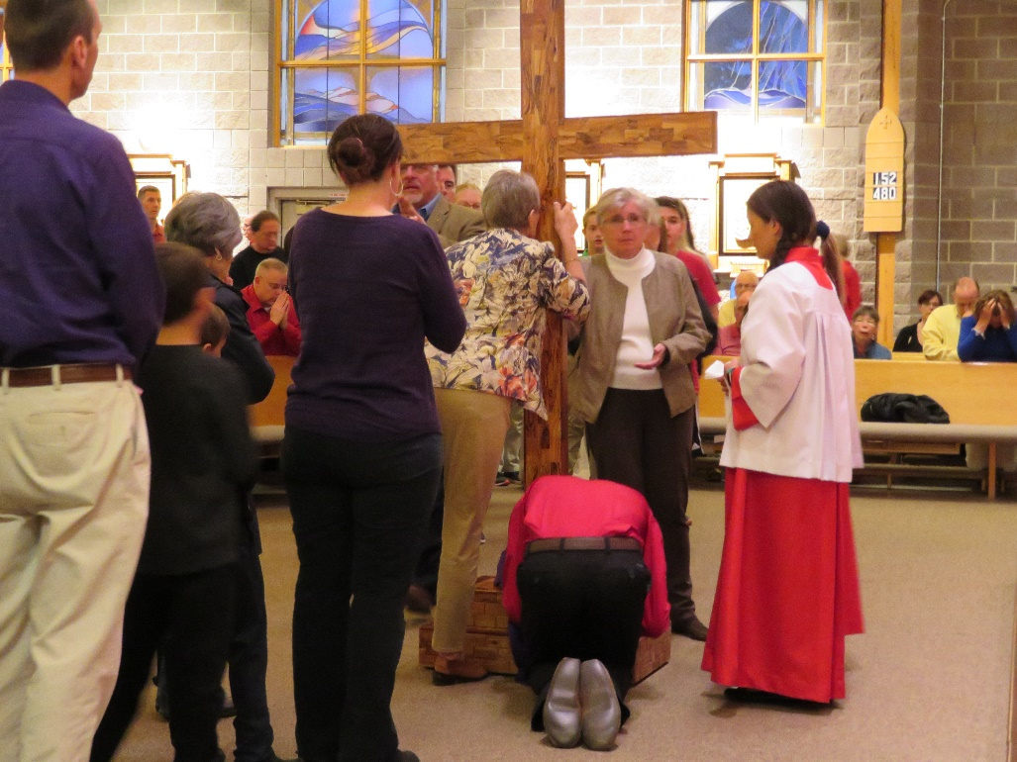
Adoration of the Holy Cross

Slide 16
Easter Vigil
Color: White / Gold
Dress code: Easter best
Sacraments for the Elect

Slide 17
Easter Sunday
Color: White / Gold
Dress code: Easter best
Sacraments for the Candidates

Slide 18
Admin
Rehearsal is on April 14th from 9-12

