Slide 1
Live in the Truth: Facing Secular Challenges to Our Faith
25 April 2024
St Peter Catholic Church,
Monument, CO
RCIA

Slide 2
Opening Prayer (Psalm 12: 2-3, 6, 8)
Help, Lord, for no one loyal remains; the faithful have vanished from the children of men.
They tell lies to one another, speak with deceiving lips and a double heart.
“Because they rob the weak, and the needy groan, I will now arise,” says the Lord;” I will grant safety to whoever longs for it.”
You, O Lord, protect us always; preserve us from this generation.

Slide 3
Why This Class
You are our heroes!
Our aim: to armor, to prepare, to share
We want you to remain strong, and to fear no evil
Know your enemy!
Be confident in your faith and trust in the Trinity

Slide 4
Agenda
A Discussion of Evil
Satan, the Father of Lies
The Enduring Impacts of Evil in History
Modernism: The Synthesis of all Heresies
Society Today
Combatting Satan

Slide 5
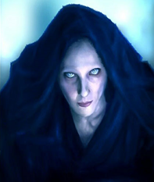
A Discussion of Evil
Evil metastasizes, then permeates,
corrupts and destroys individuals and
societies.
3

Slide 6
Definition of Evil
Evil is a privation or absence of good
“Evil is not a thing God created, because everything God made is good.” (Gen. 1:31).
Evil is not “nothing” , and it is not an “illusion”
Evil is real
God gave us free will to make choices – evil is the result of our bad choices CCC 310-311
4

Slide 7
Types of Evil
Moral evil – refers to a rational being acting against the good.
When we chose to sin, we chose to do what is evil in the sight of the Lord. CCC 311
Physical (Natural) Evil – refers to suffering or pain that have nothing to do with making evil choices
Remember: God brings good out of evil
5

Slide 8
Satan, the Father of Lies John 8:44
6

Slide 9
Satan, The Father of Lies
Devil - fallen angel (office-not-nature); aka accuser; slanderer Catholic Encyclopedia, CCC 329
Hebrew – Satan (spelled STN) which signifies an adversary, an accuser
First among the fallen angels (demons) is the Evil One CCC 391
7

Slide 10
Does Satan Exist?
Our understanding is founded on Scripture, Tradition and the Magisterium
OT/NT references: 1 Chr. 21:1, Job 1, 2, Wis. 2:24, Matt. 4:1, 5, 8, 11, Mt12:22-30; Mark 1:13, Ll10:18, John 6:68-71, Acts 5:1-3, Rom. 16:19-20, 1 Cor. 5:5, 7:5, 1 Tim. 3:6, Heb. 2:14, Rev. 2:9.
The Fall of the Angels
Gen 3:15
The War in Heaven (Revelation 12:7-9)
Isaiah 14:12-15
Where are Satan and his demons?
Ephesians 6:12
1Peter 5:8-9

Slide 11
Powers of Satan and the Demons
Cannot force you to act
Cannot read your mind
Cannot perform miracles
Can put images and ideas into your head
Can work on the bodily senses
Can work on the weaknesses of the person
Did the devil really make you do it?
10

Slide 12
The Enduring Impacts of Evil in History
11

Slide 13
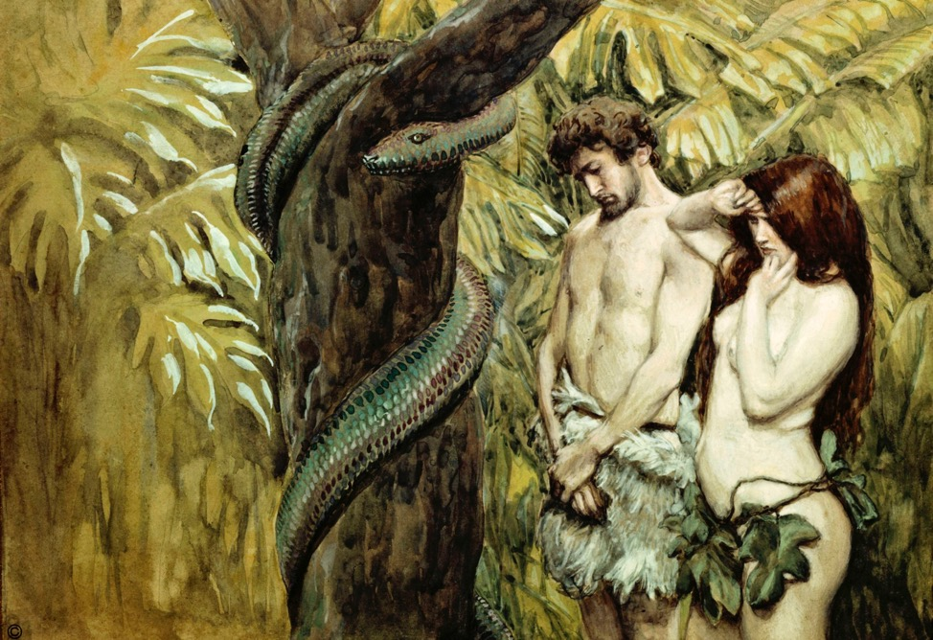
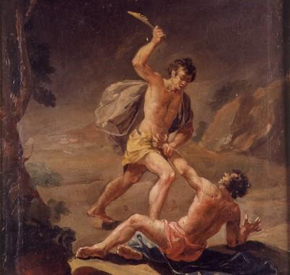
Adam and Eve
Cain and Abel

Slide 14
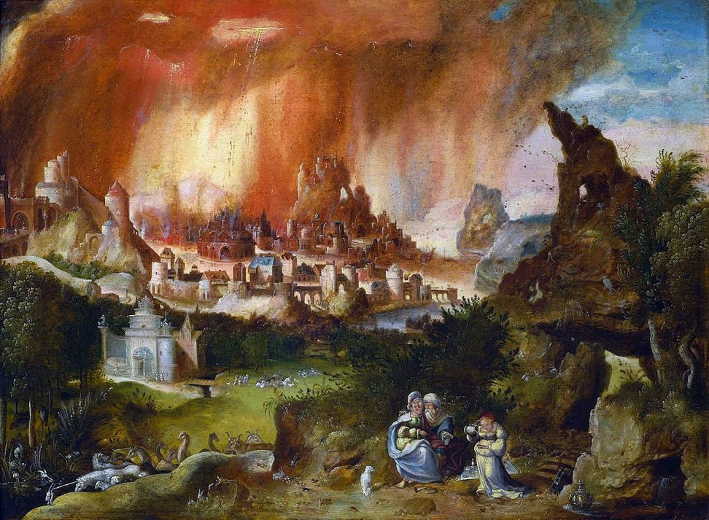
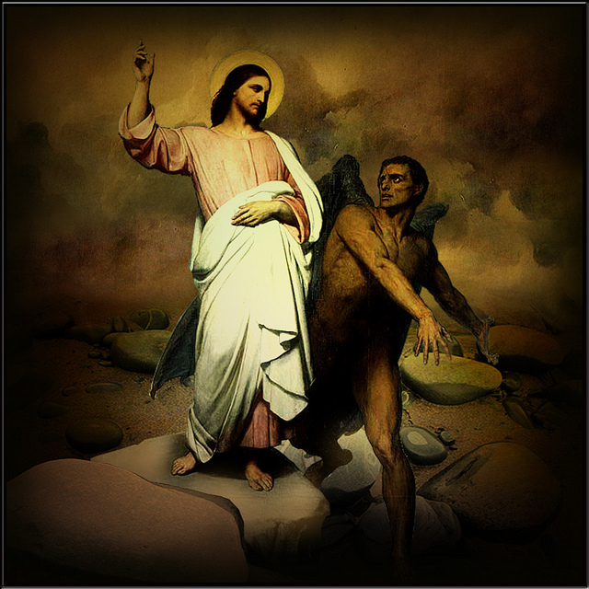
Sodom and Gomorrah
The Temptations of Christ

Slide 15
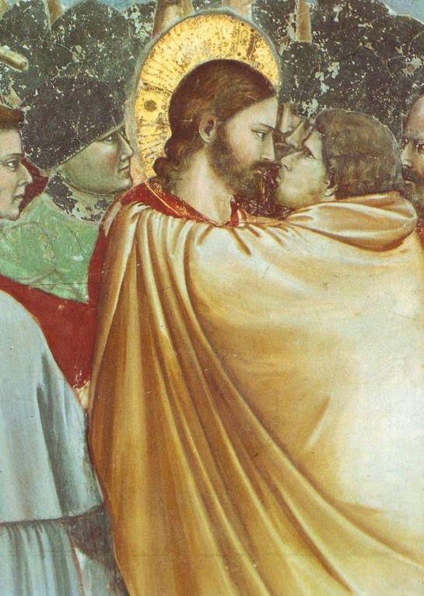
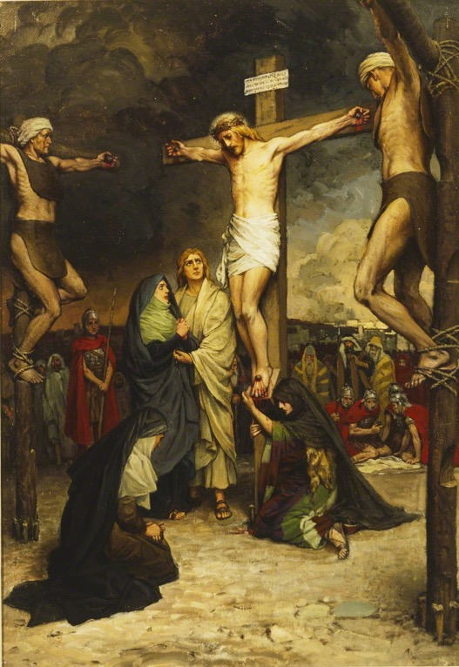
Judas and the Crucifixion
16

Slide 16
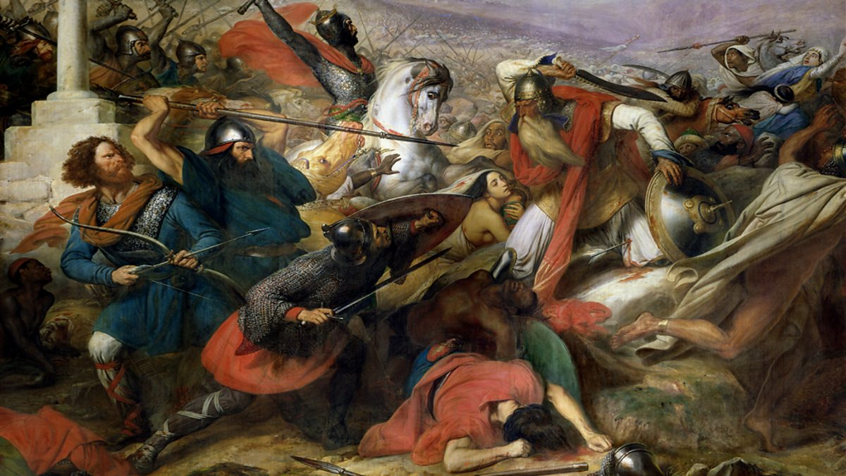
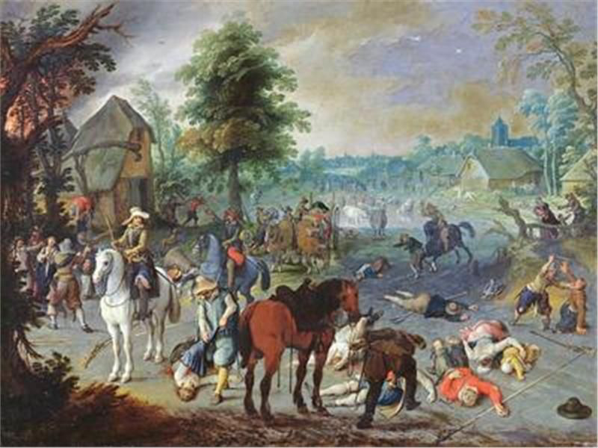
Muslim Conquest in 700’s
European Religious Wars

Slide 17
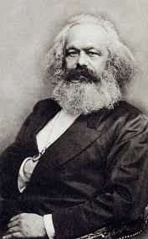
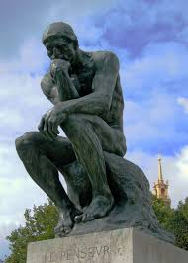
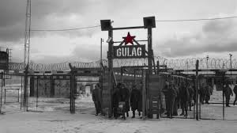
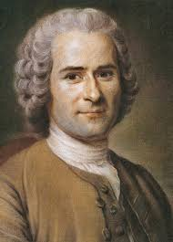
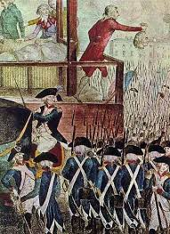
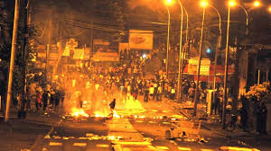
The “Enlightenment” 1715-1789
Kant
Marx
The Thinker
Rousseau
The “isms” of today

Slide 18
First and Second World Wars
WWI
WWII
1914-1918
“The Suicide of Europe”
1939-1945
Tragedy and Triumph

Slide 19
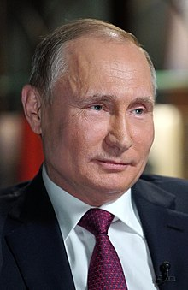
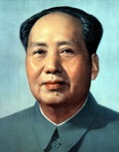
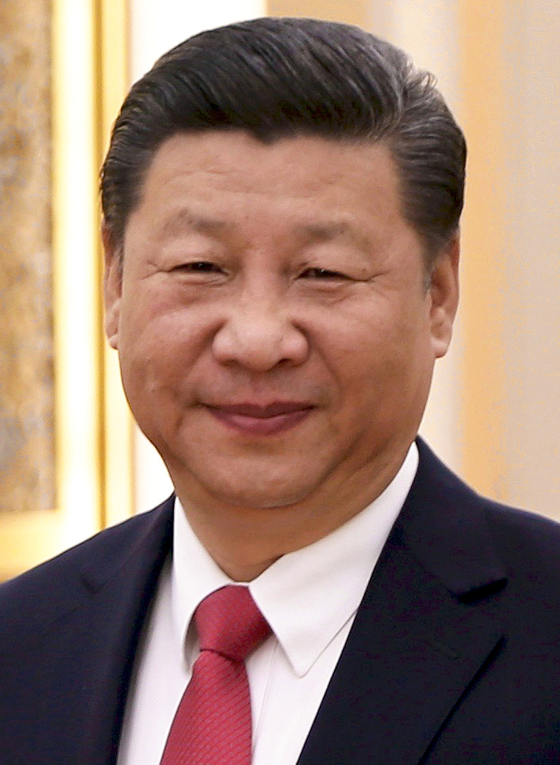
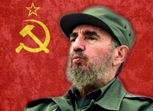
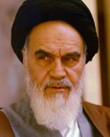
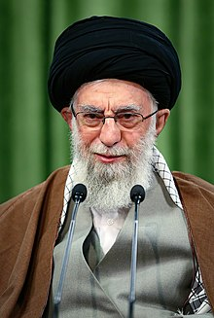
Communism/Socialism/ Totalitarianism
Putin
Joseph Stalin
Mao Tse Tung
Castro Family
Kim Jong-un
Ayatollah Khomeini
Ayatollah Khamenei
20M+
Xi Jinping
45-60M
45K-58K
710K-3.5M
#1 Sponsor of terrorism in the world
22

Slide 20
Modernism: Synthesis of all Heresies
What is modernism?
All religious truth is subject to revision
No truth is immutable and unchangeable
Personal religious “sentiment” defines “Truth”
Subjectivism: we can have no certain knowledge of things outside ourselves
Theological schizophrenia
The Church's Response:
Brilliant explanation of Catholic view of social justice in Pope Leo XIII’s 1891 encyclical Rerum Novarun
Condemned as heretical-Pope Pius X encyclical Pascendi Dominici Gregis 1907.
Trust in the guidance of the Holy Spirit, interpretations of the Magisterium and Sacred Tradition
Be aware of the manifestations of modernism

Slide 21
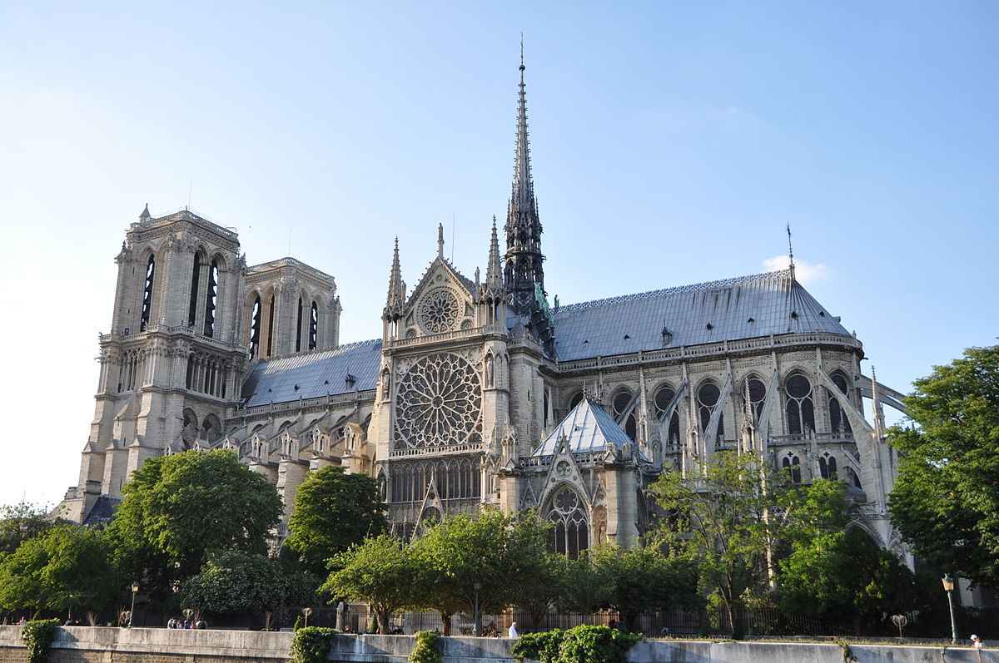
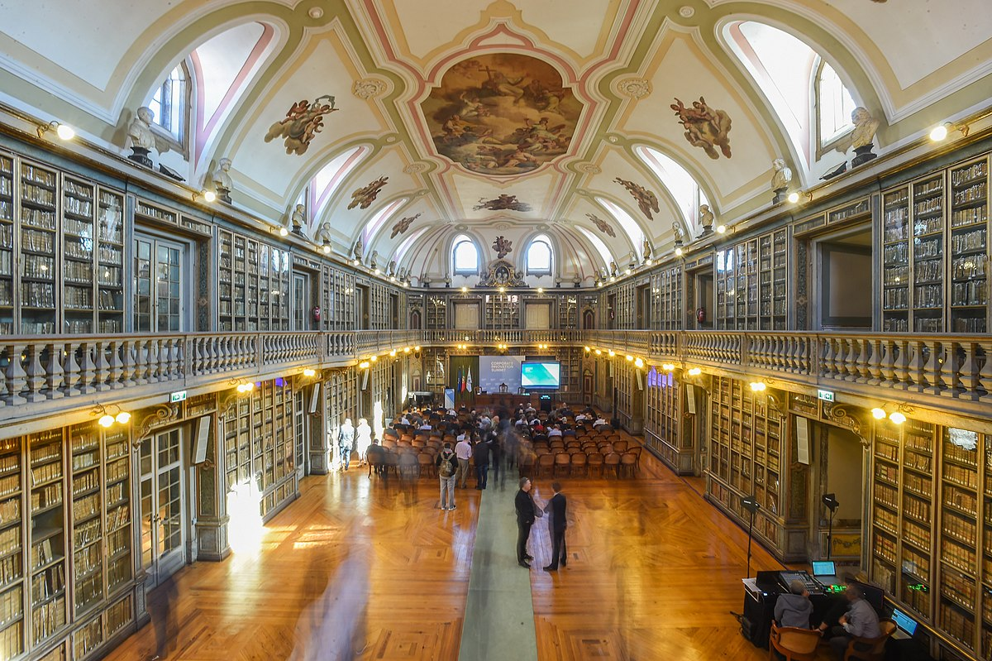
A Parallel Intellectual History
Pre-modernism (before 1600s)
Biblical world view
Modernism (1600s-1960s)
Reason and utopianism
Post-modernism (1960s-?)
God is dead; Truth is an illusion
Reason without Faith
Notre Dame
Faith & Reason
Academia

Slide 22
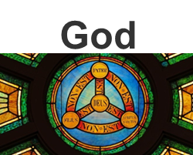
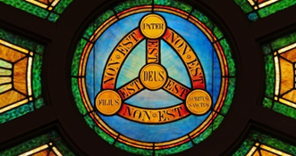
Spiritual Impact of Modernism
St. Thomas Aquinas
Modernists
God
X
X
Passion
Imagination
Will
Divine
Faculties
Reason
Will
Reason
Intellect
Human
Faculties
Intellect
Passion
Imagination
Human
Faculties
Divine
Faculties

Slide 23
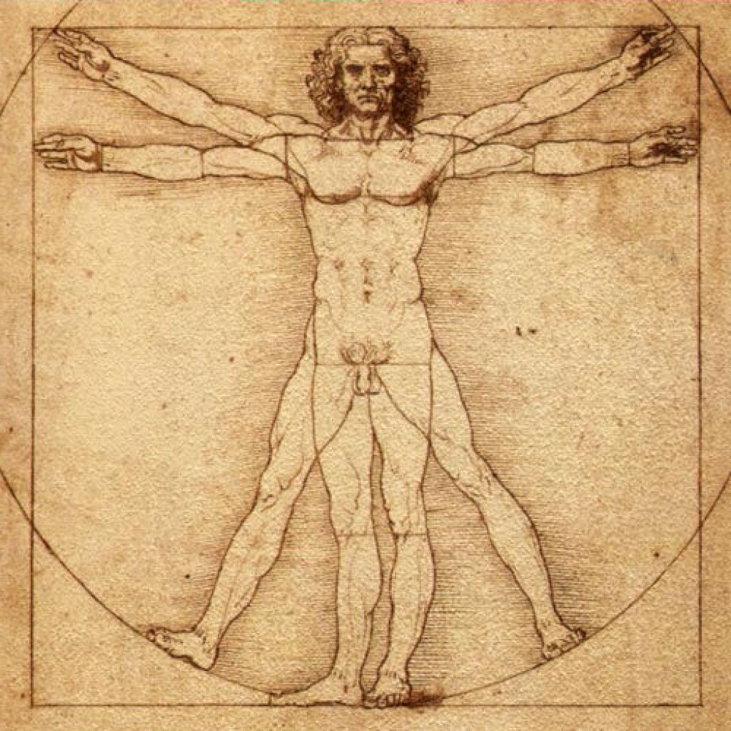
Spiritual Impact of Modernism
St. Thomas Aquinas
Modernists
God
Man
X
X
Will
Divine
Faculties
Reason
Passion
Imagination
Will
Reason
Intellect
Intellect
Passion
Imagination
Human
Faculties
Human
Faculties
Once-Divine
Faculties

Slide 24
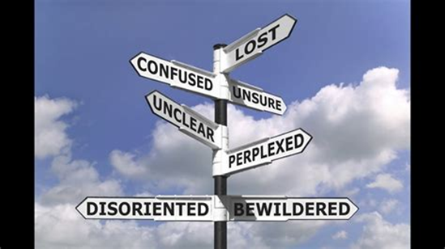
The Social Order Today: Man Seduced by Evil Gen 3:5”…you will be like gods who know what is good and what is bad.” The Serpent
26

Slide 25
Secularism: Empty Souls seeking God in man
Cult of social justice
Justice as defined by identity politics
Good and evil are a matter of power dynamics
Utopian visions drive revisionist history and reinvented language
The “rules” change as goals change
Neo-paganism
Religious faith is rejected and not tolerated
Ideology of “social justice” replaces Faith
Man must “remake” the world in his image
Politicization of all aspects of life

Slide 26
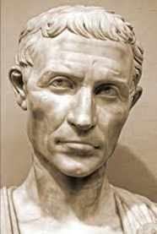
Quid est veritas? Jn 18:38
How we think about truth affects how we think about reality… a glimpse of the absurd
Truth
is the conformity of the mind with reality (Ladder of Ascent/Aristotle)
in speech it is the conformity of the spoken word to that which is known in the mind (Ladder of Ascent/Aristotle)
Jesus: I am the way, and the truth and the life Jn 14:6
https://www.youtube.com/watch?v=xfO1veFs6Ho

Slide 27
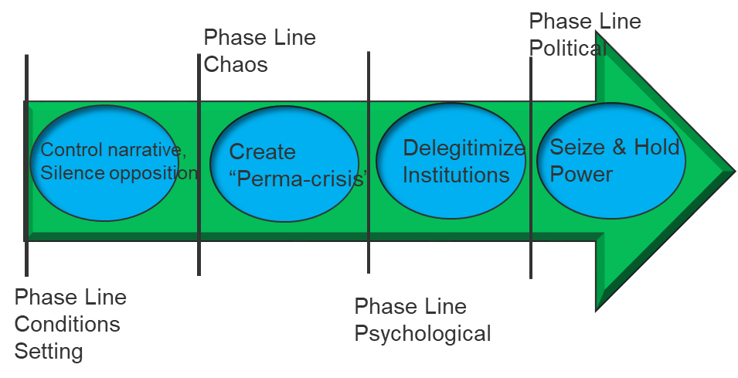
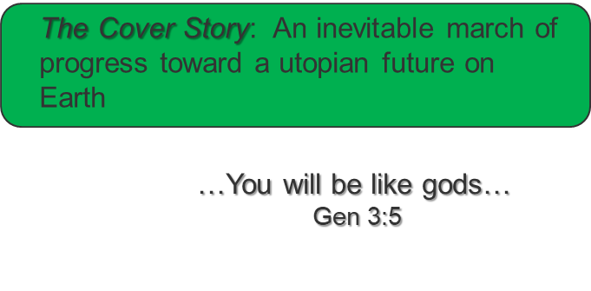
The Enemy’s Battle Plan: “Social Justice”, Death by a Thousand Cuts…
The Truth

Slide 28
Small Group Discussion
Tolerance is an attitude of reasoned patience towards evil and a forbearance that restrains us from showing anger or inflicting punishment. But what is more important than the definition is the field of its application. The important point here is this: Tolerance applies only to persons but never to truth. Intolerance applies only to truth but never to persons. Tolerance applies to the erring; intolerance to the error.
Venerable Servant of God Archbishop Fulton Sheen
-In a world numb to evil, how do we identify
and call it out?
-How do we testify to the Truth in a world that
does not acknowledge Truth?
Catholic view of social
Justice: CCC 1877-1948
If the world hates you, realize that it hated Me first Jn 15:18
30

Slide 29
Small Group Discussion
Tolerance is an attitude of reasoned patience towards evil and a forbearance that restrains us from showing anger or inflicting punishment. But what is more important than the definition is the field of its application. The important point here is this: Tolerance applies only to persons but never to truth. Intolerance applies only to truth but never to persons. Tolerance applies to the erring; intolerance to the error.
Venerable Servant of God Archbishop Fulton Sheen

Slide 30
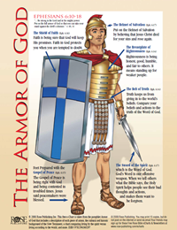
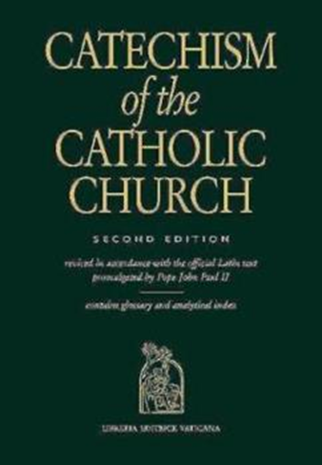
Combatting Satan and Winning the Cultural War.
We are soldiers in a battle (Church Militant)
We are protected by the Armor of God
Live not by lies: testify to the truth and act on Catholic principles of social justice
Feed your Faith
Prayer: listening, persistence, Rosary
Adoration
Reading Scripture
Study
Sacraments, especially Eucharist and Reconciliation
32

Slide 31
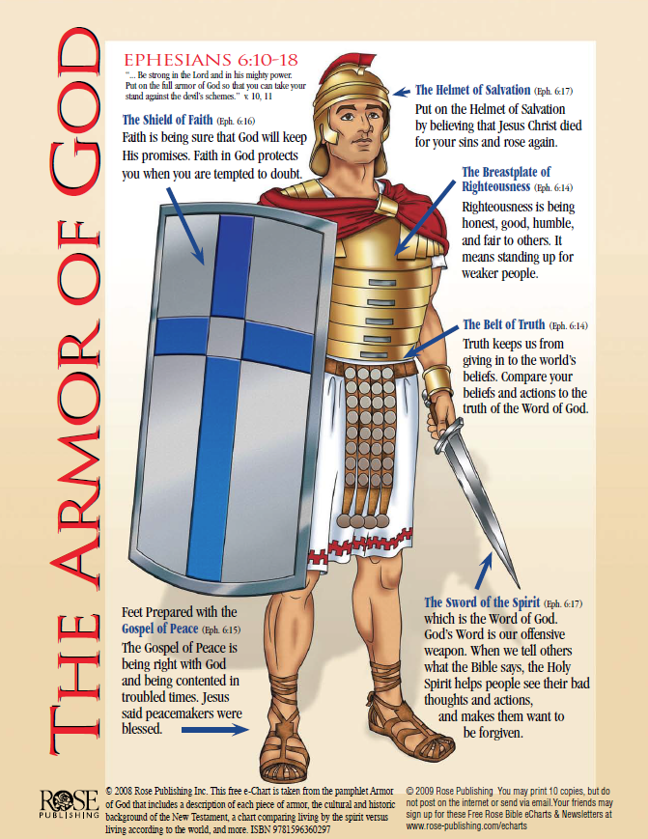
Combatting Satan and Winning the Cultural War, cont.
Do not be afraid to suffer for the Truth (2 Tim 4:1-5, Deut 30:15-19)
33

Slide 32
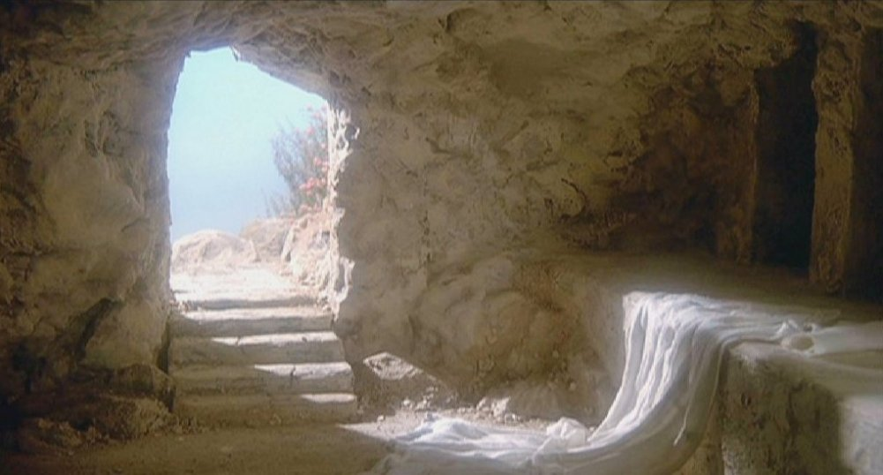
Christus Vincit!
Christ conquers!
I have told you this so that you might have peace in me. In the world you will have trouble, but take courage, I have conquered the world. John 16:33
Notes:
TC presents

Slide 33
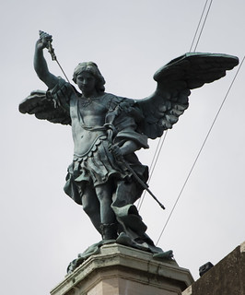
Closing Prayer
Saint Michael the Archangel, defend us in battle. Be our protection against the wickedness and snares of the devil. May God rebuke him, we humbly pray, and do thou, O Prince of the Heavenly Hosts, by the power of God, thrust into hell Satan and all the evil spirits who prowl about the world seeking the ruin of souls. Amen
35
Notes:
TC presents

Slide 34
Bibliography
Caldwell, Taylor, Dialogs with the Devil
Burke, Dan, Spiritual Warfare and the Discernment of Spirits
Benedict XVI, Pope, Values in a Time of Upheaval
Denver Catholic Catechetical School, The Ladder of Ascent, St. John Vianney Theological Seminary, 2019
Dreher, Rod, Live Not by Lies, Sentinel Press, 2020
36
Notes:
TC presents

Slide 35
Bibliography, cont.
Halligan, Nicholas, What the Devil, Catholic Answers article
Kreeft, Peter, How to Win the Culture War, Intervarsity Press, 2002
Kreeft, Peter, A Refutation of Moral Relativity, Ignatius Press, 1999
Lewis, C.S., The Screwtape Letters, Harper San Francisco Pub. 1996
Sarah, Cardinal Robert, The Day is Now Far Spent
Assorted articles on www.catholic.com
37
Notes:
TC presents

