Slide 1
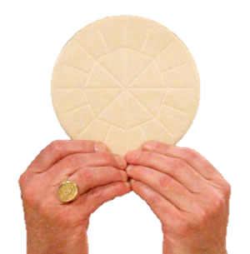
The Eucharist thru Jewish Eyes
Was the Eucharist just a meal to remember Jesus by?
How would ancient Jews have understood the Last Supper?

Slide 2
Just a Way to Remember Jesus?
Joseph Bayly’s modern parable:
“How Shall We Remember John?”
The whole point: the Lord’s Supper was just a family dinner to remember Jesus.
Really? That’s it?

Slide 3
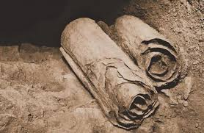
A Jewish Perspective on the Last Supper
For modern Americans, many details of the Last Supper go unnoticed and unremarked, and it’s just “a meal to remember Jesus.”
But for Jews of the first century, every detail of the Last Supper accounts would have been significant.
Paying attention to these details, in light of the Dead Sea Scrolls, the only contemporary Jewish documents we have, enable us to reconstruct the last days of Jesus more vividly.

Slide 4
The Jewish Sect of the Essenes
The Essenes were a sect or “party”, as were the Sadducees and the Pharisees, and similar in size
The Essenes consider themselves the “true Israelites,” the faithful remnant of God’s people
The practiced strict observance of God’s law, and lives of poverty, prayer, and works of charity.
They alone practiced monasticism.
They had a monastery by the shores of the Dead Sea, and the remains of their library are the famous “Dead Sea Scrolls”

Slide 5
The Essene Monastery at Qumran on the Dead Sea

Slide 6
The Essene Monastery at Qumran on the Dead Sea

Slide 7
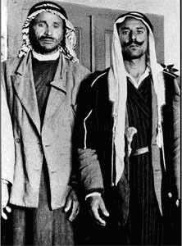
The Men Who Found the Scrolls: Muhammed edh-Dhib & Juma Muhammed, c. 1947

Slide 8
Qumran Caves

Slide 9
Overview of Monastery

Slide 10
Large Number of Ritual Baths

Slide 11
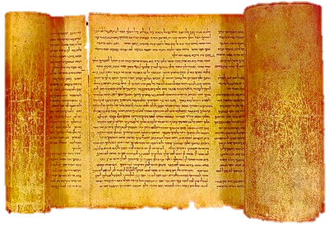
The Great Isaiah Scroll

Slide 12
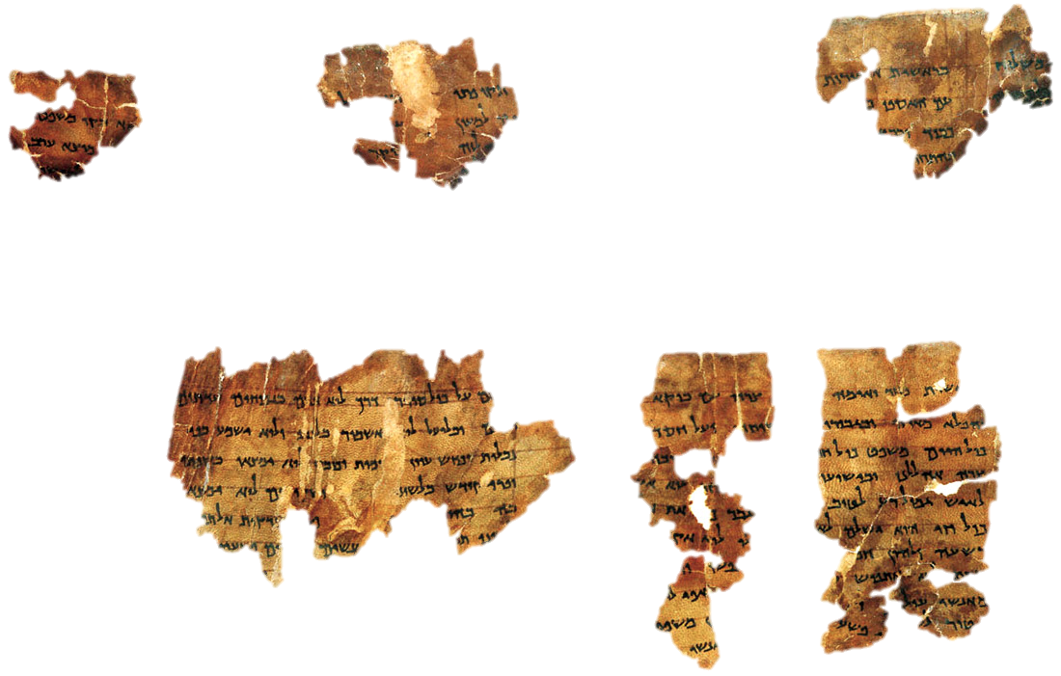
The Community Rule

Slide 13
So what do the Essenes have to do with the Last Supper?
The Essene monks hid their library of scrolls in caves when they saw they were going to be attacked by Roman soldiers … only to be rediscovered in 1947 …
How does that relate to the Gospel accounts?

Slide 14
These Monks Had Kind of “Eucharist”
They had a sacred, communal meal every day at noon.
The meal consisted of bread and wine, and anticipated the coming of the Messiah
A priest had to officiate at the meal.
The priest had to stretch out his hand to bless the bread and the wine before anyone else.
One had to be a member of the community to take the meal.
The meal marked your membership in the “new covenant”
The meal began and ended with Thanksgiving Psalms, sayin, “I thank you, O Lord!” in Greek: “Eucharistô Kyrie!”

Slide 15
The Essenes at their Meal

Slide 16
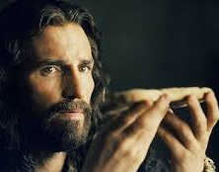
Jesus the Priest at the Last Supper
Mark 14:22 “He took bread, and after blessing it broke it and gave it to them …²³ And he took a cup, and when he had given thanks he gave it to them…
He takes and gives thanks first…
“When the table has been set for eating or the new wine readied for drinking, it is the priest who shall stretch out his hand first, blessing the first portion of the bread or the new wine.” (“The Community Rule” [1QS] from Qumran)

Slide 17
The Eucharist as Memorial Offering
Luke 22:19: He gave it to them, saying, “This is my body, which is given for you. Do this in remembrance of me.”
“Remembrance” = “Memorial Offering”
Greek: eis tên emên anamnêsin =
“Do this as my memorial offering”, a Temple sacrifice that consisted of grain and served to renew the covenant
See title of Pss 38, 70 (LXX 37, 69)
Jesus is using Jewish liturgical language

Slide 18
Luke’s Account of the Eucharist
Luke 22:19: Do this in remembrance of me.”
Greek: eis tên emên anamnêsin =“as my memorial”
Ps 38:1: Psalmos tô David: eis anamnêsin peri sabbatou = “A Psalm of David for the memorial offering of the Sabbath”
Ps 70:1 tô David, eis anamnêsin = “Of David, for the memorial offering”

Slide 19
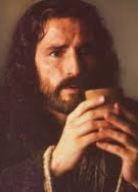
The “Many” as Term for the Church
Matt. 26:28 “For this is my blood of the covenant, which is poured out for Many for the forgiveness of sins….”
The term “Many” was used to refer to the whole sacred community …
“The novice must not touch the pure food of the Many before they have examined him …” Damascus Document 6:16-17
“Many” is a typical way of referring to the community, i.e. the Church …

Slide 20
The Eucharist is the New Covenant!
Luke 22:19: Do this in remembrance of me.” 20 And likewise the cup after supper, saying, “This cup is the new covenant in my blood which is poured out for you …”
Notice the new covenant is “the cup [consisting of] my blood…”
Notes:
James A. Swanson Dictionary of Biblical Literature with Semantic Domains: Greek (1997)

Slide 21
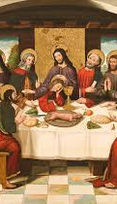
The Eucharist Fulfills the Prophecies!
Luke 22:20 And likewise the cup after supper, saying, “This cup which is poured out for you is the new covenant in my blood.”
The fulfillment of Jeremiah 31:31!
Jer. 31:31 “Behold, the days are coming, says the LORD, when I will make a new covenant with the house of Israel …”
“In my blood” means “consisting of my blood”

Slide 22
Light from Qumran on the Eucharist?
Luke 22:24 “A dispute also arose among them, which of them was to be regarded as the greatest.”
“Then the Messiah of Israel may enter, and the heads of the thousands of Israel are to sit before him by rank.... … Afterward the Messiah of Israel shall reach for the bread. Finally, each member of the whole congregation … by rank.” [Appendix to the Community Rule (1QSa) 2:14ff]
It wasn’t just that the disciples were vain …

Slide 23
Summing Up: Qumran & the Eucharist
Last Supper no mere “memorial meal” as many Christians mistakenly think.
Disciples would have understood the priestly and messianic significance of Jesus’ actions
Disciples had concept of bread-and-wine meal with the Messiah in the end times
Eucharist is covenant meal making us God’s family, and establishing us as God’s kingdom.
Eucharist also goes beyond anything Essenes imagined

Slide 24
Getting Back to “How Shall We Remember John”
Was the Eucharist nothing but a “meal to remember John”?

Slide 25
Differences Between “The Meal to Remember John” and the Last Supper
John’s family wasn’t building on a long tradition of sacred meals in their culture—but Jesus was!
John’s parents weren’t claiming to establish a “new covenant” between God and humanity through this meal—but Jesus did!
None of the meal actions of John’s family were intended or understood to be priestly or liturgical—but Jesus’ were!

Slide 26
Differences Between “The Meal to Remember John” and the Last Supper
John’s family wasn’t culturally formed to expect to celebrate a meal like this with the Messiah in the end time—but the Apostles were!
John’s parents didn’t claim to be fulfilling ancient prophecies by celebrating this meal—but Jesus did!

Slide 27
Want to See the Sacred Sites?
Pilgrimage to the Holy Land, June 23–July 2, 2023.
Info and Sign-ups: www.JohnBergsma.com
Or www.CatholicBibleTeacher.com
www.jbergsma@franciscan.edu

