Slide 1
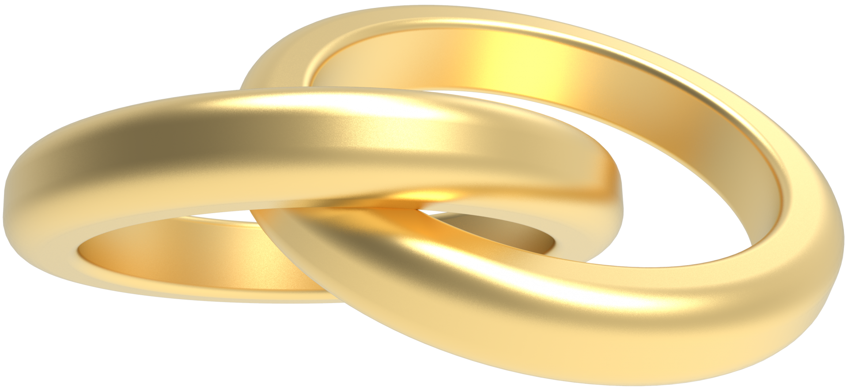
Holy Matrimony
St. Peter Catholic Church RCIA
January 18, 2024

Slide 2
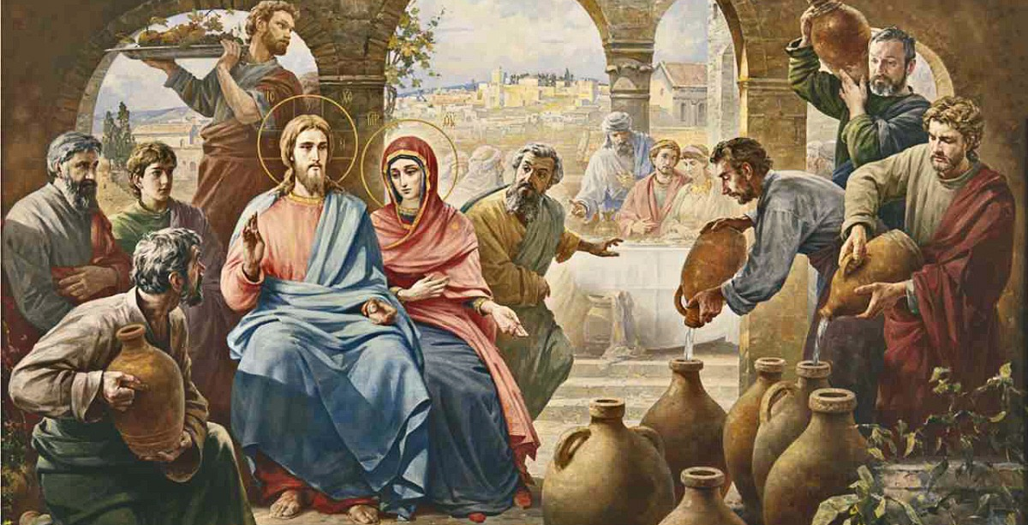

Slide 3
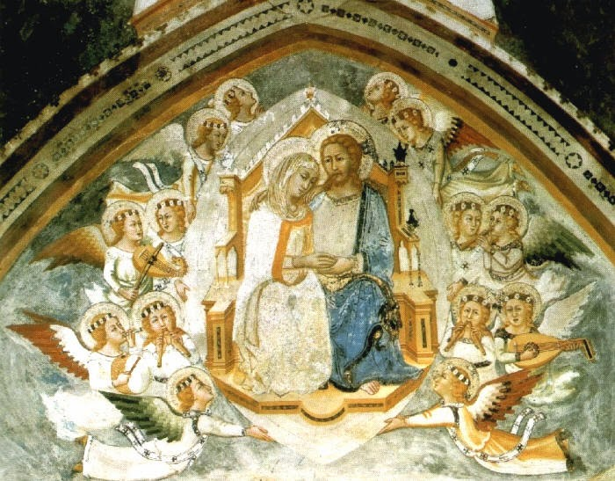
God created man and woman in His own image and likeness. Matrimony is the image of the self-donating love of Trinity and of Christ’s nuptial relationship with His Church. It is
A SACRAMENT OF SERVICE TO THE BODY OF CHRIST
CCC 1601-1666

Slide 4
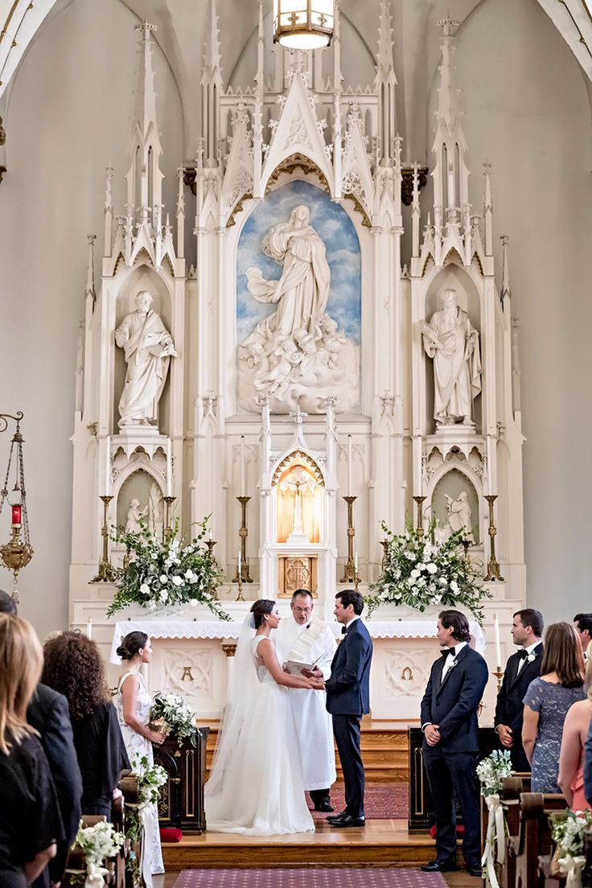
Sacrament of Service to Build Up the Kingdom
A sacred vocation, to sanctify each other and work out their salvation
The foundation of society
Covenant
Participate in God’s work of creation
Indissoluble

Slide 5
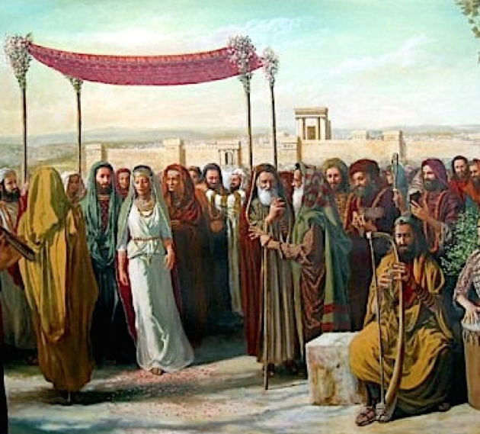
Marriage in the Old Testament
Gen 1:26-28, Gen 2:18-24
Ps 128:3-4
Isaiah 54:1-14
Jer 2:1 – 3:5
Hos 2:14-20
Malachai 2:13-16

Slide 6
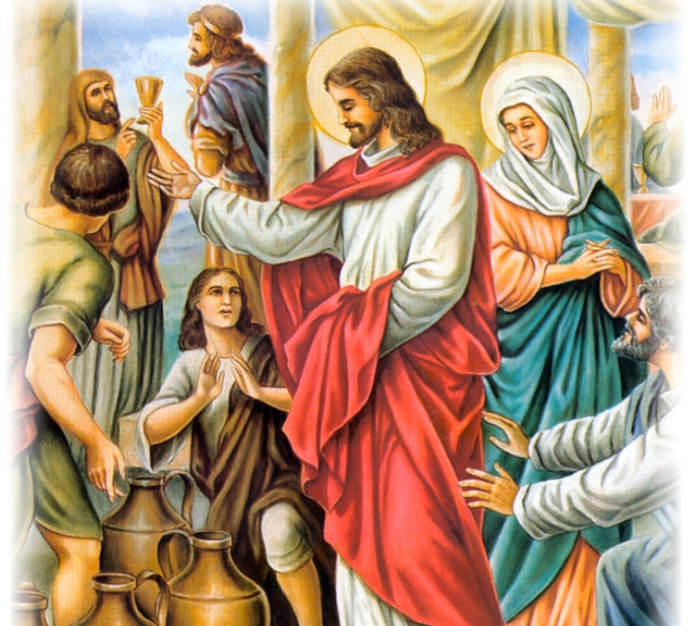
Marriage in the New Testament
Mt 5:31-32
Mt 19:3-9
John 2:1-10
Eph 5:21-33
Eph 6:4
Rev 19:5-9

Slide 7
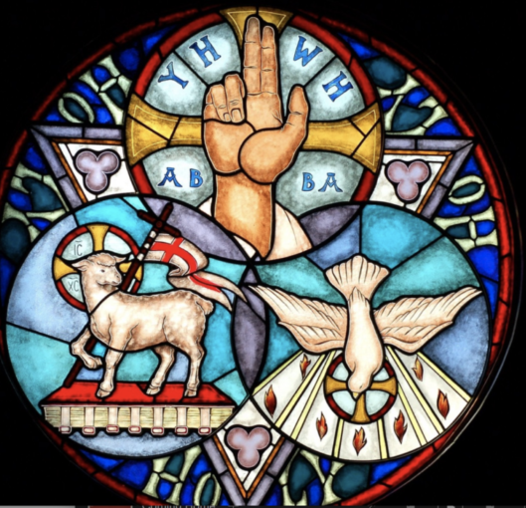
Reflecting the Love of the Trinity
Self-donating Love
God is the primordial lover
Jesus is the Beloved
The Holy Spirit is the Personification of their love.
Notes:
“The human body includes right from the beginning... the capacity of expressing love, that love in which the person becomes a gift – and by means of this gift – fulfills the meaning of his being and existence.”
St. John Paul II

Slide 8
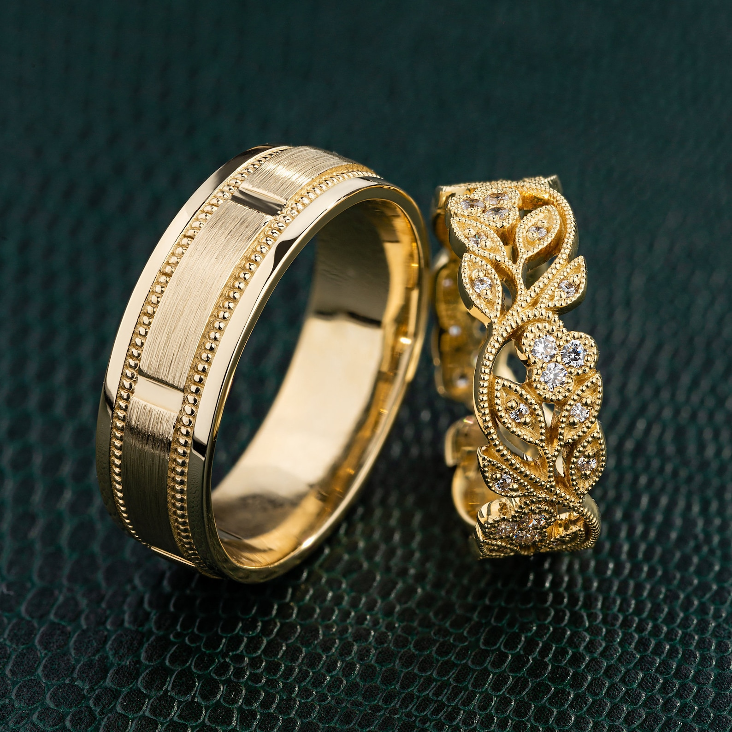
The Fruits of the Sacrament of Matrimony
The good of the couple is in the “unitive end” of Matrimony: two in one flesh (Gen 2:23-24)
The good of children is the “procreative end” of Matrimony: marriage is at the service of life (Ps 127:3)
The good of society is from the foundation of a stable and loving family unit

Slide 9
Does Marriage Matter?
Personal Impacts
Societal Impacts
Eternal Impacts

Slide 10
Sins Against the Dignity of Marriage (1Cor 6:9-20)
Any form of sexual union outside of marriage
Any interference with the natural conception of children
Any attempt to dissolve the union

Slide 11
Marriage Preparation
Catholics who go through formal marriage preparation are less likely to divorce https://www.ncregister.com/news/divorce-statistics-indicate-catholic-couples-are-less-likely-to-break-up
Instruction on the essential elements of marriage
The formal process varies somewhat
Nearly 94% of couples find it valuable in their marriage

Slide 12
The Rite of Marriage
Normally celebrated within the Mass
Elicit consent of couples through questions
Blessing and exchange of rings
Liturgy of the Eucharist
Spouses mutually confer upon each other the sacrament of Matrimony by expressing their consent before the Church CCC 1623
Nuptial blessing
Sign of peace
Communion
Solemn blessing
The priest is a witness. CCC 1623 and 1625-32

Slide 13
Separation and Divorce
In some situations, living together becomes impossible
The Church will permit physical separation
This does not mean they cease being husband and wife
Many Catholics obtain a civil divorce and contract new civil unions
Declaration of Nullity (CCC 1629)

Slide 14
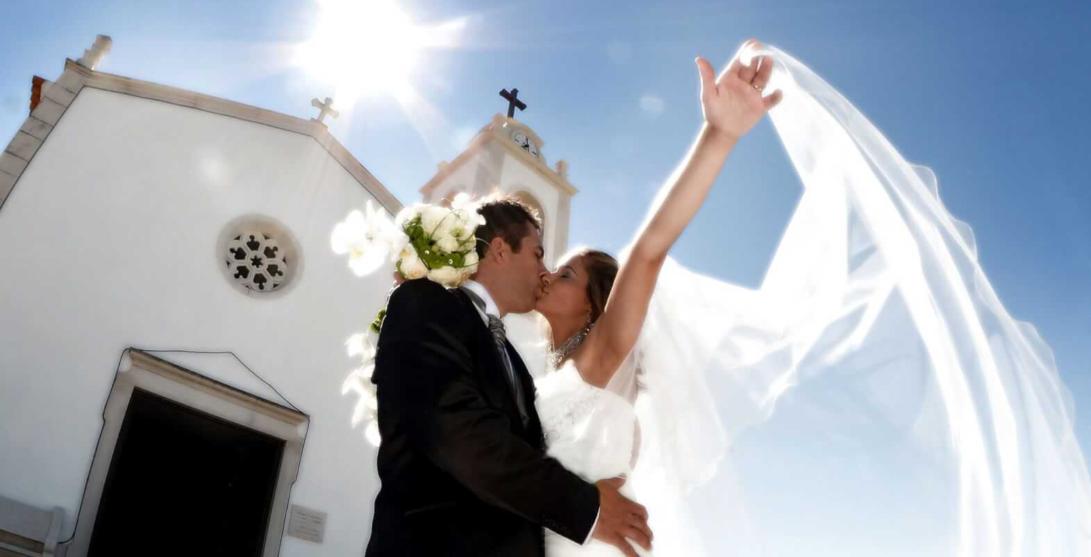

Slide 15
Further Reading
“Humanae Vitae” (“Of Human Life”, July 25, 1968) – Encyclical of Pope Paul VI regarding married love, responsible parenthood, and continuing to reject most forms of birth control
USCCB document on Pope St. JPII’s Theology of the Body: https://www.usccb.org/issues-and-action/marriage-and-family/natural-family-planning/catholic-teaching/theology-of-the-body
Catholicnet: https://theologyofthebody.net/ Includes in depth references to Pope St. JPII’s meditations
Original transcripts of Pope St. JPII’s sermons: https://stmarys-waco.org/documents/2016/9/theology_of_the_body.pdf
Theology of the Body for Beginners: Revised Edition by Christopher West
Catechism of the Catholic Church paragraphs 1601-1666

