Slide 1
GRACE
RCIA 2020-2021

Slide 2
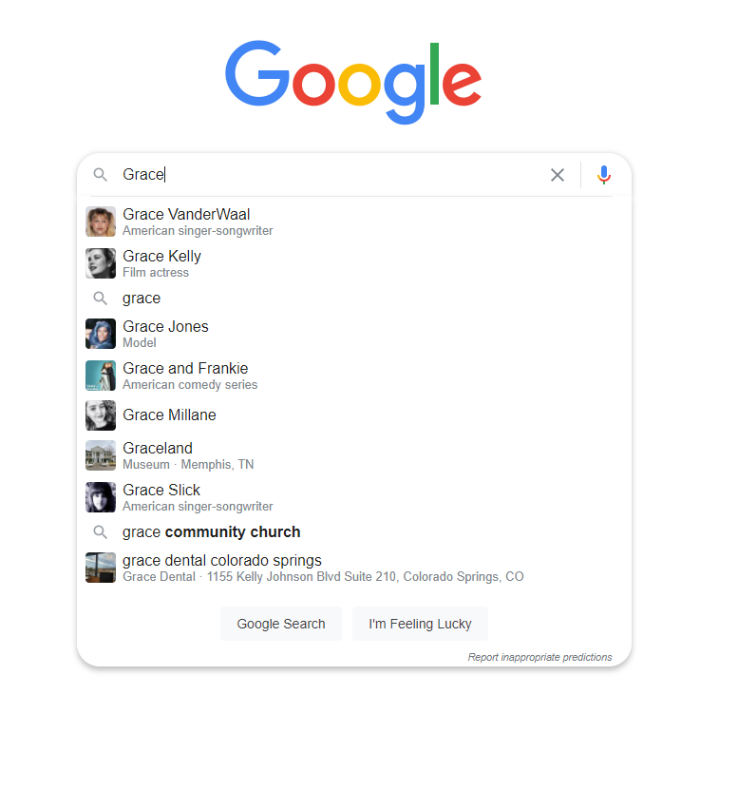

Slide 3
The End.

Slide 4
In Your Own Words
Define…

Slide 5
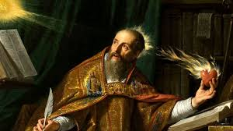
St. Augustine of Hippo
What is grace? I know until you ask me; when you ask me, I do not know.

Slide 6
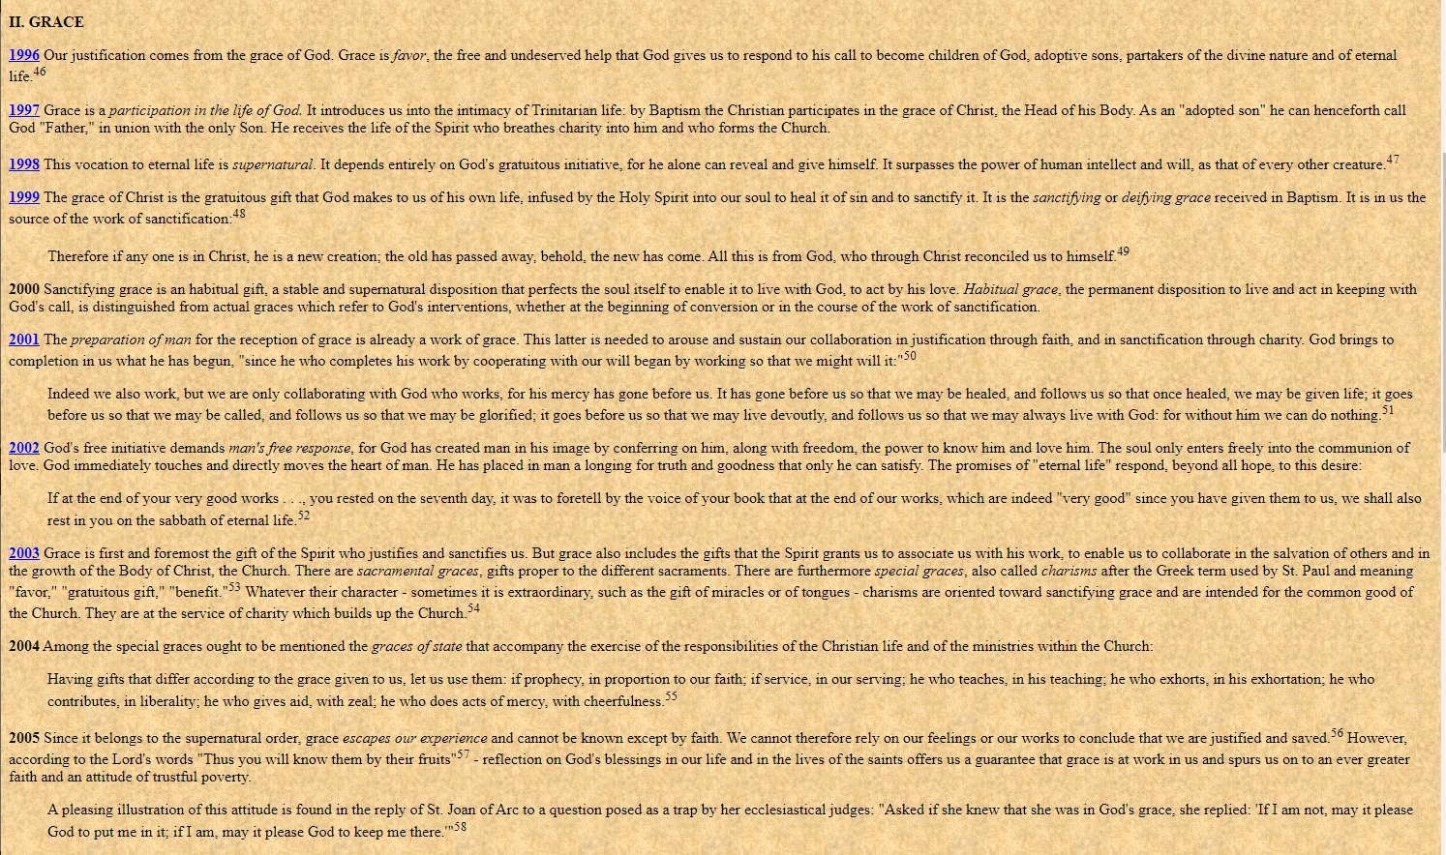

Slide 7
Catechism of the Catholic Church
Grace is a favor
Grace is a participation
Grace is a vocation
Grace is a gratuitous gift
The reception of grace is already a work of grace
Grace demands man’s free response
Grace belongs to the supernatural order, it cannot be known except by faith
There’s Sanctifying Grace and Actual Grace

Slide 8
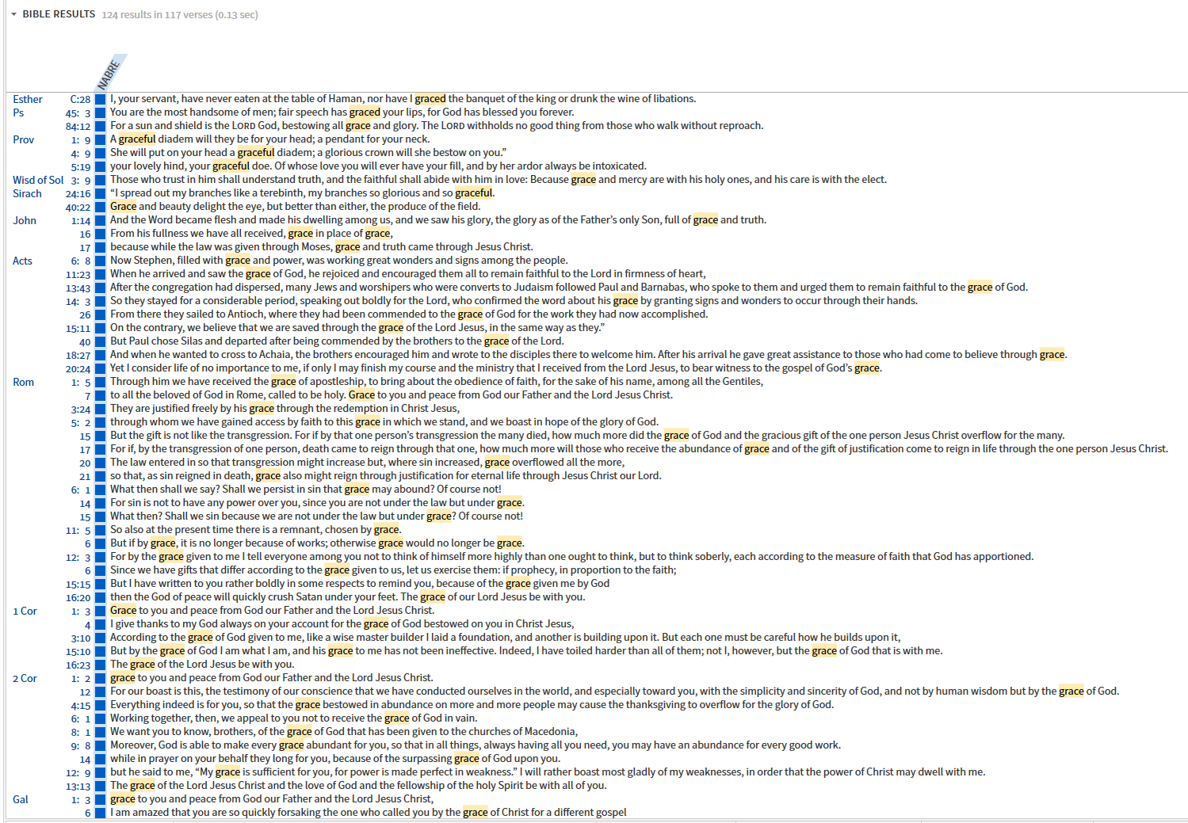

Slide 9
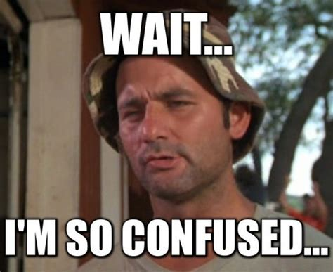

Slide 10
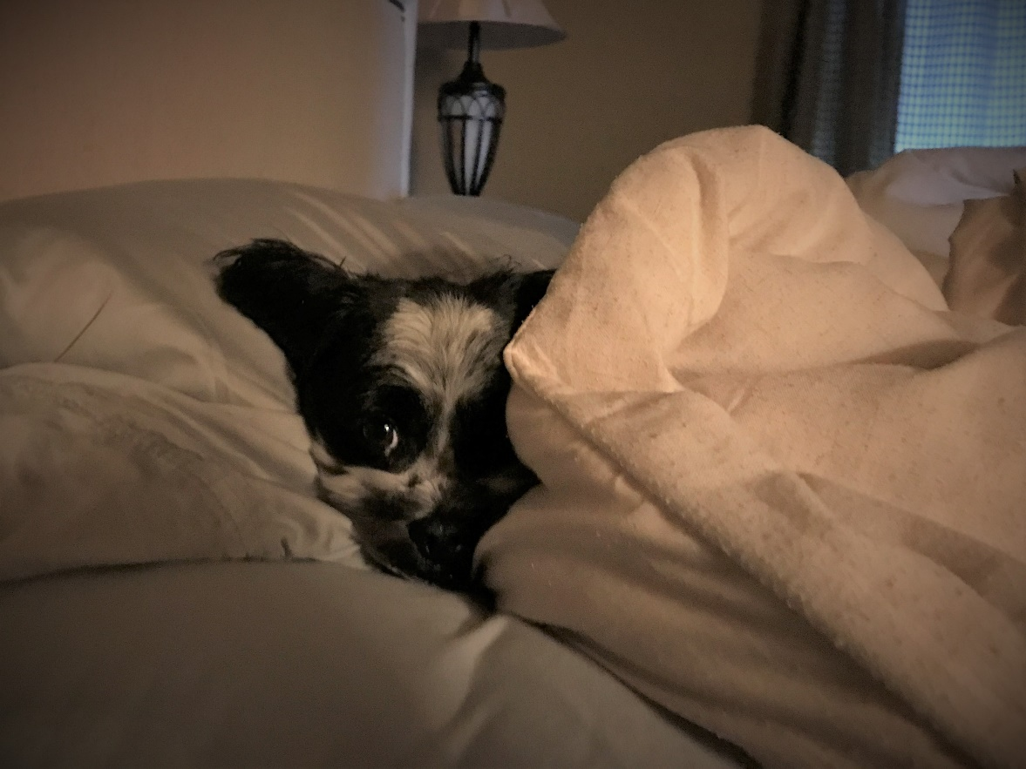
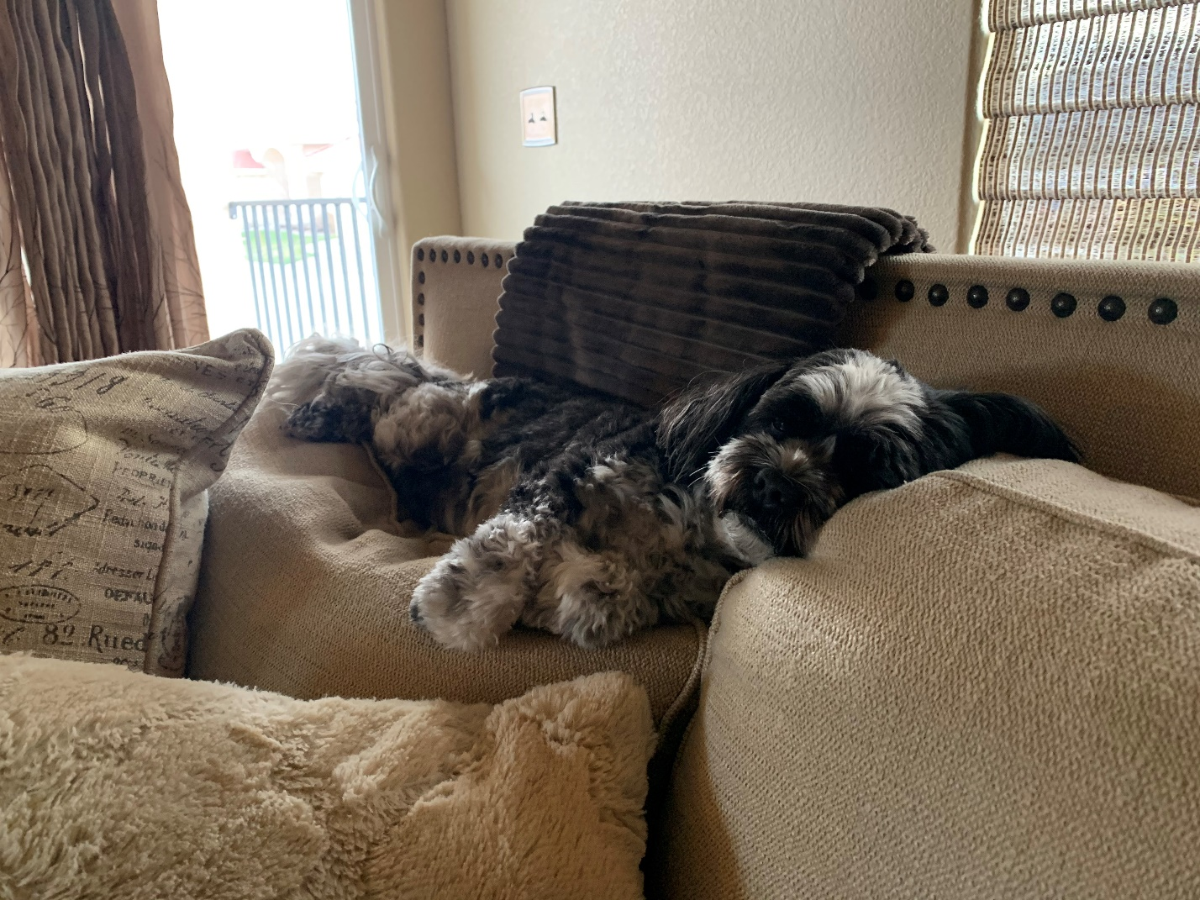

Slide 12
Justice is the state of being in which everything is what it is meant to be, everything is in right order with everything else.

Slide 13
God’s Plan
God, infinitely perfect and blessed in himself, in a plan of sheer goodness freely created man to make him share in his own blessed life.
In the fullness of time, God the Father sent his Son as the Redeemer and Savior of mankind, fallen into sin
Thus calling all into his Church and, through the work of the Holy Spirit, making them the adopted children and heirs of his eternal happiness.

Slide 14
Grace is
The indispensable means necessary to achieve the Beatific Vision.

Slide 15
Grace (simply said, is)
Divine influence on the heart,
so that in the end we may see God face
to face.

Slide 16
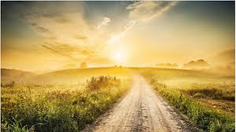

Slide 17
find our way…
Actual Grace
Sanctifying Grace
A gift of God when we need it or seek His help
We receive, so we may believe and respond (Act)
The Sacraments confer, that is, gifts specific to the purpose of each
Prepares us for union with God
We can not earn salvation, we need His help
So that our sins are truly forgiven; new creatures (a state of being)
The sacraments confer, that is, to make holy

Slide 18
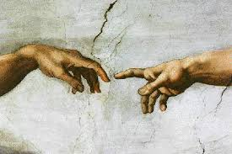
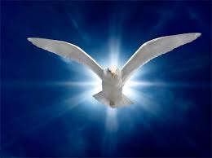
Grace (finding our way by)
Actual grace, the hand of God
Sanctifying grace, the breath of God
Father G. Ames

Slide 19
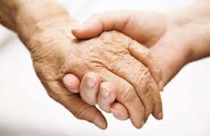
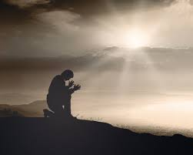
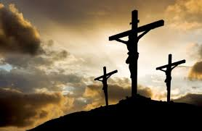
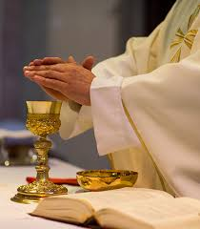
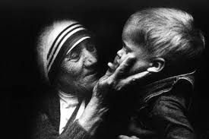
Grace is to know and to love God

Slide 20
find our way…
Additional Passages
Importance of Grace
Hebrews 4:14-16 (throne of grace)
Romans 5:20-21 (eternal life)
2 Peter 3-4 (partakers of divine nature)
We were made on purpose; we don’t always live on purpose.
We don’t live as if we truly believe in God.
The call to holiness is nothing other than a call to live a life of grace.

