Slide 1
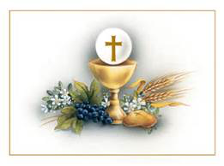
EUCHARIST II Source and Summit
St. Peter Catholic Church, Monument
December 7, 2023

Slide 2
Opening Prayer
Touch our hearts, Lord … R. Be with us.
Let us learn, Lord … R. Be with us.
Lift our minds, Lord … R. Be with us.
Show the way, Lord … R. Be with us.
Move our hearts, Lord … R. Be with us.
Teach us love, Lord … R. Be with us.
Amen

Slide 3
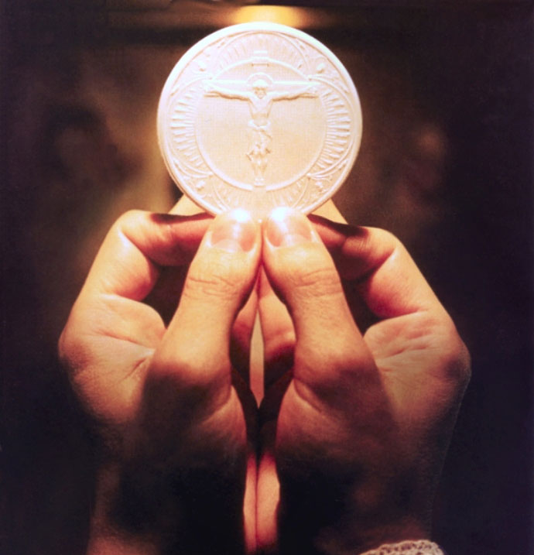
Objective
To begin unravelling the mysteries of the Holy Eucharist

Slide 4
Quick Review of Bishop Golka’s Talk

Slide 5
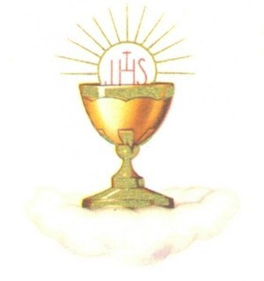
What is the Eucharist?
Sacrament and a sacrifice
Under the appearances of bread and wine, the Lord Christ is contained, offered, and received.
The whole Christ is really, truly, and substantially present in the Holy Eucharist.

Slide 6
What is the Eucharist?
All Christians, with but few minor exceptions, held the true doctrine of the Real Presence from the time of Christ until the Protestant Revolution in the sixteenth century.
The word "Eucharist" means "Thanksgiving."

Slide 7
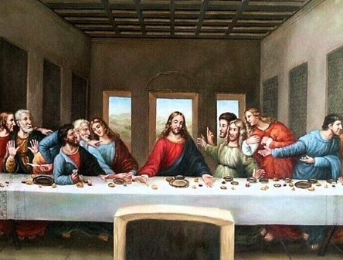
Synoptic Gospel References
Mk 14:12-25
Mt 26:17-29
Lk 22:7-20
What do these tell us about the Eucharist?

Slide 8
Foreshadowing in the Old Testament
Melchizedek, priest-king of Salem offers bread and wine as thanksgiving. Gn 14: 18-20
God miraculously feeds the Israelites in the desert with manna and quail. Ex 16: 2-16 “I am going to rain down bread from heaven.”
God commands that the Bread of Presence is to be always in the sanctuary as a sacrificial offering. Ex 25: 23-30
God prescribes the Passover ritual, centered on killing and eating the Paschal lamb - an unblemished, perfect lamb - and on preparing and eating unleavened bread. Ex 12: 1-20

Slide 9
Miracle of the Loaves and Fishes
Elijah multiplies flour and oil to keep a widow and her son alive. 1 Kings 17:8-16
Elisha multiplies bread. He has twenty barley loaves to feed 100. Kings 4:42-44
Jesus has 5 loaves and feeds 5000 with 12 baskets left over. Jn 6: 1-15

Slide 10
The Bread of Life Discourse
John 6:35-59
First, an invitation to faith
John 6:35-47
“I am the bread of life” “I have come down from heaven” “he who believes has eternal life”
Then, an invitation to the Eucharist
John 6:48-59
“I am the bread of life” “This is the bread which came down from heaven” “he who eats my flesh and drinks my blood has eternal life”

Slide 11
The Bread of Life Discourse
The Catholic Church takes Jesus literally when he says “I am the Bread of Life”
When God speaks, what He says comes to pass
If He says “Let there be…” it becomes
When He says “This is...” it becomes
But even some of the followers of Jesus’ time “no longer accompanied him.”

Slide 12
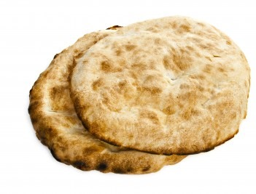
The Bread of Life Discourse, cont.
If the Eucharist were merely commemorative or symbolic, it would be no better than manna. People died even if they ate manna.
Read John 6:33-35
Also, John 6:48-51

Slide 13
The Bread of Life Discourse, cont.
Jesus usually took care to clear up any misperceptions by his hearers eg: John 3:1-15, Matt 16: 5-12
Why didn’t Jesus soften this teaching?
In fact, he doubled down: He repeats his message several more times
The Greek verb “to eat”
Phago – more common form, used early in John 6
Trago – to chew or gnaw. Used 4 times in John 6:54-58
Changes the focus, tone and emphasis of what Jesus is saying from necessity of faith to the actual consumption of the Eucharist.

Slide 14
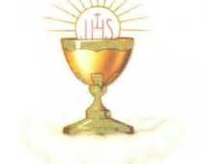
The Bread of Life Discourse, cont.
To Jews in Jesus’ time, to “eat the flesh” meant to inflict grievous injury
This doesn’t make sense in Jesus’ discourse, telling people to inflict grievous injury on him
This would not have been lost on his followers
It is reasonable, then, to take Jesus literally

Slide 15
The Bread of Life Discourse, cont.
“It is the spirit that gives life, while the flesh is of no avail. The words I have spoken to you are spirit and life.” (John 6:63)
If we try to understand this teaching with our human natures (flesh), we fail. We need the spirit (grace of God) to accept this in faith
It would not make sense for Jesus to tell us to eat his flesh, and then tell us it is pointless to eat his flesh

Slide 16
Transubstantiation
Something must either exist in its own right, such as water, a tree, a cat, or else it must exist in something else, such as color or shape. What "stands on its own feet," as it were, is a substance; what exists in something else is an “accident”.
Denial of substances leaves color, size, weight and so on without a subject, which implies a color which is not the color of anything, size which is not the size of anything, weight which is not the weight of anything.

Slide 17
Transubstantiation, cont.
The dogma of transubstantiation teaches that the whole substance of bread is changed into that of Christ's body, and the whole substance of wine into that of his blood, leaving the accidents of bread and wine unaffected.
Reason, of course, can't prove that this happens.
But it is not evidently against reason either: it is above reason. Our senses, being confined to phenomena, cannot detect the change: we know it only by faith in God's word.

Slide 18
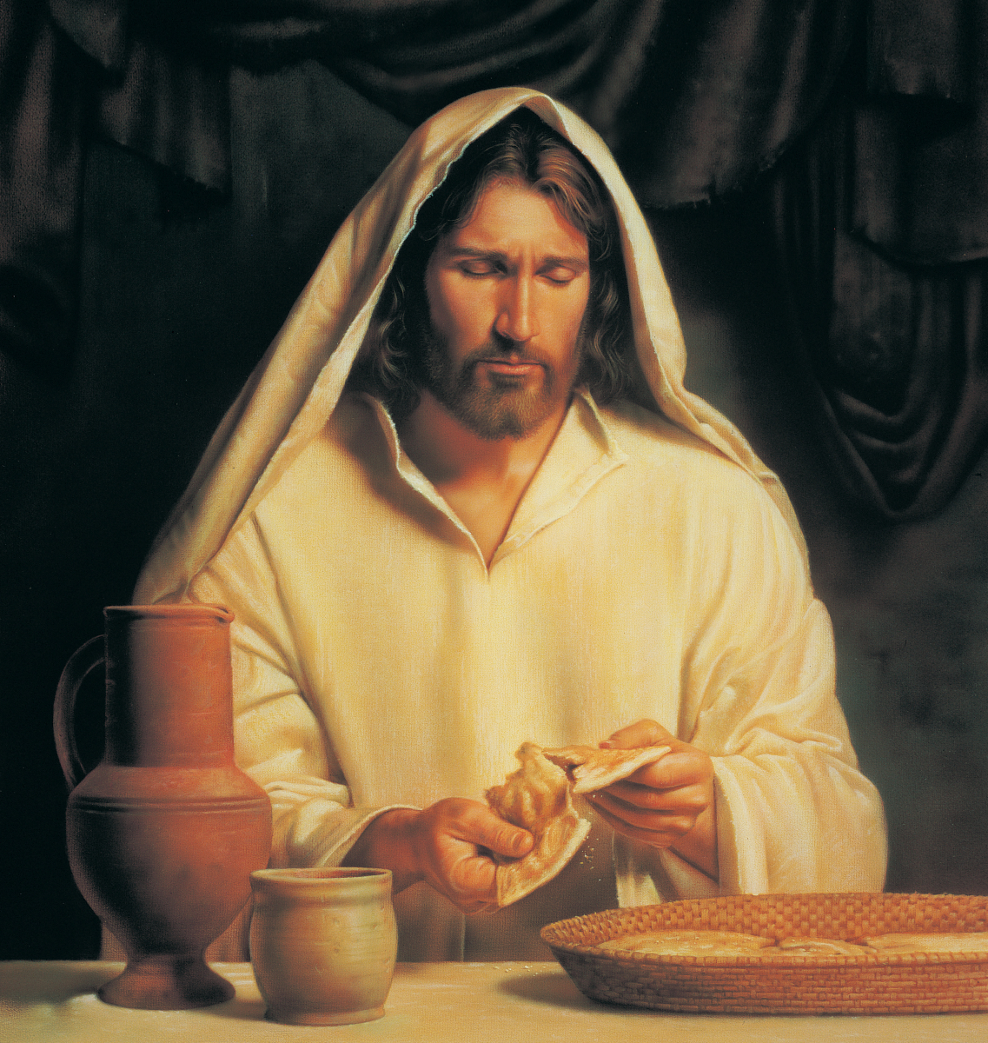
The Last Supper
Jesus said, “This is my body” and “This is my blood”
He is the Lamb being sacrificed for our Passover, out of slavery into eternal life
Jesus said “Do this in memory of me”
The Last Supper is when Jesus instituted the Eucharist, and the priesthood
This is one way Jesus fulfills his promise to be with us always

Slide 19
The Eucharist as Sacrifice
Remembrance as “re-presentation”
Past, present and future are all one to God.
Heb 13:8 “Jesus Christ is the same yesterday, today and forever.”
When we say we re-present Christ’s sacrifice at the Mass, we are not saying he dies again and again
Jesus, having once and for all shed his blood for us, now offers himself to God in an un-bloody manner as a holy, living sacrifice on our behalf (CCC 1362-1372)
We also offer ourselves as a “living sacrifice to God” (Rom 12:1).
The offering of a sacrifice does not necessarily entail death and blood.

Slide 20
The Veil Removed

Slide 21
The Eucharist in the Early Church
The Road to Emmaus
Luke 24: 13-25
Verse 30 - ” …he took bread, said the blessing, broke it, and gave it to them. With that their eyes were opened and they recognized him...”
Verse 35 – “...the two recounted what had taken place on the way and how he was made known to them in the breaking of the bread.”

Slide 22
The Eucharist in the Early Church, cont
The early Christians followed Jesus’ command to “Do this in memory of me”
Acts 2:42 – They devoted themselves…to the breaking of the bread and to the prayers.
Acts 2:46 - Every day they devoted themselves…to breaking bread in their homes.
CCC 1342 – “From the beginning the Church has been faithful to the Lord’s command…”
CCC 1345-1347 The Mass of all ages
The Liturgy of the Word and the Liturgy of the Eucharist together form “one single act of worship”

Slide 23
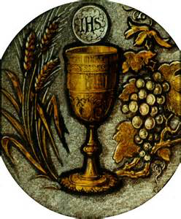
The Church Fathers on the Eucharist
Ignatius of Antioch, 110 a.d.
Justin Martyr 150 a.d.
Origin 244 a.d.
Cyril of Jerusalem mid-300s

Slide 24
Another Early Homily on the Eucharist
“When [Christ] gave the bread he did not say, ‘This is a symbol of my body,’ but, ‘This is my body.’ In the same way, when he gave the cup of his blood he did not say, ‘This is the symbol of my blood,” but, ‘This is my blood,’ for he wanted us to look upon the {Eucharistic elements}, after their reception of grace and the coming of the Holy Spirit, not according to their nature, but to receive them as they are, the body and blood of our Lord” (Theodore of Mopsuestia, Catechetical Homilies 5:1 4th century)

Slide 25
Sanctifying Effects
We receive the fullness of grace, the very life of the Trinity
Augments our union with Christ (CCC1391)
John 6:54 – “…whoever eats my flesh and drinks my blood has eternal life, and I will raise him on the last day.”
“…preserves, increases and renews the life of grace received at Baptism.” (CCC 1392)
Separates us from sin (CCC 1393)

Slide 26
Sanctifying Effects, cont.
Strengthens our charity (CCC 1394)
Preserves us from future mortal sin (CCC 1395)
Unity in the Mystical Body: the Eucharist makes the Church (CCC 1396)
Commits us to the poor (CCC 1397)
We are united to God on earth

Slide 27
Communion and Community
Holy Communion signifies that we are one in our belief, one community in Christ
The Eucharist is confected through the priest, in persona Christi, who is empowered through the sacrament of Holy Orders
“Ecclesial communities derived from the Reformation and separated from the Catholic Church ‘have not preserved the proper reality of the Eucharistic mystery in its fullness, especially because of the absence of the sacrament of Holy Orders.’ It is for this reason that, for the Catholic Church, intercommunion with these communities is not possible.” (CCC 1400)

Slide 28
Receiving Communion
Every time we dip our fingers into holy water, we place ourselves back into the baptismal covenant
Acceptance of the Creed
Rejection of Satan
Must be in a state of grace to receive communion (1 Cor 11:27-29)
No mortal sin
Repented of venial sin

Slide 29
Receiving Communion, cont.
Must fast from food a minimum of 1 hour before reception
Bow before the elevated host and chalice
Say “Amen” to indicate belief and acceptance
Can receive on the hand or on the tongue

Slide 30
Eucharistic Miracles
Desert Fathers in Egypt – bread appeared on altar as a little child
Bolseno/Orvieto, 1263 – bloody corporal
Wawel, Poland, 1300s – thieves stole and discarded a monstrance, which emitted a bright light in the swamp
Buenos Aires, 1996:
http://therealpresence.org/eucharst/mir/a3.html
Notes:
Eucharistic miracles
https://www.ncregister.com/search?q=Eucharistic+miracle

Slide 31
Adoration
It is always right to worship God
We have the privilege of His physical presence in the host, and it is very powerful to spend time in His presence in Eucharistic Adoration
Stories abound of spiritual peace and help rendered through Adoration
See CCC 1378

Slide 32
Recommended Reading
“The Seven Secrets of the Eucharist” by Vinny Flyn
“The Lamb’s Supper” by Scott Hahn
“Transforming Your Life Through the Eucharist” by John L. Kane
“The Mass of the Early Christians” by Mike Aquilina
“The Essential Catholic Survival Guide” by the Staff at Catholic Answers
“A Biblical Defense of Catholicism” by Dave Armstrong
“The Eucharistic Miracles of the World (Catalog of the Vatican International Exhibition) by The Most Reverend Raymond Leo Burke, et al
And plenty more….

