Slide 1
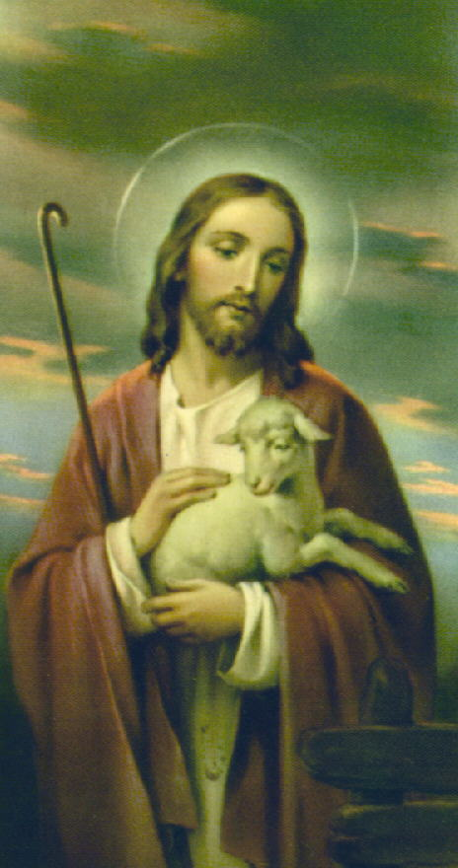
The Communion of Saints
“What is the Church if not the assembly
Of all the Saints? CCC 946
RCIA
St Peter Catholic Church
Monument, CO
11 Apr 2024

Slide 2
Let’s Learn…
What is a Saint?
Historical Perspective
The Communion of Saints
Praying to Saints
Process for Declaring Someone a Saint
Goal: Become a Saint!

Slide 3
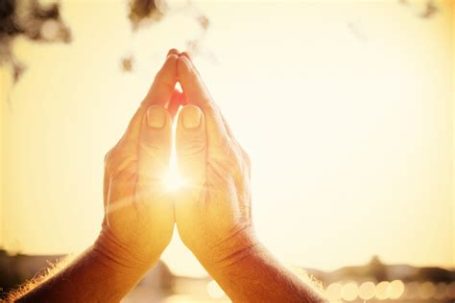
Opening Prayer
Father,
Give perfection to beginners,
understanding to the little ones,
and help to those who are running their course.
Give sorrow to the negligent,
fervor to the lukewarm,
and a good consummation to the perfect.
St. Irenaeus of Lyons (c.125-202)
Bishop, Defender of the Faith, and Martyr

Slide 4
What is a Saint?
From the Latin “sancti”, means “holy ones”
Originally, it referred to all Christians
Phil 4:21
Colossians 1:2
Later: Those martyred during the persecutions
Now: Those who have entered Heaven

Slide 5
Historical Perspective
Persecutions in the Early Church created many martyrs
Veneration was a local affair
Qualification for this honor was by popular acclaim, with Bishop approval
The list of saints multiplied
Missionary travels spread the devotion to the saints
Saints began to be included in the liturgy, encouraged by the Pope
After the Orthodox split (1054), the Western Church set standards for sainthood
Now the right to canonize someone is reserved to the Holy See

Slide 6
The Communion of Saints
The Church is Christ’s body ( 1 Cor 12:12-13, 26-27)
Christ has only one body
Christians are united through Christ
We are not separated by death.
Therefore, this body includes Christians in heaven, on earth, and in purgatory
Our God is not the God of the dead, but of the living (Mark 12:26-27)
We honor who Christ honors, including his Blessed Mother
Any friend of God is a friend of mine
Our Lady and the Saints are closest to Him
James 5:16 – the prayer of a righteous man has great power in its effects
The Council of Trent: “it is good and useful to invoke the saints reigning together with Christ”

Slide 7
Catechism and the Cloud of Witnesses
The Catechism of the Catholic Church 946-992
948 - communion “in holy things (sancta)” and “among holy persons (sancti)”
956 - The saints fix the whole Church more firmly in holiness
They do not cease to intercede with the Father for us
So, by their fraternal concern is our weakness greatly helped
Heb 11 – Abel, Enock, Noah, Abraham, Moses, other heroes in Israel’s history
Heb 12:1 – We are surrounded by a great cloud of witnesses
What is this cloud of witnesses?
The saints in heaven, who have gone before us and endured the same things we are going through.
They are the “home team advantage!”

Slide 8
Saints and Prayers
The Bible tells us to pray for each other
Gen 20:7
2 Macc 12:39-45
2 Macc 15:12-14
1 Tim 2:1-4
2 Tim 1:3
Rom 10:1
Rom 15:30-32
2 Cor 1:10
Col 1:4, 9-10
Eph 6:18
James 5:16
Acts 12:5
Saints bring our prayers to God
Rev 5: 8
Rev 8:3-4

Slide 9
Praying to the Saints
Prayer is a form of communication
Worship formerly meant worthy of respect; has evolved to refer to adoration of a deity
Prayer is not necessarily worship
Catholic explanation of the way we pray
Latria – supreme worship reserved for God
Dulia – veneration and reverence of saints
Hyperdulia – extra veneration for Mary
We do not and must not worship Mary and the saints as we do God
We look to them all–
For inspiration
For help
To pray with us to God

Slide 10
The Process for Proclaiming Someone a Saint
Usually, cannot begin until 5 years after death
Bishop of the diocese petitions the Vatican
If approved, the person becomes Servant of God
All the person’s writings must be collected, including private writings such as diaries and letters to friends and family. The person’s entire life must be documented
If the process is advanced, the person is called Venerable
At this point, a documented miracle must be attributed to the intercession of this person
Such miracles must be investigated and confirmed by two tribunals, one scientific and one theological

Slide 11
The Process, cont.
The next step is “beatification” and the person is given the title Blessed
At this time, private or diocesan-level veneration is permitted
The Church’s investigation continues, and a second miracle is necessary for sainthood.
The study must be completed before proceeding
The declaration of sainthood is considered infallible
Once the Holy Father gives his consent, the person may be canonized and becomes Saint

Slide 12
To Be a Saint – Our Only Goal
“You are therefore to be perfect, even as your Heavenly Father is perfect.” (Matt 5:48)
Christ brought the power of redemption and with it, grace
Sources of grace: sacraments, prayer, the Church
Christ is our example
Sanctity is the close union of man with God
The closer we get to Him, the holier we get
A saint practices heroic goodness Don’t buy the myth that you can’t be holy
It’s not too late to start
Don’t settle for mediocrity

Slide 13
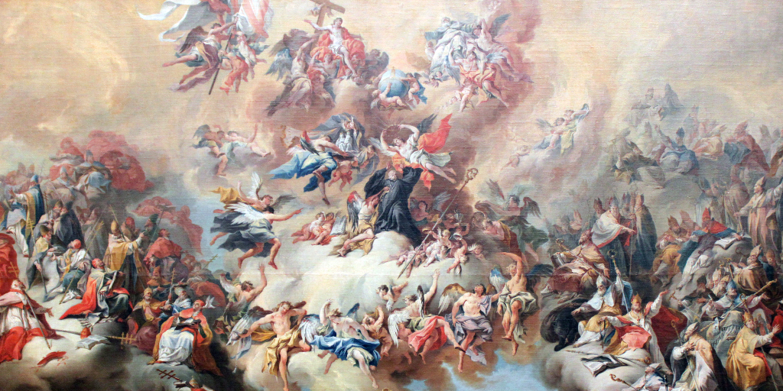
Closing Prayer to our Patron Saint
Dear St. N…,
I have been honored to bear your name-
A name made famous by your heroic virtues.
Help me never to do anything to besmirch It.
Obtain God’s grace for me
That I may grow in faith, hope and love,
And all the virtues.
Grant that by imitating you
I may imitate your Lord and Master, Jesus Christ.
Watch over me along the way of the rest of my life
And bring me safe to my heavenly home at my death.
Amen

Slide 14
Sources & Recommended Reading
The Catechism of the Catholic Church, Ligouri, 1994.
Madrid, Patrick: Any Friend of God is a Friend of Mine, Basilica Press, 1996.
Armstrong, Dave: A Biblical Defense of Catholicism, Sophia Institute Press, 2003.
Keating, Karl: Catholicism and Fundamentalism, Ignatius Press, 1988.
Continued on next page…

Slide 15
Sources & Recommended Reading
Ripley, Canon Francis: This is The Faith, Tan Books and Publishers, 2002.
Romero, Fr. Mario P: Unabridged Christianity, Queenship Publishing, 1999.
https://www.catholic.com/encyclopedia/beatification-and-canonization
https://www.catholic.com/tract/praying-to-the-saints

