Slide 1
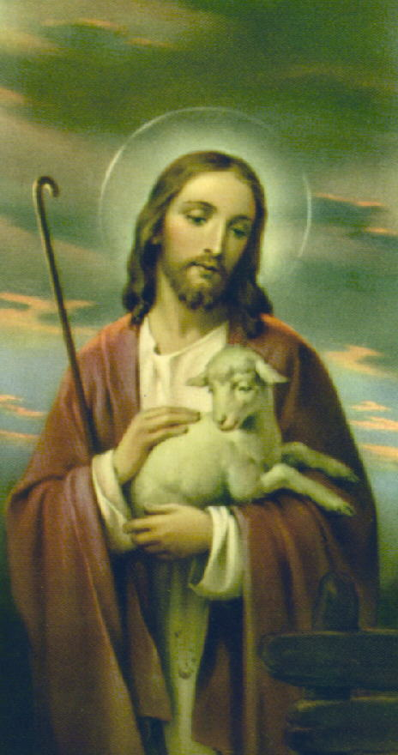
The Communion of Saints
December 15, 2022
RCIA
St Peter Catholic Church
Monument, CO

Slide 2
Let’s Learn…
What is a Saint?
Historical Perspective
Biblical Evidence
The Communion of Saints
Praying to Saints
The Early Fathers
Process for Declaring Someone a Saint
Goal: Become a Saint!

Slide 3
What is a Saint?
From the Latin “sancti”, means “holy ones”
Originally, it referred to all Christians
Phil 4:21
Colossians 1:2
Later: Those martyred during the persecutions
Now: Those who have entered Heaven

Slide 4
Historical Perspective
Persecutions in the Early Church created many martyrs
Veneration was a local affair
Qualification for this honor was by popular acclaim, with Bishop approval
The list of saints multiplied
Missionary travels spread the devotion to the saints

Slide 5
Historical Perspective, cont.
Saints began to be included in the liturgy, encouraged by the Pope
After the Orthodox split (1054), the Western Church set standards for sainthood
Now the right to canonize someone is reserved to the Holy See

Slide 6
Biblical Evidence
1 Samuel 28:12, 14-15
Tobit 12:12, 15
Matthew 17:1-3
Mark 12:26-27
Heb 12:22-23

Slide 7
The Communion of Saints
The Church is Christ’s body ( 1 Cor 12:12-13, 26-27)
Christ has only one body
Christians are united through Christ
We are not separated by death.
Therefore, this body includes Christians in heaven, on earth, and in purgatory
Our God is not the God of the dead, but of the living (Mark 12:26-27)

Slide 8
The Communion of Saints, cont.
We honor who Christ honors, including his Blessed Mother
Any friend of God is a friend of mine
Our Lady and the Saints are closest to Him
James 5:16 – the prayer of a righteous man has great power in its effects
The Council of Trent: “it is good and useful to invoke the saints reigning together with Christ”

Slide 9
The Communion of Saints, cont.
The Catechism of the Catholic Church 946-992
948 - communion “in holy things (sancta)” and “among holy persons (sancti)”
956 - The saints fix the whole Church more firmly in holiness
[T]hey do not cease to intercede with the Father for us
So by their fraternal concern is our weakness greatly helped

Slide 10
The Cloud of Witnesses
Heb 11 – Abel, Enock, Noah, Abraham, Moses, other heroes in Israel’s history
Heb 12:1 – We are surrounded by a great cloud of witnesses
What is this cloud of witnesses?
The saints in heaven, who have gone before us and endured the same things we are going through.
They are the “home team advantage!”

Slide 11
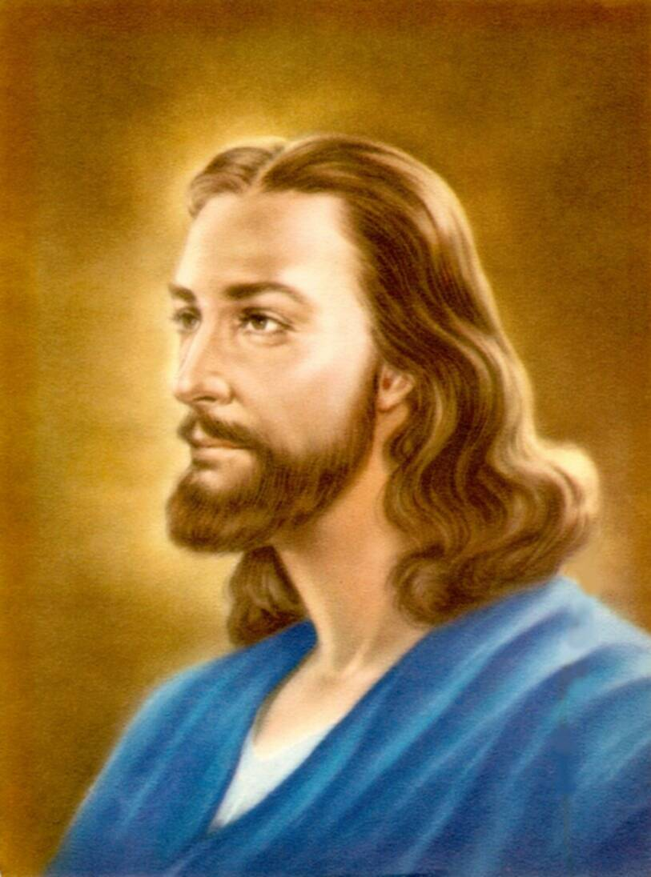
Why We Pray to the Saints
The Bible tells us to pray for each other
Gen 20:7
2 Macc 12:39-45
2 Macc 15:12-14
1 Tim 2:1-4
2 Tim 1:3
Rom 10:1
Rom 15:30-32
2 Cor 1:10
Col 1:4, 9-10
Eph 6:18
James 5:16
Acts 12:5

Slide 12
What Are Patron Saints?
The early Christians venerated the martyrs of their town or area
Asked them to interceded for them to help
These were “patron saints” of that area
In the Middle Ages, people looked to saints for help in daily lives: occupations, illnesses, family, perils, decisions

Slide 13
Do Saints Bring our Prayers to God?
Rev 5: 8
Rev 8:3-4

Slide 14
Praying to the Saints
Prayer is a form of communication
Worship formerly meant worthy of respect; has evolved to refer to adoration of a deity
Prayer is not necessarily worship
Catholic explanation of the way we pray
Latria – supreme worship reserved for God
Dulia – veneration and reverence of saints
Hyperdulia – extra veneration for Mary

Slide 15
Praying to the Saints Summary
We do not and must not worship Mary and the saints as we do God
We look to them all –
For inspiration
For help
To pray with us to God

Slide 16
The Saints in the Liturgy
We profess our belief in the communion of saints in the Apostle’s Creed
We invoke the angels and saints in the prayer of consecration

Slide 17
The Early Fathers
St. Cyril of Jerusalem (A.D. 315-386) in about 348:
“Then we commemorate also those who have fallen asleep before us, first the patriarchs, prophets, apostles, and martyrs, that at their prayers and intercessions God would receive our petition. Then on behalf, also of the holy Fathers and bishops who have fallen asleep before us and, in a word, of all who in past years have fallen asleep among us, believing that it will be a very great benefit to the souls for whom the supplication is put up [i.e. offered up to God] while that holy and most awful sacrifice is set forth.”

Slide 18
The Early Fathers, cont.
St. Jerome (A.D. 347-419), in a letter against a heretic named Vigilantius in 406:
“You say in your book that while we live, we are able to pray for each other, but afterwards, when we have died, the prayer of no person for another can be heard; and this is especially clear since the martyrs, though they cry for vengeance for their own blood, have never been able to obtain their request. But if the Apostles and martyrs while still alive in the body can pray for others, at a time when they ought still to be solicitous about themselves, how much more will they do so after their crowns, victories and triumphs!”

Slide 19
The Process for Proclaiming Someone a Saint
Usually, cannot begin until 5 years after death
Bishop of the diocese petitions the Vatican
If approved, the person becomes Servant of God
All the person’s writings must be collected, including private writings such as diaries and letters to friends and family. The person’s entire life must be documented

Slide 20
The Process, cont.
If the process is advanced, the person is called Venerable
At this point, a documented miracle must be attributed to the intercession of this person
Such miracles must be investigated and confirmed by two tribunals, one scientific and one theological

Slide 21
The Process, cont.
The next step is “beatification” and the person is given the title Blessed
At this time, private or diocesan-level veneration is permitted
The Church’s investigation continues, and a second miracle is necessary for sainthood.

Slide 22
The Process, cont.
The study must be completed before proceeding
The declaration of sainthood is considered infallible
Once the Holy Father gives his consent, the person may be canonized and becomes Saint

Slide 23
Confirmation Saints
Tradition: Confirmation Candidates choose a saint to be their patron for the rest of their lives
Acceptable/encouraged: adopt as your patron the saint of your baptismal name
This saint can either be someone you identify with, or someone who is different from you

Slide 24
To Be a Saint – Our Only Goal
“You are therefore to be perfect, even as your Heavenly Father is perfect.” (Matt 5:48)
Christ brought the power of redemption and with it, grace
Sources of grace: sacraments, prayer, the Church
Christ is our example

Slide 25
To Be a Saint – Our Only Goal
Sanctity is the close union of man with God
The closer we get to Him, the holier we get
A saint practices heroic goodness in all his actions
Don’t buy the myth that you can’t be holy
It’s not too late to start
Don’t settle for mediocrity

Slide 26
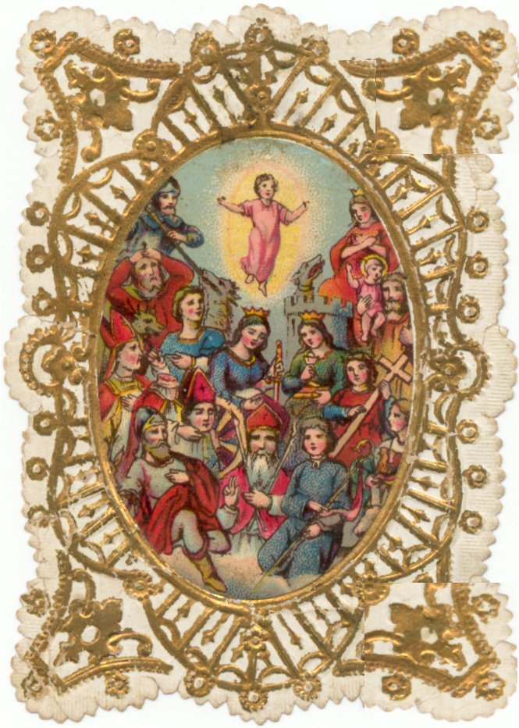

Slide 27
Sources & Recommended Reading
The Catechism of the Catholic Church, Ligouri, 1994.
Madrid, Patrick: Any Friend of God is a Friend of Mine, Basilica Press, 1996.
Armstrong, Dave: A Biblical Defense of Catholicism, Sophia Institute Press, 2003.
Keating, Karl: Catholicism and Fundamentalism, Ignatius Press, 1988.
Continued on next page…

Slide 28
Sources & Recommended Reading
Ripley, Canon Francis: This is The Faith, Tan Books and Publishers, 2002.
Romero, Fr. Mario P: Unabridged Christianity, Queenship Publishing, 1999.
https://www.catholic.com/encyclopedia/beatification-and-canonization
https://www.catholic.com/tract/praying-to-the-saints

