Slide 1
Lesson 9 Baptism Confirmation

Slide 2
Outline
Objective: to understand how we encounter Jesus through the sacraments of Baptism and Confirmation
Sacraments
Baptism
Confirmation

Slide 3
The Seven Sacraments
Sacraments of Initiation
Baptism
Confirmation
Eucharist
Sacraments of Service
Matrimony
Holy Orders
Sacraments of Healing
Reconciliation
Anointing of the Sick
Confirmation
Holy
Orders
Matrimony
Eucharist
Anointing
of the Sick
Reconciliation
Baptism

Slide 4
Nature of a Sacrament
Efficacious sign of grace
Instituted by Jesus Christ
Administered by the Church
Enabling divine life through the Holy Spirit
Work through the power of Christ, not by the one who administers it
“...I believe in one Baptism for the forgiveness of sins…”

Slide 5
Baptism
First sacrament of initiation
Sacramentally joins us to Christ
We are given access to the Father through Christ
Principal sacramental means for forgiveness of sins and birth into new life
Washes us of original sin (and all other sins)
Fills the soul with grace
Incorporates us into the Body of Christ (the Church) (1 Cor 12:13)
Instead of circumcision, we have Baptism

Slide 6
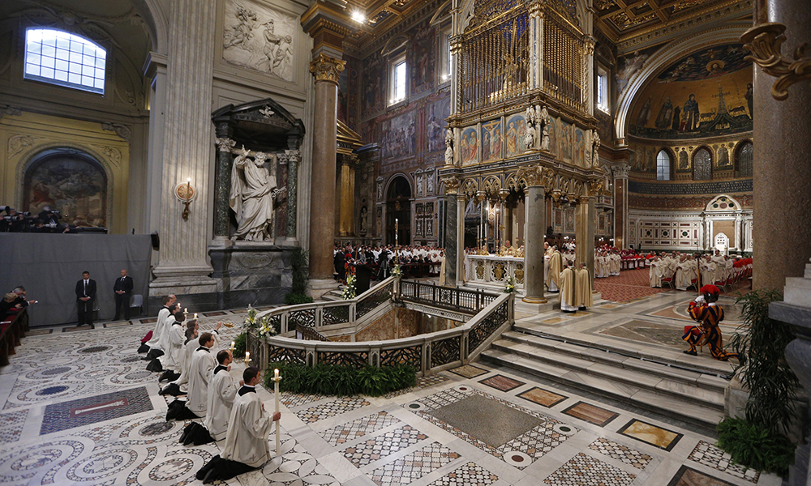
Scripture Time
NT
Mk 1:4-8
Mt 3:13-17
Mt 16:15-16
Mt 28:19-20
Jn 1:26-34
Acts 8:27-38
Acts 16:25-33
Rom 6:3-4
1 Cor 7:14
1 Cor 12:12-13
Gal 3:27
Eph 4:4-6
Eph 5:25-27
Col 2:11-12
1 Pt 3:18-22
Titus 3:4-7
St Patrick Cathedral, New York
Also ref early church writings
Didache
Ignatius of Antioch
Justin Martyr
Irenaeus
Clement of Alexandria
Tertullian
Athanasius
Basil the Great
Gregory of Nissa
Ambrose of Milan
John Chrysostom
Augustine of Hippo
OT
Gen 6-8
Ex 14:10-30
2 Kg 5:1-14
Is 1:16-20
Ez 36:22, 25-27
Zech 13:1
St John Lateran Basilica, Rome

Slide 7
The Rite of Baptism
Normal
Matter: Water
Form: Trinitarian (Mt 28:19) [CCC 1240]
By priest or deacon
Emergency
By any baptized Christian (or non-Baptized with the required intention) [CCC 1256]
Baptism of Desire [CCC 1259]
Those who have not had the opportunity

Slide 8
Infant Baptism
Catholics believe in Baptism as a sacrament not an ordinance
Not a public manifestation of conversion
Rather, it imparts grace and is necessary for salvation and should not be denied
Bible does not restrict Baptism to adults
Lk 2:21—Baptism replaces circumcision
CCC 1250: Children also have need of the new birth in Baptism to be freed from the power of darkness
Scripture References:
Mt 19:14-15
Acts 2:38-39
Acts 16:15
Acts 22:12-16
1 Cor 1:16
Col 2:11-12

Slide 9
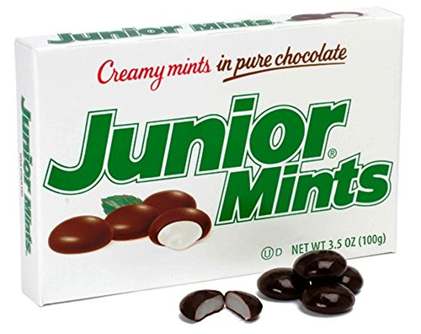
Movie Time

Slide 10
Confirmation
Sacrament of Initiation
On Pentecost, Holy Spirit came to Apostles
Acts 2:1-4
Acts 8:14-17
Perfects the grace received in Baptism
We become more fully children of our Heavenly Father (Rom 8:14-17)
More firmly united to Christ (2 Cor 1:20-22)
Strengthened against sin
Obtain gifts (Is 11:1-3) and fruits (Gal 5:16-25) of the Holy Spirit

Slide 11
The Rite of Confirmation
Normal
Matter: Anointing with Chrism
Form: Words (“Be sealed with the gift of the Holy Spirit”)
By bishop or priest
Like Baptism, makes an indelible spiritual mark on the soul
And so is never repeated

Slide 12
Confirmation: Gifts of the Holy Spirit
Ref: Is 11:1-3, CCC 1285-7, 1830-1, 1845
Wisdom: knowledge of and judgment about “divine things”
Understanding: penetrating insight especially truths
Counsel: allows a man to be directed by God in matters necessary for his salvation
Fortitude: firmness of mind in doing good and in avoiding evil
Knowledge: ability to judge correctly about matters of faith and right action
Piety: revering God with filial affection
Fear of God (Awe): “filial” or chaste fear whereby we revere God and avoid separating ourselves from him

Slide 13
Takeaways
Sacraments serve the plan of the Father to transform us through grace and be united in the divine life
Baptism is the first of the sacraments of initiation, cleanses us of original sin and joins us the in the new life of Jesus Christ
Confirmation imparts on us the seal of the Holy Spirit strengthening us to do God’s will

Slide 14
Questions?

