Slide 1
Lesson 4
The Deposit of Faith:
Sacred Tradition

Slide 2
Outline
Objective: to understand the role of Sacred Tradition within the Catholic Church
Sacred Tradition
  Scripture basis
  Interrelationships & definitions
  Examples
Catechism of the Catholic Church
Liturgical Year

Slide 3
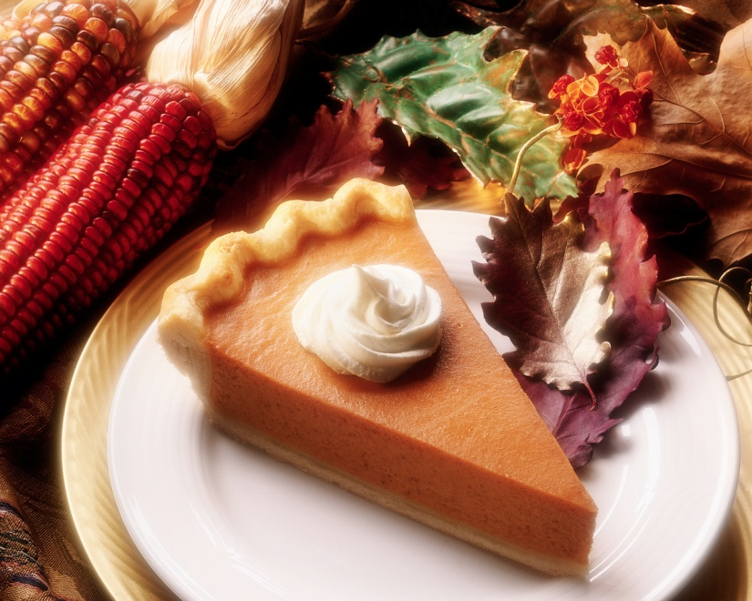
BIG T or little t?

Slide 4
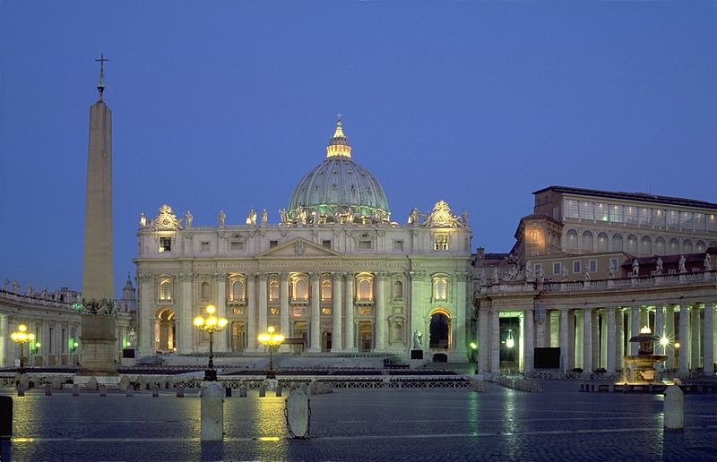
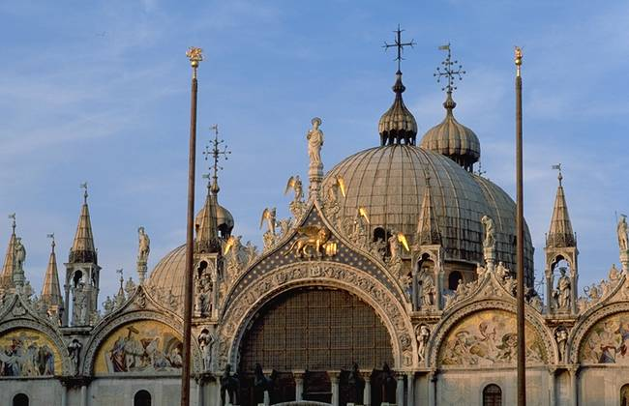
Scripture Time
St Peter Basilica, Rome
St Mark’s Basilica, Venice

Slide 5
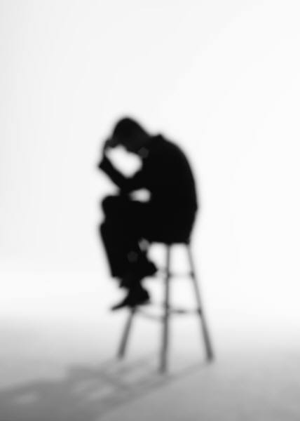
3 Legs of the Table
Sacred Scripture
Sacred Tradition
Magisterium
Tradition is:
  The living transmission of the entirety of revelation by the successors of the Apostles under the guidance and protection of the Holy Spirit

Slide 6
Legal Stuff
“…no new public revelation is to be expected before the glorious manifestation of our Lord Jesus Christ.” (CCC 66)
“The Son is his Father’s definitive Word; so there will be no further Revelation after him.” (CCC 73)
  For you & I: Scripture is written and complete
“Yet even if Revelation is already complete, it has not been made completely explicit; it remains for Christian faith gradually to grasp is full significance over the course of the centuries.” (CCC 66)
  For you & I: We (the people of God) still have to figure it out

Slide 7
History
Jesus’ Ministry
Ministry of the Apostles
  Tradition Begins to be Formed
  Acts 15: 28-29
  1 Cor 11: 2
Writing of the New Testament
Early Church and Subsequent Development of Sacred Tradition
Controversy and Disagreement
ONE
HOLY
CATHOLIC
APOSTOLIC

Slide 8
Definitions
Doctrine / Dogma: Revealed teachings of Christ which are proclaimed by the fullest extent of the exercise of the Church’s Magisterium (CCC glossary)
  Doctrine: Usage in CCC relates to teachings
  Dogma: Usage in CCC relates to truths
Deposit of Faith: Entirety of revelation contained in Sacred Scripture and Sacred Tradition
  All that God has revealed to us

Slide 9
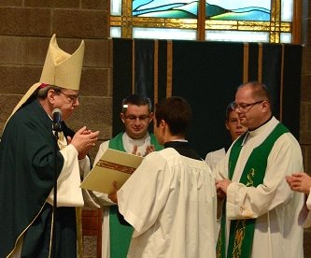
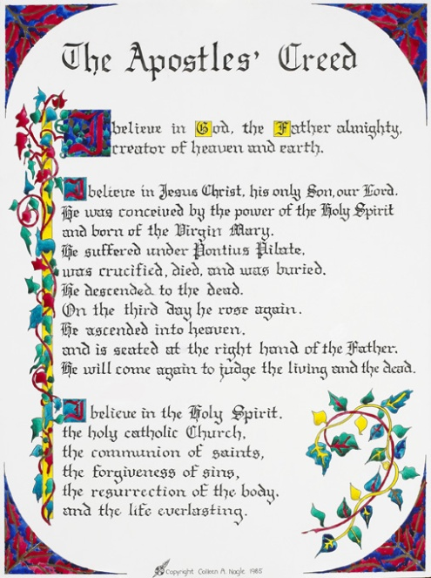
Examples
  Duty to obey & respect bishop
  Holy Orders
Apostles Creed
  Counter heresy of Docetism (denying Jesus’ humanity)
Date of birth
Sabbath
Bible formation
Liturgy

Slide 10
Where to from here?
“There is an organic connection between our spiritual life and the dogmas. Dogmas are lights along the path of faith; they illuminate it and make it secure.” (CCC 89)
“Therefore, brothers, stand firm. Hold fast to the traditions you received from us, either by our word or by letter.” (2 Thes 2:15)

Slide 11
Catechism
Statement of the Church’s faith and of catholic doctrine
Attested to or illumined by Sacred Scripture, Apostolic Tradition, and the Church’s Magisterium
“I declare it to be a sure norm for teaching the faith and thus a valid and legitimate instrument for ecclesial communion.”
Pope St Johannes Paulus II
Apostolic Constitution Fidei Depositum

Slide 12
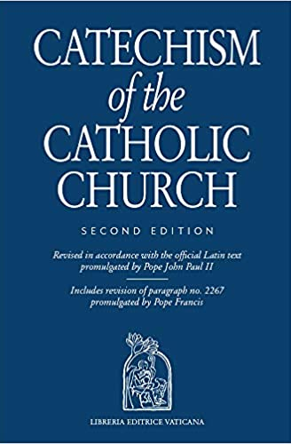
CCC Prologue
CCC 1: “God, infinitely perfect and blessed in himself, in a plan of sheer goodness freely created man to make him share in his own blessed life.”

Slide 13

CCC Structure
Four pillars
  Baptismal profession of faith (the Creed)
  Sacraments of faith
  Life of faith (the Commandments)
  Prayer of the believer
Index
Glossary
Note: Use of small print indicates
Observations of historical or apologetic nature
Supplementary doctrinal explanations
Quotations (from patristic, liturgical, etc sources) intended to enrich doctrinal presentations

Slide 14
CCC Structure
Referenced by paragraph
Footnotes (also Index of Citations)
  Scripture
  Councils
  Pontifical and Ecclesiastical documents
  Canon Law
  Liturgy
  Ecclesiastical writers

Slide 15
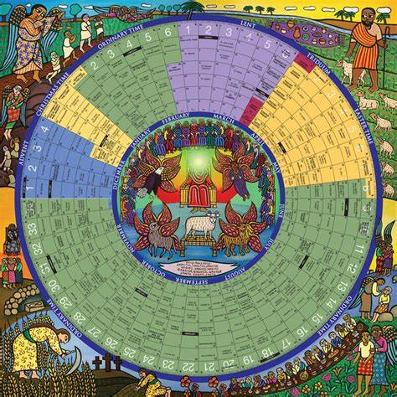
The Liturgical Year
“On the first day of the week when we gathered for the breaking of the bread…”
Acts 20:7

Slide 16
Liturgical Seasons
Season | Advent | Christmas | Ordinary Time | Lent | Triduum | Easter | Ordinary Time
Length
Purpose
Things to notice / do
Varies depending on year
34 weeks total
4 weeks
~12 days
40 days
3 days
50 days
Proclamation of the Kingdom of God
Preparation; repentance; spiritual renewal
Nothing ordinary about Ordinary Time
Celebration of Jesus among us
Holiest 3 days of the year
Celebration of the Resurrection
Preparation
Begins with Baptism of the Lord and ends with the Feast of Christ the King
Begins with Ash Wednesday
Fasting and abstinence
Omission of Gloria
Christmas songs during the whole season
Holy Thursday: White
Good Friday: Red
Omission of Gloria
2nd Reading from Acts of the Apostles

Slide 17
Other Occasions
Holy Days of Obligation
Determined by region
US has:
  January 1: Mary, Mother of God
  Fortieth day after Easter: Ascension (Diocese of
  Colorado Springs celebrates on a Sunday)
  August 15: Assumption of the Blessed Virgin Mary
  November 1: All Saints
  December 8: Immaculate Conception
  December 25: Nativity of Our Lord Jesus Christ
Feast days
Many feast days commemorate saints who glorified Christ in their lives on earth and now share His glory in the Kingdom of Heaven. Their feast days usually correspond to the date of death, the birth of the saint into eternal life.
Purpose
Color
  Red for Martyrs
  White/Gold
Types of celebrations:
Solemnity:
  Highest rank of celebration
  Events in our Lord’s life and certain saints
Feast
  Certain saints (i.e. feast of the Archangels, most of the Apostles)
Memorials
  Celebrations of most of the saints

Slide 18
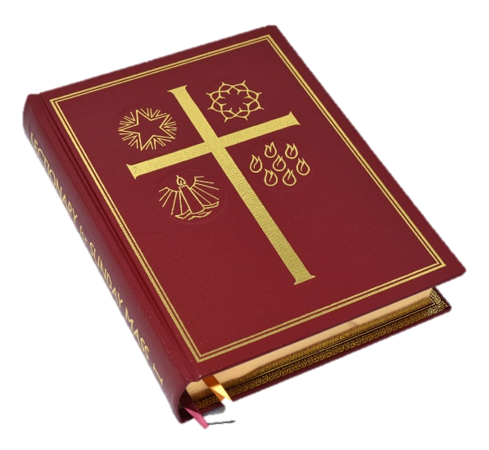
Liturgical Cycles
Mass has 3 (daily) or 4 (Sunday) readings (including Responsorial Psalm)
Cycle of Sunday readings
  A: Mark, B: Matthew, C: Luke
Cycle of weekday readings
  1, 2
2022: Year C, Weekdays Cycle 2
2023: Year A, Weekdays Cycle 1
Note that we share the liturgical cycle of readings with the Episcopal/Anglican and Lutheran churches
Almost all of the bible is covered over 3 years

Slide 19
Takeaways
Sacred Tradition preserves the fullness of revelation, oral & written
Scripture, Tradition & Magisterium are connected
Sacred Tradition is Scriptural
The Church is liturgical
Notes:
Teaching Notes:
Basic Script:
References:
Terms:

Slide 20
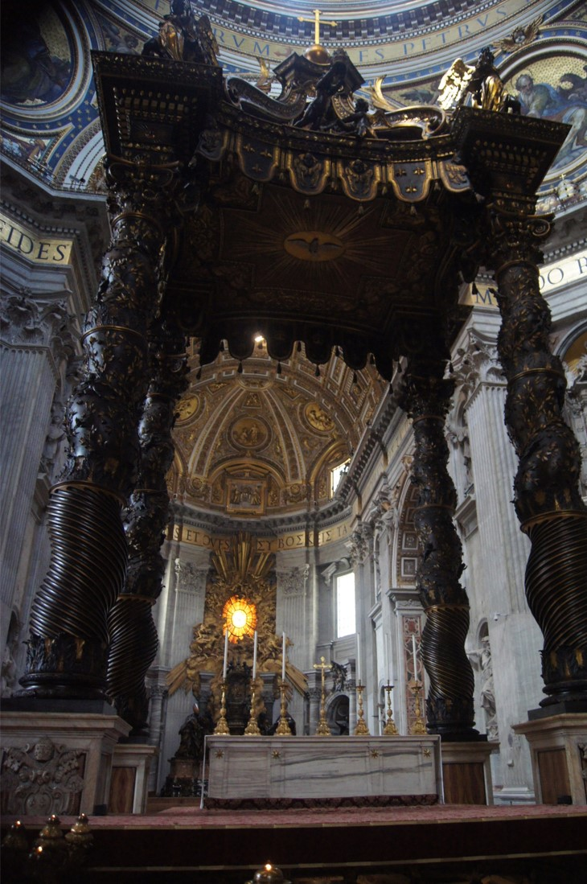
Questions?

