Slide 1
Lesson 19
Salvation and Redemption

Slide 2
Overview
Objective: Understand God’s concept of Salvation and Redemption
Terms
The Fall
Suffering
God’s Plan
Our Redeemer
The Way to Salvation
Justification
Faith vs Works
Warning: Scripture intensive lesson, have your Bible ready

Slide 3
Terms
Salvation: the plan of God to free us from the slavery of sin and reconcile us to Himself
CCC Glossary: “…forgiveness of sins and restoration of friendship with God, which can be done by God alone”
Redemption: Jesus’ saving action that ransomed us from sin and reconciled us to the Father

Slide 4
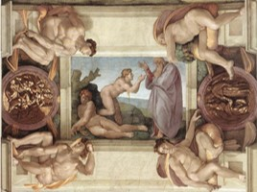
The Fall
Fall of Adam and Eve (Gn 2:15-3:24)
Turned away from God, losing grace of original holiness (CCC Glossary)
God, in His love, desires us to be saved (1 Tim 2:4-5)
God took the initiative to save us since we could never satisfy His justice
God promised one who would fight Satan on our behalf (Gn 3:15)
Teaser:
Eve said “no,” turned away from God’s love
Mary said “yes,” made salvation through Christ possible (Lk 1:38)
Michelangelo Sistine Chapel Ceiling

Slide 5
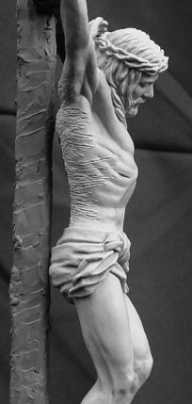
A Comment on Suffering
The fall introduced sin, suffering, death
Humans caused this, not God
God’s answer: Jesus’ sacrifice on the cross
Scripture passages
Is 53:1-11, Mt 16:24, Col 1:24, Rom 5:3-5, Rom 8:17, Jas 1:2-3, 1 Pet 2:21
Redemptive suffering
Our ability to unite our sufferings to Christ and, in turn, benefit the body of Christ
Self-denial, sacrifice: links/binds us to Christ
See also CCC 618, 1520

Slide 6
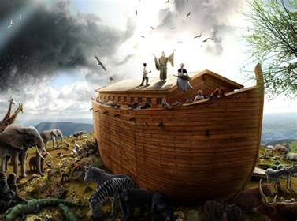
God’s Plan in the OT
Plan prefigured in OT
Gn 3:15
Gn 22:1-10
Lv 16:1-22
Is 53:1-11
Jesus won our redemption
Lk 22:20
Heb 10:1-22
Also:
Gn 6-8 Noah saved from the flood
Ex 12-15 Passover & deliverance out of Egypt

Slide 7
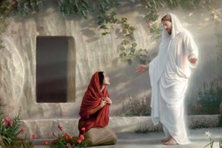
Our Redeemer
Redemption is the act of Christ through His Passion, Death and Resurrection
Jesus perfectly demonstrated love and obedience
His suffering: only action that can truly atone for sin
CCC 1708: “By His Passion, Christ delivered us from Satan and from sin. He merited for us the new life in the Holy Spirit. His grace restores what sin had damaged in us.”
CCC 2020: “Justification has been merited for us by the Passion of Christ. It is granted us through Baptism.”
See also Acts 2: Rom 6:3-4, Col 2:11-12, Titus 3:4-7

Slide 8
Justification
Note: Justice and Righteousness represent the same underlying concept in Latin, Greek and Hebrew.
Justification: Gracious action of God which frees us from sin (Rom 3:22)
Also the sanctification and renewal of the interior man (CCC Glossary, Council of Trent DJ7)
Considerable disagreement in its meaning
Catholic view: God wants us to grow in righteousness over the course of the Christian life. Justification is not just something that happens at the beginning of Christian life.
Once justified, always?
2 Tim 2:11-12, Col 1:21-23
Hence, Catholic emphasis on the sacraments

Slide 9
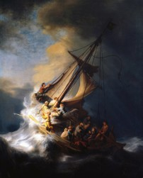
The Way to Salvation
So, what can you do to earn salvation?
We cannot merit salvation (CCC 2007)
We can ask for it through our participation in the faith and cooperation in God’s work
Our response
Believe in Christ Jesus (Jn 3:16, Acts 2:36-38)
Strive to achieve perfection in God’s grace (Mt 5:48)
Put God first (CCC 1811)
Obey the Commandments and show faith in our works (Mt 19:16-19)
Storm on the Sea of Galilee
Rembrandt

Slide 10
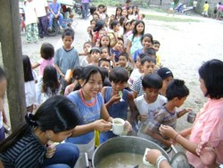
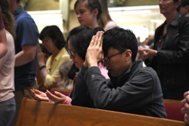
Faith vs Works Debate
Faith: Eph 2:8
Where does faith alone appear in NT?
Works are the substance of Faith
1 Cor 3:5-8, Jas 2:18-26
Mt 25:31-46
Catholic view:
Council of Trent: “none of those things that precede justification, whether faith or works, merit the grace of justification. ‘For, if by grace, it is not now by works, otherwise,’ as the Apostle says, ‘grace is no more grace’” (DJ 8, quoting Rom. 11:6).”
Trent relates James’s statement not to initial justification but to growth in righteousness that occurs over the course of the Christian life
Caution: Catholic Church approach is more sophisticated than most people expect

Slide 11
Catholic Dogma on Salvation
Who can be saved?
Rom 10:9-10
There is no salvation apart from Christ and His Church (CCC 846)
Roman Catholic Church views Christianity as “one” and “catholic” (CCC 813, 818, 830)
Salvation is possible to “those who, through no fault of their own, do not know the Gospel of Christ or His Church, but who nevertheless seek God with a sincere heart”
Non-Christians may be saved (CCC 839-848)
“in ways known to himself, God can lead those…to that faith”

Slide 12
Takeaways
The fall was an offense against God and His love
Father’s plan was prefigured in the Old Testament
Our Redeemer is the Son of God
The way to salvation is through the Holy Spirit

Slide 13
Closing Prayer
Almighty Father, come into our hearts, and so fill us with Thy love that forsaking all evil desires, we may embrace Thee, our only good. Show us, O Lord our God, what Thou are to us. Say to our souls, I am your salvation, speak so that we may hear. Our hearts are before Thee; open our ears; let us hasten after Thy voice. Hide not Thy Face from us, we beseech Thee, O Lord. Open our hearts so that Thou may enter in. Repair the ruined mansions, that Thou may dwell therein. Hear us, O Heavenly Father, for the sake of Thy only Son, Our Lord Jesus Christ, who lives and reigns with Thee and the Holy Spirit, one God now and forever. Amen
St Augustine

