Slide 1
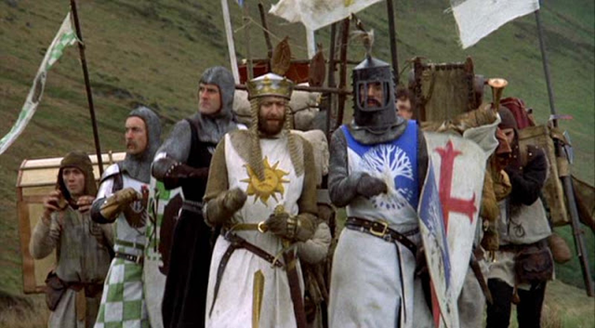
Catholic Peculiarities
RCIA
St. Peter Catholic Church
February 23, 2023
Notes:
Some of the things Catholics do seem strange to others
Catholics are often ridiculed for their rituals, signs, statues, incense, rosaries, and other ‘strange’ habits
Mostly this is on account of misunderstandings
If we understand them, we can embrace them more fully
If we understand them, we can explain them to others
Human beings are creatures of body and soul and by virtue of visible creation we can raise our minds to invisible truths

Slide 2
What Are Devotions?
Those external practices of piety by which the ardor of the faithful finds life and expression.
Devotions begin through a desire to increase one’s faith or closeness to God through a specific action
Strong appeal which they make to man’s emotions
Simplicity of form which puts them within the reach of all
Stimulus of association with many others in the same good work
Derivation from the example of saints
Examples: Adoration of the Blessed Sacrament, devotion to Mary, devotion to the Rosary, the Psalms, the Holy Land, the Immaculate and Sacred Hearts, First Saturdays, First Fridays, etc.

Slide 3
Sample Devotions
Adoration of the Blessed Sacrament
Mary (many forms)
The Holy Rosary
First Fridays/First Saturdays
Preservation of the Holy Land
Sacred Heart
Immaculate Heart
Particular Saint, such as Saint Kateri, Padre Pio

Slide 4
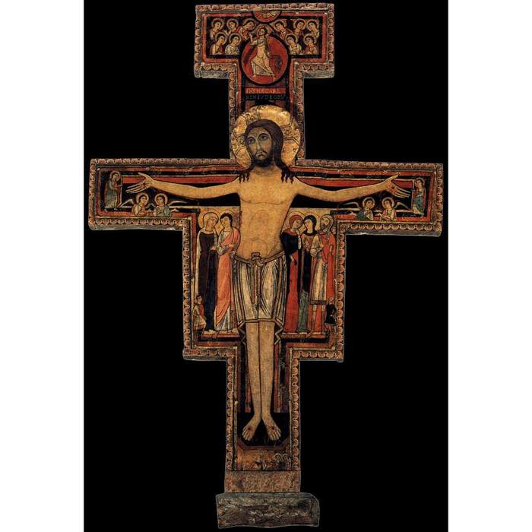
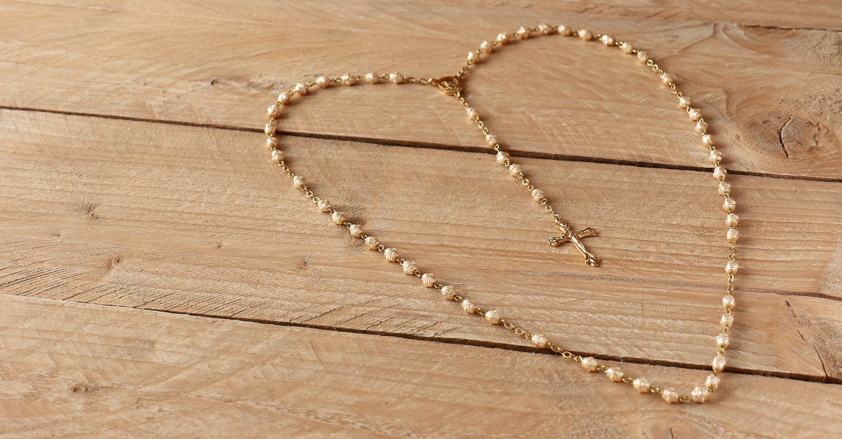
What are Sacramentals?
A gift!
“…These are sacred signs which bear a resemblance to the sacraments, and various occasions in life are rendered holy.” (CCC 1667)
Sacramentals do not confer grace but they prepare us to receive grace and dispose us to cooperate with it (CCC 1670)

Slide 5
Sacramentals
Not instituted by God, as are Sacraments
Do not convey Christ’s grace in the way that Sacraments do
Instituted by the Church and symbolize the effects that come about primarily through the prayers of the Church
They open us to God’s grace in a way that surpasses our personal prayer
Two classifications – blessings and blessed objects

Slide 6
Why Have Sacramentals?
Man is a physical AND spiritual being
They are bridges between realities
Mankind intuitively seeks elevation toward God
The Good, the True and the Beautiful are worthy things

Slide 7
Are We Being Superstitious?
A common accusation by Protestants and secularists
A risk assumed by the ill-catechized or uninformed
Acts 19:11-12 “And God did extraordinary miracles by the hands of Paul so that handkerchiefs or aprons were carried away from his body to the sick, and diseases left them and the evil spirits came out of them.”

Slide 8
Sample List of Sacramentals
Sign of the Cross
Statues, icons, pictures
Holy Water
Incense
Oils
Genuflecting and kneeling
Holy medals
Holy cards
Rosaries
Stained glass windows
Crucifixes
Scapulars
Shrines
Relics
Devotions
Candles
Palm leaves and ashes
Sanctuary lamps
Bells
Advent wreaths
Nativity scenes

Slide 9
Sources
Why Do Catholics Do That, Kevin Orlin Johnson, Ph.D, Ballantine, 1994.
This is the Faith, Canon Francis Ripley, TAN, 2002
The Privilege of Being Catholic, Father Oscar Lukefahr, Liguori, 1993
The Complete Idiot’s Guide to Understanding Catholicism, Bob O’Gormand and Mary Faulkner, Alpha, 2002
Signs of Life, Scott Hahn, Image, 2018
Notes:
Also https://www.catholic.com/search?q=what%20are%20devotions

