Slide 1
Creating a Home Where Love Heals

Slide 2
What is Bakhita Mountain Home?
Mission
Bakhita Mountain Home is a non-profit that assists women transitioning from human trafficking to self-sufficiency and successful reintegration into society. Women experience healing through three components:
Safe haven
Trauma-informed therapy
Life-enhancing skills
Vision
A community where love heals, restores and empowers women impacted by human trafficking.
Notes:
History:
September 16, 2018 Articles of Incorporation, State of Colorado
July 15, 2019 Letter of Determination for 501(3)(c)
December 1, 2019 First Meeting of the Board of Directors
December 5, 2019 Lease for Bakhita Mountain Home with Colorado Health Initiatives signed
April to July 2020 Renovation of facility by Art Klein, Inc.
End of 2021 Anticipated opening of Bakhita Mountain Home

Slide 3
The Scourge of Human Trafficking
Human trafficking is modern-day slavery in which traffickers use force, fraud, or coercion to control victims for the purpose of engaging in sex acts or labor services against his/her will.
Trafficking goes by many names
A human rights violation
Sex trafficking
Labor trafficking
Estimated 4.8 million people
In forced sex exploitation globally.
(International Labour Organization, 2017)
Notes:
Force, Fraud or Coercion… focus briefly on this definition.
Force= violence
Fraud = debt or other control
Coercion = includes drug dependency, blackmail, psychological manipulation
Human Trafficking has two focus areas; Labor and Sex Workers.
BMH will focus on adult women survivors who were trafficked as sex workers.
There are programs for minors who were trafficked (i.e. Sarah’s Home in Colorado Springs.)

Slide 4
Global
Human Trafficking By the Numbers
United States
Commercial sexual exploitation generates $99 billion globally in illegal profits every year.
(International Labour Organization)
In the United States 1 out of 6 runaways became child sex trafficking victims. 86% were in the care of social services of foster care when they ran away.
(Polaris, 2016)
99% of victims in the commercial sex industry are female.
(International Labour Organization, 2017)
11,500 human trafficking cases were reported in 2019 in the United States involving 22,236 survivors.
(National Human Trafficking Hotline)*
Notes:
The vast majority of trafficked sex workers in the US were initially trafficked at 14 years of age.
The vulnerabilities of a dysfunctional family, runaways, and children being cared for by strangers are often were these victims are first encountered by a trafficker.

Slide 5
The Need for Restorative Care Programs for Survivors is Profound
In the United States, hundreds of thousands of victims are trafficked for sex each year, and yet recent reports indicate there are only about 1,800 beds available for survivors.*
*Multiple sources including Polaris Project and the Tim Tebow Foundation,
Notes:
A survivor is quoted as saying: “When you see a 19 year old woman on the street, in working clothing, weighing 95 pounds and strung out, you are looking at a very expensive problem to fix”.
These survivors have suffered extensive cumulative traumas and need time and support to heal. The includes therapy, medical treatment, education, and a safe place to live and community to be a part of (a home).

Slide 6
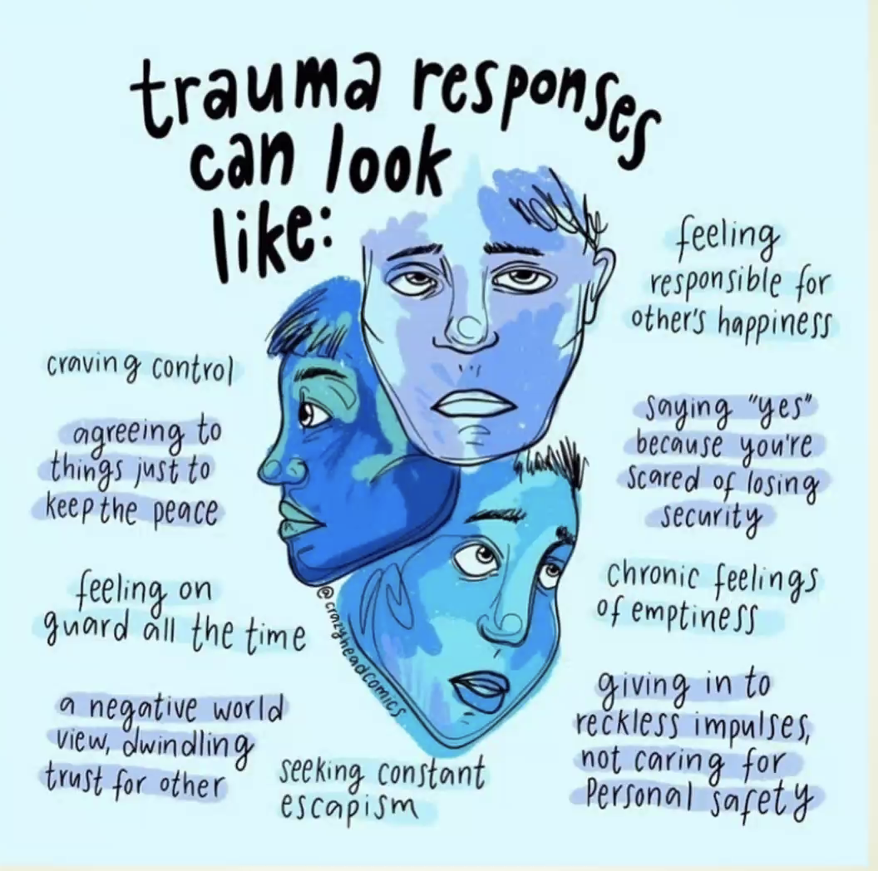
Survivors suffer cumulative traumas and require extensive support to heal
Notes:
People suffering multiple and cumulative traumas react differently to their environment than might be expected.
Trauma response are recognizable…
Trauma informed care is a mandate to be able to support the survivor in the healing process.

Slide 7
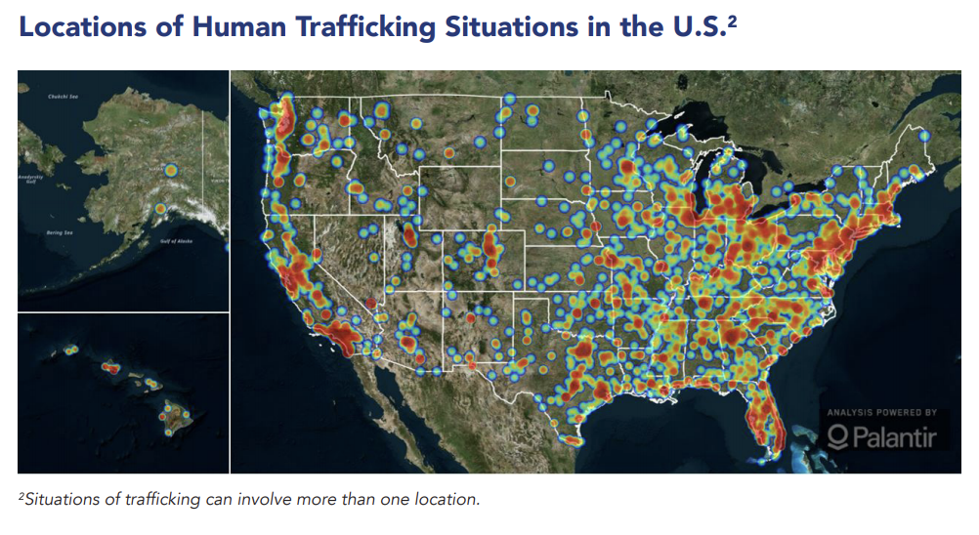
Why Colorado Needs Bakhita Mountain Home…
Colorado identified 176 cases of human trafficking in 2019 (Polaris).
This is a fraction of the reality.
Polaris 2019 Data Report, US National Trafficking Hotline
Notes:
The pandemic has driven demand for trafficked sex workers through social media and online technology.
Sources:
Familial
Bars, Clubs, Strip Clubs
Illicit Massage Parlors
Hotel/Motel Based
Residential Brothels
Escort Services

Slide 8
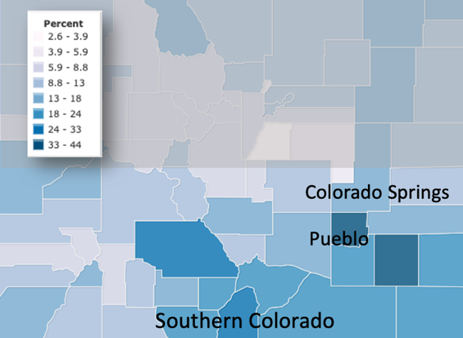
Why Southern Colorado Needs Bakhita Mountain Home…
Poverty in Southern Colorado is significantly higher than in Northern Colorado.
Poverty rates correlate to increased victimization of young people with fewer law enforcement resources, fewer social services, and less economic opportunity.
Bakhita Mountain Home will be the only program in Southern Colorado for restorative treatment of adult women survivors trafficked as sex workers.
Poverty Rate as a % of the Population
https://www.indexmundi.com/facts/united-states/quick-facts/colorado/percent-of-people-of-all-ages-in-poverty#map
Notes:
There is one existing restorative program for adult women in Denver (Esther’s House, Outdoor Ministries). 6 beds.
There is a program going into Boulder (Generate Hope). 6 beds. Open later in 2021
Mary’s Home in Colorado Springs, is a restorative home for women who are under 18 years of age
There is an aspirational program in Central Colorado (BV Hope) that is targeted to open in 2023.

Slide 9
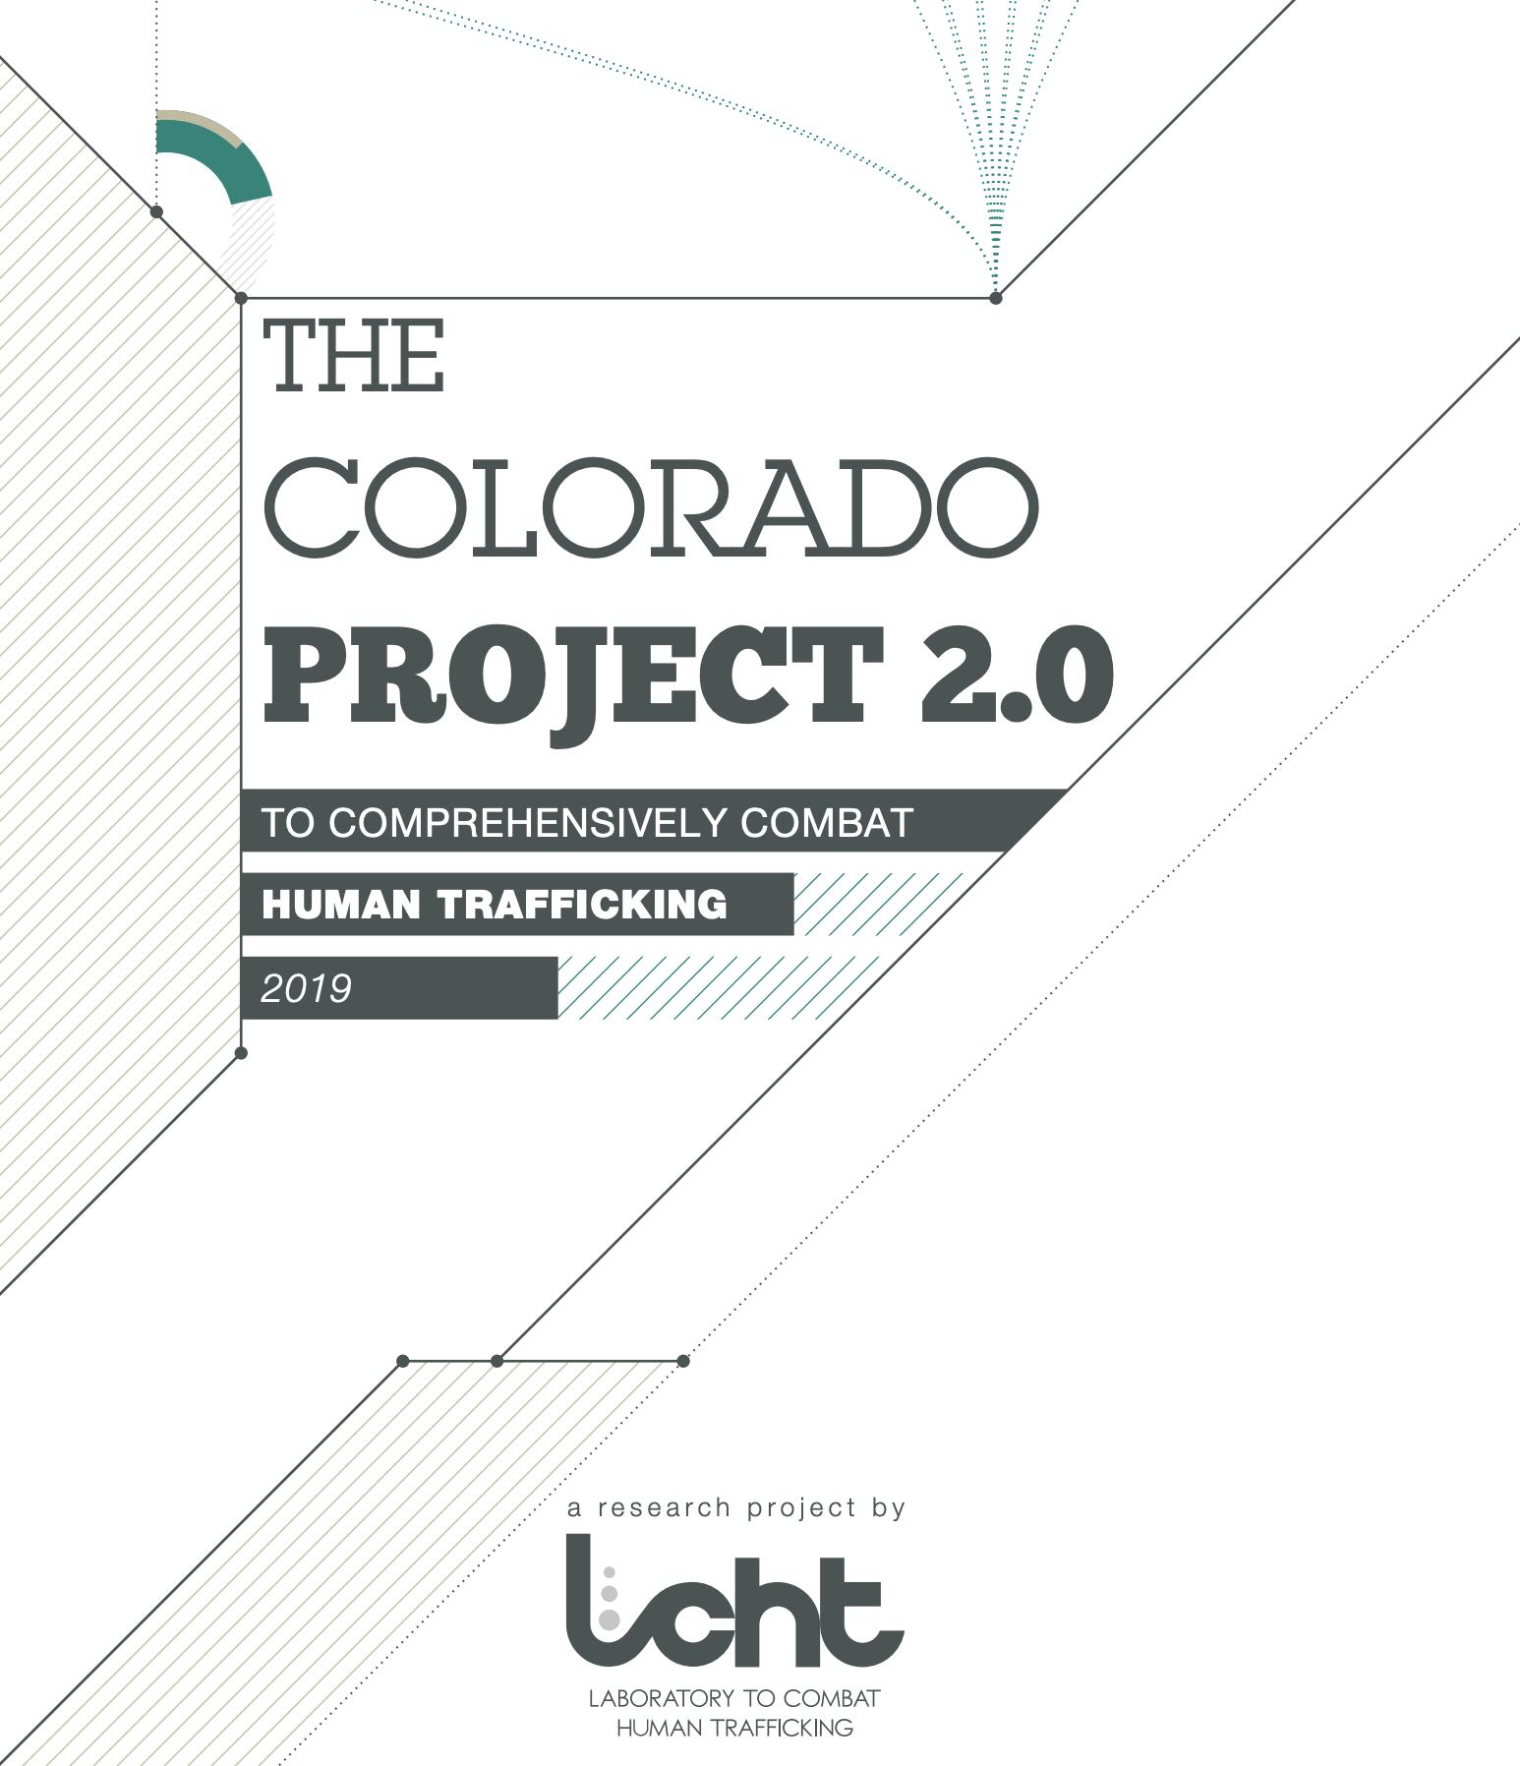
What is the Need in Colorado?
In 2019, the Laboratory to Combat Human Trafficking (LCHT) recommended building housing and restoration services in CO
Bakhita Mountain Home is one of three programs* that focus on long-term restoration services for adult survivors in Colorado.
*The other two programs are located in Boulder and Denver.
Notes:
Mission of LCHT is:
To inform social change that eliminates human exploitation.
LCHT is formerly known as Polaris Colorado
LCHT specifically recommends building capacity for restorative care.

Slide 10
Bakhita Mountain Home Provides Restoration Services for Survivors of Human Trafficking
Bakhita Mountain Home addresses “restoration” services for adult women survivors.
Our partnership with other organizations and agencies is vital in addressing the problems.
Notes:
We are focused on the greatest need from the harm caused by human trafficking – restoration services for women who have been trafficked as sex workers.
These women were often forced, coerced or defrauded into trafficking as minors. By the time they have been rescued or otherwise left the life, they have years of trauma, physical ailments and substance addiction.

Slide 11
Notes:
The home is leased from Catholic Health Initiatives, part of Centura Health and Penrose St Francis Hospital.
The home was built in 1946, and required renovations.
Renovations were completed in 2020, by a local contractor (Art Klein Construction) for a cost of $190,000.
All furniture has been donated – the house is nearly fully furnished.

Slide 12
All bed quilts and window treatments were hand made and donated.
Notes:
All bed quilts and window treatments were hand made and donated.

Slide 13
Partnering Organization Thistle Farms National Network
The Thistle Farms Network meets a universal call for healing
Survivors of trafficking, prostitution, abuse and addiction share a story that has been universal since the beginning of time.
“Thistle Farms National Network is a growing community of circles across the nation and around the world that believes that, in the end, LOVE is the most powerful force for change in the world. We want to change a culture that still allows human beings to be bought and sold. “
Notes:
We decided that we would model our home after Thistle Farms in Nashville.
This Farms has operated successfully for over 23 years.
There are almost 100 organizations (like BMH) affiliated as partners to Thistle Farms. About half are in start-up, and half are open and operating. They are the largest organization of their kind in the US, with about 500 beds total capacity across the nation. (BMH will be 5-beds).
Thistle Farms provides mentorship and guidance to BMH.

Slide 14
Why the Thistle Farms Model?
Thistle farms respects the dignity of every human being
At Thistle Farms they ask “what happened to you?” rather than “what did you do?”
It is not a halfway house. Women decide for themselves if they want to be there.
The program is a four-phase individualized process
Welcome to the Circle -- orientation
Seeking employment and education
Find your Way Home – transition to independent living
Sisters for Life – graduation to independent living
Thistle Farms does not require religious education
Thistle Farms just gave me a key to the house. It is the only place I’ve ever lived in where I didn’t have to turn a trick to have a bed”
– Survivor/Thistle Farms Sister
Notes:
We know that people who are abused are far more likely to be trafficked and we know that churches have been settings for abuse. Thistle Farms found the Rev. Becca Stevens was herself abused by the senior warden of the church where her father was a priest during her childhood.
Survivors have told us that if the house was on church property, or was overtly religious it would turn survivors away.
We also know from our conversations with the Department of Human Services and with law enforcement that they are not referring people to the homes that do exist here in Colorado that have this religious education/dogma component.
One of the reasons that we are working well with the Benedictine and Franciscan Sisters is that we share a tradition of pastoral care that intentionally doesn’t tell others how to think. We have traditions of being with and walking alongside people . Of course we hope that they will come to know and love God in a deeper way through all of that, but it is not required. \

Slide 15
Why Women Over 18?
Some programs exist for exploited and trafficked children (under 18) - Sarah’s Home in Colorado Springs is one such program
When a survivor turns 18, state and county services are typically no longer available to them
Girls who were rescued at 16 or 17 still need care when they turn 18

Slide 16
The Bakhita Mountain Home Model
Residents are women 18+
Suitable for 5 women at a time
Residents receive:
Two years of rent-free housing in a safe and pleasant community environment
Medical and Dental Care
Trauma-Informed Therapy
Work in the community and help building life skills e.g. money management, meal planning, etc.
Notes:
Providing a safe, pleasant home environment based on a community living model;
Helping residents to live honest, sober, and self-sufficient lives
Providing educational and vocational opportunities;
Fostering self-understanding through personal and spiritual growth;
Providing life-skill building and maintenance education;
Providing a mechanism for income and asset development through Individual Development Accounts and peer lending programs.

Slide 17
How Will Survivors Find Bakhita Mountain Home?
Referrals from a variety of existing sources including present survivor facilities like TESSA, Rescue America, Covered Colorado, and others
Upon referral, an individual is interviewed by members of the admissions team
The Bakhita Mountain Home staff reviews the application to determine if the woman meets the criteria for the program and if she can best be served by BMH
Notes:
Affiliations with other social service organizations including TESSA, Sarah's Home, and other programs for survivors in Colorado.

Slide 18
Bakhita Mountain Home Financial Overview
$2,500,000 (for 10 years)
Start-up costs include:
Remodeling Cost (completed) $190,000
Operating Costs for 2-Years $500,000
Start of Services
Notes:
We will have about 2-years of funding when we start. (About $250,000 per year (mostly salary and resident services, facility and related costs are < 10% of the budget).
The goal is to get to $2.5 million in funding – to allow operation for 10-years.

Slide 19
Currently at Bakhita Mountain Home…
Finalizing preparations for opening
Developing partnership agreements
Aligning our program as “survivor informed”
Developing policies and procedures for the program
Training our volunteers
Fundraising for subsequent years of operation
We are in the process of searching for the BMH Program Director – intend to hire in Fall of 2021
Our first residents at BMH will be welcomed in late 2021
BMH will seek accreditation with the National Trafficking Shelter Alliance in 2022

Slide 20
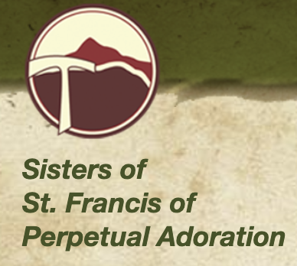
Bakhita Mountain Home Partners

Slide 21
YOU Can Help!
Join our email list for our Bakhita Highlights Newsletter
Donate
bakhitamountainhome.org
Set up recurring donations or make a one-time gift
Register our program with your online shopping services for donations (i.e. Amazon Smile, King Soopers, Safeway)
Go Fund Me (Facebook)
Volunteer!
Notes:
Our two needs: Money and Volunteers

Slide 22
Questions
Website: www.bakhitamountainhome.org
Email: info@bakhitamountainhome.org

