Slide 1
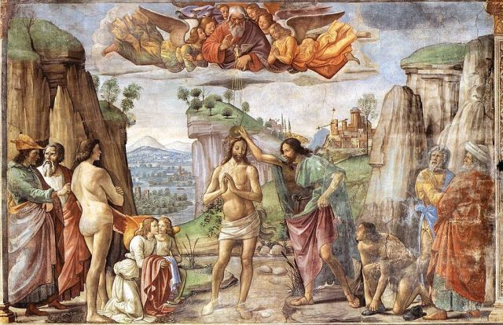
Baptism makes us new creatures, capable of sharing the life of the Blessed Trinity

Slide 2
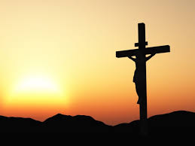
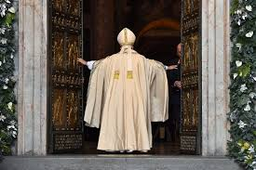
He did not require to do penance; He was without sin.
He had taken our sins upon Him to atone for them.
Therefore, He humbled himself. Placed Himself on a level with sinners.
He obediently subjected Himself to be baptized, as He had submitted to be circumcised and presented in the Temple.
A divine lesson in Humility and Obedience, that we fulfill Justice.
He sanctified water and gave it the power of purifying and sanctifying the soul of man.
We are freed from sin and reborn as sons of God.
It is the door which gives access to the other Sacraments.

Slide 3
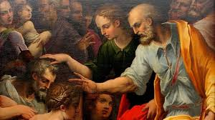
The Church handing on the grace of Pentecost

Slide 4
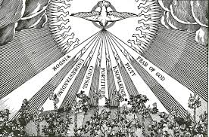
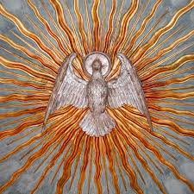
An indelible effect of the anointing of the Holy Spirit, unrepeatable as with Baptism and Holy Orders.
By clothing a Christian with the power from on high to bear witness.
Ex opere operato; by the very fact of the action performed.
An increase and deepening of baptismal grace.
Increases the Gifts of the Holy Spirit within us.
An anointing with the laying on of hands, “Accipe signaculum doni Spirtus Sancti.”
- Be sealed with the Gift of the Holy Spirit.
Then they laid hands on them and they received the Holy Spirit. Acts 8:14-17

