Slide 1
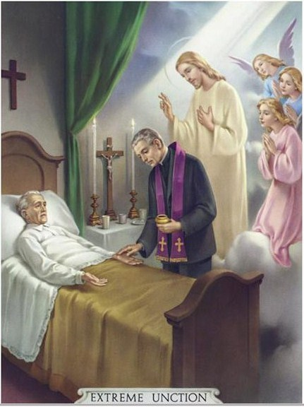
ANOINTING OF THE SICK

Slide 2
Biblical Background of the Anointing of the Sick
The sacrament took shape from the healings of Jesus and the practices of his first followers. It drew heavily from the passage from James 5:14-16:“Is anyone among you sick? He should summon the presbyters of the church, and they should pray over him and anoint (him) with oil in the name of the Lord, the prayer of faith will save the sick person, and the Lord will raise him up. If he has committed any sins, he will be forgiven.” (NAB)

Slide 3
Biblical Background of the Anointing of the Sick
The sacrament took shape from the healings of Jesus and the practices of his first followers. It drew heavily from the passage from James 5:14-16:“Is anyone among you sick? He should summon the presbyters of the church, and they should pray over him and anoint (him) with oil in the name of the Lord, the prayer of faith will save the sick person, and the Lord will raise him up. If he has committed any sins, he will be forgiven.” (NAB)
The elders had the specific role of praying over the sick and anointing them with oil, which they understood to be endowed with special power from the Holy Spirit. Believers should believe they would be saved, raised, forgiven and healed.

Slide 4
Anointing of the Sick
Used to be called "Extreme Unction"
("unction" means "anointing")
Also called “Last Rites”
Before Vatican II in the 1960’s, the emphasis of the sacrament was on preparing for death.

Slide 5
Anointing of the Sick
Used to be called "Extreme Unction"
("unction" means "anointing")
Also called “Last Rites”
Before Vatican II in the 1960’s, the emphasis of the sacrament was on preparing for death.
Vatican II restored the sacrament for physical and spiritual healing for ALL seriously ill persons, not just the dying

Slide 6
Anointing of the Sick
The anointing of the sick was then to be seen as an expression of God’s presence in the midst of human illness and Christ’s healing power and concern for all those who are seriously sick. (SC 73-75)
The anointing of the sick, by which the Church commends the faithful who are dangerously ill to the suffering and glorified Lord in order that he relieve and save them, is conferred by anointing them with oil and pronouncing the words prescribed in the liturgical books. (Cann. 998)

Slide 7
Origin of the Sacrament
Healing Ministry of Jesus
Jesus heals the sick, lame, paralyzed, blind, deaf, and the possessed
Jesus bestows healing ministry on his Apostles
“Then Jesus called the twelve together and gave them power and authority over all demons and to cure diseases, and he sent them out to proclaim the kingdom of God and to heal.” (Matthew 10)
Healing ministry passes from Apostles to the Church
"Are any among you sick? They should call for the elders of the Church and have them pray over them, anointing them with oil in the name of the Lord.” (James 5:14)

Slide 8
Who may receive the sacrament?
Individuals: Any person who is
Seriously ill (in body, mind, or spirit)
Seriously weakened by advanced age
Scheduled for serious or life-threatening surgery
A Parish Community: Parishes may hold a special Mass of Anointing for any who need the sacrament

Slide 9
Two provisions exist in the Church’s general law
The kind of desire a person must have to receive anointing
The people who are living in notorious sin

Slide 10
Two provisions exist in the Church’s general law
The kind of desire a person must have to receive anointing
This sacrament is to be administered to the sick who, when they were in possession of their faculties, at least implicitly asked for it (Canon 1006).

Slide 11
Two provisions exist in the Church’s general law
The people who are living in notorious sin
The Anointing of the Sick is not to be conferred upon those who obstinately persist in a manifestly grave sin (Canon 1007).

Slide 12
Two provisions exist in the Church’s general law
The kind of desire a person must have to receive anointing
The people who are living in notorious sin
Between these two situations lies the whole issue of having the proper dispositions to receive the graces available through anointing.

Slide 13
Two kinds of blessing which this sacrament confers
The principal blessing is for the soul
The secondary is for the body

Slide 14
Two kinds of blessing which this sacrament confers
The principal blessing is for the soul
The secondary is for the body
The guilt of mortal sin is removed, so that a sinner is restored to God’s friendship
The eternal punishment due to mortal sin is also removed
The guilt and temporal punishment of venial sins are removed

Slide 15
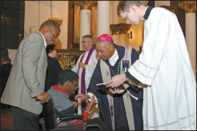
What are the essential elements of the sacrament?
Oil of the Sick
Blessed by the Bishop with the other Holy Oils
In emergency, any vegetable oil may be used
Laying on of Hands and Prayer
Minister anoints the forehead and hands of afflicted and prays over him or her

Slide 16
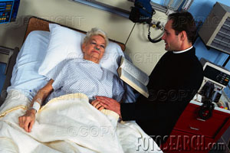
Where is the Sacrament of Anointing of the Sick administered?
Anywhere!
Hospital, private home, retirement home, etc.
Parish church during Mass of Anointing
(The other sacraments are usually performed in a church)

Slide 17
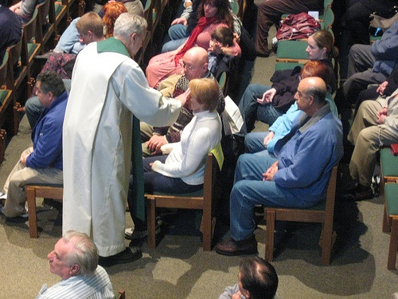
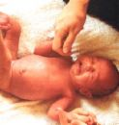
What are the effects of the Sacrament of Anointing of the Sick?
God’s healing grace
Forgiveness of venial sins
Physical cure is possible

Slide 18
Some truths about healing
Medical professionals can cure.
Healing, on the other hand…
Can be emotional and spiritual
Comes through the love and kindness of others
Comes through the holy oil of the Sacrament Of Anointing.
The priest is the one who prays, and it is God who heals, for the sacrament is not a person’s work but the work of God.

